Slide 1
Missouri Public Health Institute Updates
2026 Spring LPHA Regional Meetings

Slide 2
Who We Are
Dedicated to transforming Missouri’s public health system.
Collaborates with stakeholders and communities to create the conditions for improved health outcomes statewide.
Administrative home of the Missouri Center for Public Health Excellence (MOCPHE) membership association

Slide 3

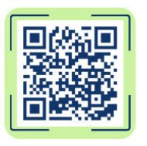
Member Meetings – Come Hang Out!
Meet Monthly – First Wednesday
  May 6th at 10 am
  June 3rd at 10 am
Breakout session discussions
Learn from others and make connections
kmcgowan@mophi.org

Slide 4
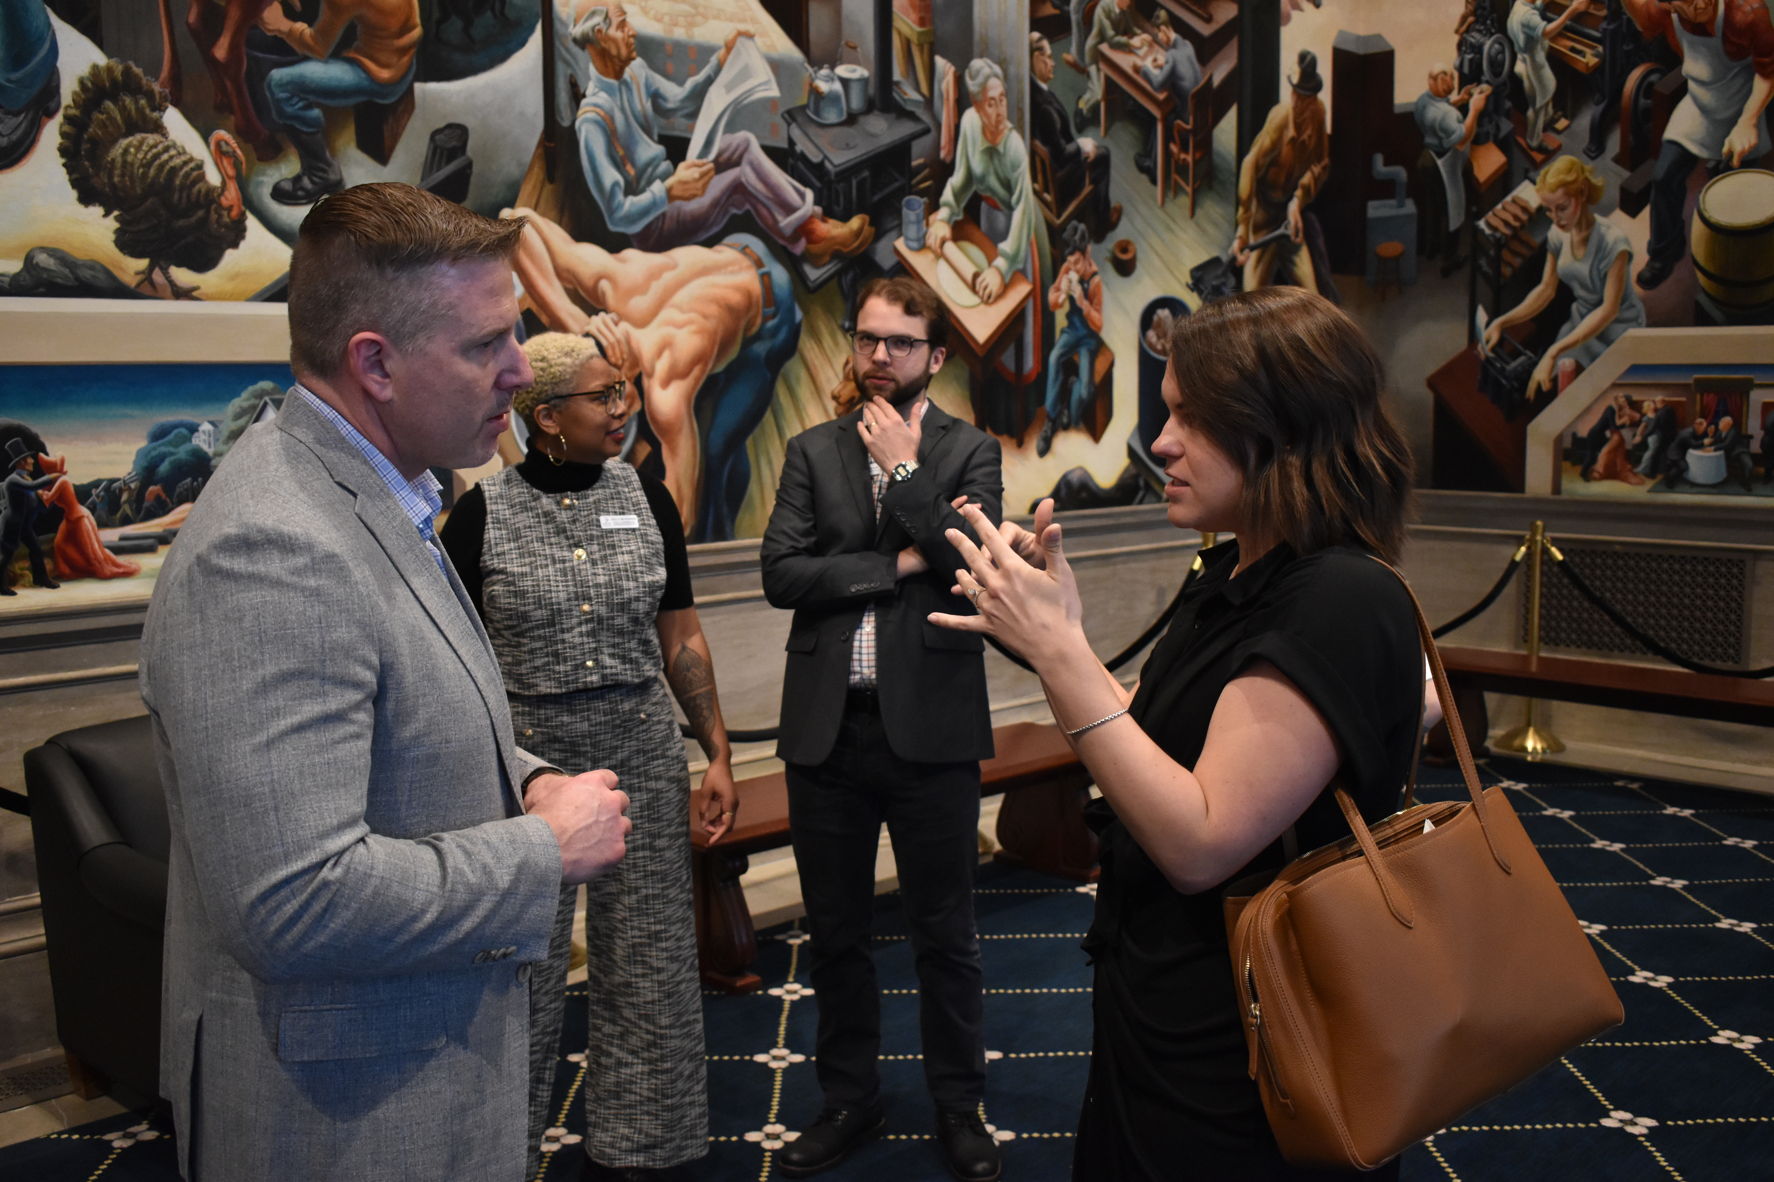
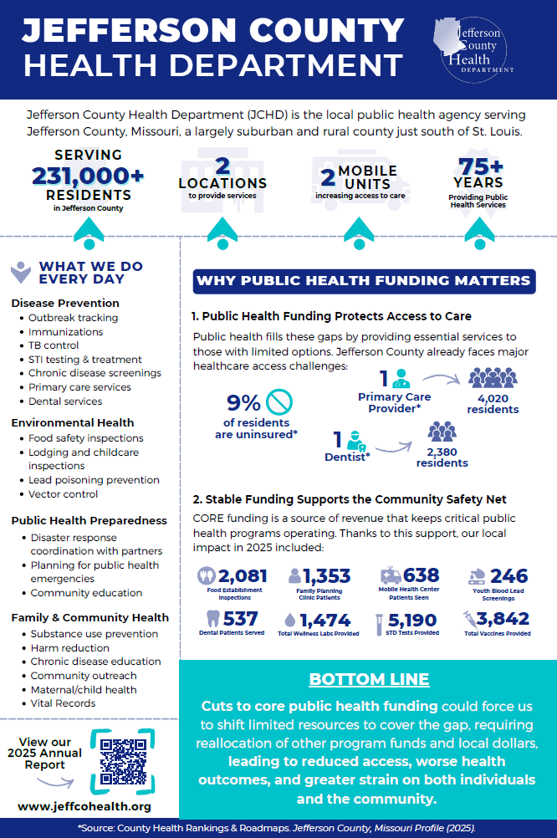
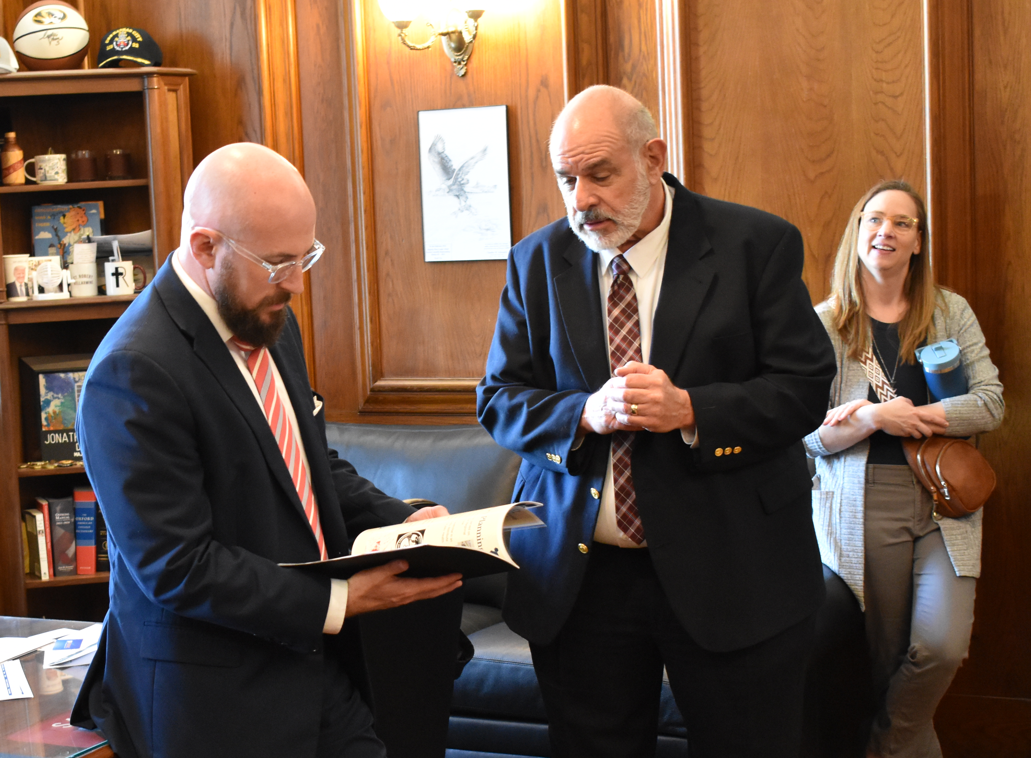
Capitol Day
"I enjoyed the whole day and so did our Team. We all felt it gave us the confidence to do more advocating in the future. It isn't as intimidating as previously thought."
Steve Sikes, Executive Director, Jefferson County Health Department

Slide 5
Grant Management & Compliance Trainings
Evaluation Due: 4/24
  Complete short survey via Microsoft Forms
  MUST be done for incentive funding.
Slides, recordings and resources: Grant Management & Compliance 2026
lhouse@mophi.org

Slide 6
Non-Accreditation Collaboratives
Data Learning Collaborative
  Third Thursday from 9 – 10 am
  abodin@mophi.org
Public Health Nursing Collaborative
  First Tuesday from 1:30 – 2:30 pm
  tanderson@mophi.org

Slide 7

Accreditation Assistance
Collaborative & Cohorts
  PHAB
  MICH
  CHA/CHIP
Upcoming Trainings & Events
  Accreditation Coordinator Retreats – this Summer
accreditation@mophi.org
Notes:
Even if you aren't currently seeking accreditation. There is probably something we have on the resource library or that we are discussing in one of our groups that may be helpful for something you are working on.
Times are on handout. Can share what happens in each. PHAB collaborative now includes information on reaccreditation as well (used to be separate cohort). Meetings will also cover new PHAB 2026 standards and measures will be implemented July 1st, 2026 . Good time to join as we are going back through each domain.
Looking to focus on PM/QI before the end of the year with a training or cohort

Slide 8
New Things at the Institute!

Slide 9

Data Action Center
Harness data for evidence-based decision making.
Build public health workforce capacity.
Elevate data use.
abodin@mophi.org

Slide 10
Lines of Service of the Data Action Center
Advocacy and Leadership to Support Policy Change
Assessment and Evaluation to Determine Impact and Advance Quality Improvement
Collaboration to Convene a Community of Practice
Education and Training to Collaborate on Practical Education
Engagement in Thought Processing with Communities and Partners
Practice-Based Research and Development to Promote Evidence-Based Practice
Reporting on the State of Public Health
abodin@mophi.org

Slide 11
Policy Collaborative
Network strengthening.
Equipping public health others with the tools.
Increase engagement and advocacy at the state and local level.
Coming this Summer!
kmcgowan@mophi.org

Slide 12
Upcoming Free Events!
Plain Talk Webinar
  Tuesday, May 26th from 12 – 1:30 pm
  Webinar exploring how to effectively engage and support Plain Anabaptist communities
  Featuring: Webster Co Health Unit & Audrain Co Health Dept
Data Training Series
  Virtual, 3-part series funded by NACCHO
  Build foundational knowledge around data collection, management, & utilization for decision-making.
  Session Dates:
    Thurs, May 21st from 11am – 12 pm
    Thurs, June 18th from 11am – 12 pm
    Thurs, July 9th from 11am – 12 pm
  More information and how to register coming soon
Accreditation Coordinator Retreats
  More information coming this Summer

Slide 13
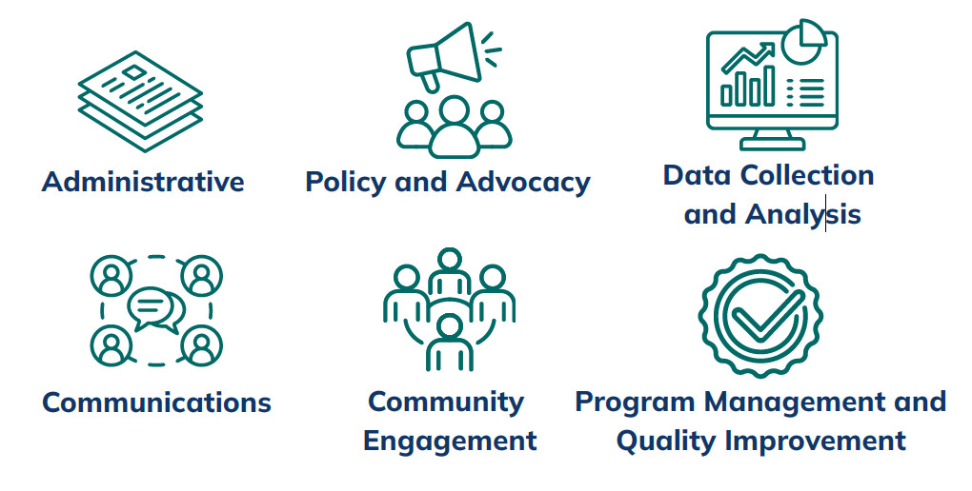
New Service! Trainings
lhouse@mophi.org

Slide 14

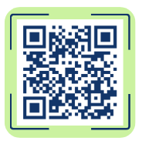
Resources
MOPHI Resource Library
  Archive from Governmental Public Health Summit
  Public Health Trust Poll
  Accreditation
  Advocacy
Public Health in Action
  New to website!
  Showcases annual reports and impact stories from LPHAs
  Send annual reports to: svotaw@mophi.org
MOPHI Newsletter
  Sign up for updates!

