Slide 1




Public Health Performance Management
A framework for accountability, transparency, and trust
Missouri Department of Health and Senior Services
July 2025

Slide 2






What is performance management?
Performance Management leads to:
Ongoing process of measuring, monitoring, and reporting of progress towards organization, division, or program goals
Incorporates 4 key elements:
Data-Driven decisions
Performance standards: What does good look like?
Performance measures: How do you know you're doing well?
Reporting of progress: What do our stakeholders need to know?
Quality improvement: How do we continue to get better?
Accountability
Transparency
Trust
Your performance management system can answer:
What you're doing
How well you're doing
Who it impacts
Why it matters

Slide 3






Why it matters
In the face of an uncertain future, we must find ways to:
If a citizen, a board member / commissioner, or funder asked, could you answer and prove:
Maximize our funding
Why you do what you do?
What you prioritize?
How you're making progress?
How well you're doing?
Who's benefitting from it?
Why and how you could use more support?
Find innovative ways to deliver services
Centralize those we serve
Key Takeaway:
Performance management is vital to illustrate what you do,
prove its importance, and quantify your impact on those you serve

Slide 4



Performance Management leads to Quality Improvement
Measuring progress provides insight into areas of improvement. Where are we lagging behind?
We have resources to tackle QI projects!
The DHSS QI plan outlines:
How to identify potential projects
How to conduct QI projects
Toolkit of QI methods for any type of problem
DHSS' Office of Performance Management is available to discuss QI approaches in your agency

Slide 5
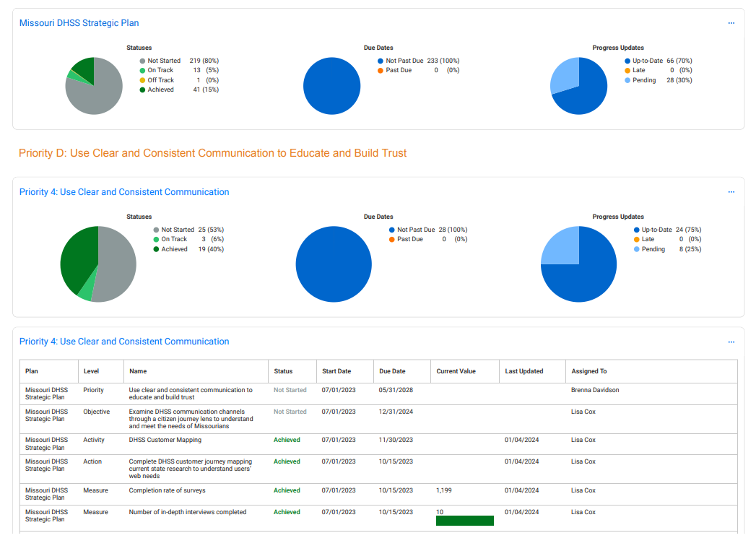
How do you measure progress?
You don't need a fancy system!
You can track and report progress through:
Excel: implementation plans to collect metrics, graphing as reporting
Low cost solutions:
  Microsoft 365 suite
  Smartsheet
Shared software: jurisdictions can combine funding to share a system
DHSS uses the AchieveIt software as our performance management system
DHSS can offer resources through PHIG support for performance management systems

Slide 6

Building meaningful metrics
Make your metrics matter:
Does this save money, time, or resources?
Are Missourians better off?
Are you showing that your operations are efficient?
The best metrics are:
Tied to outcomes for those we serve
Include the voice of those we serve
Illustrate your impact
Reflect timely data sources
Incorporated into SMART goals

Slide 7


Let's Practice!
Helpful Resources
Work with your table to talk through:
Your agency's "why"
Core activities that contribute to your "why"
High level priorities
How you can achieve those priorities
NACCHO Guides
Public Health Foundation: Performance Management Toolkit
CDC Improvement Journey
ASTHO Resources
DHSS QI Plan and Toolkit
Then turn all that goodness into a SMART goal!
Thank you
for all you do!
Don't hesitate to reach out!
Brenna.Davidson@health.mo.gov

