Slide 1
HAI/AR Program:
The Basics and Beyond

Slide 2
Objectives
Review HAI/AR Program background and topics of focus
1
Understand HAI/AR Program core functions
2
Observe HAI/AR Program reported case volume and distribution
3
Review Infection Prevention & Antimicrobial Stewardship Efforts
4
Discuss HAI/AR opportunities for LPHAs
5

Slide 3
HAI/AR Program Background

Slide 4
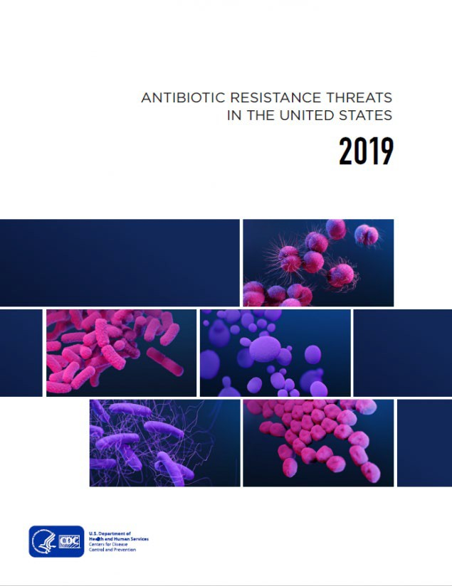
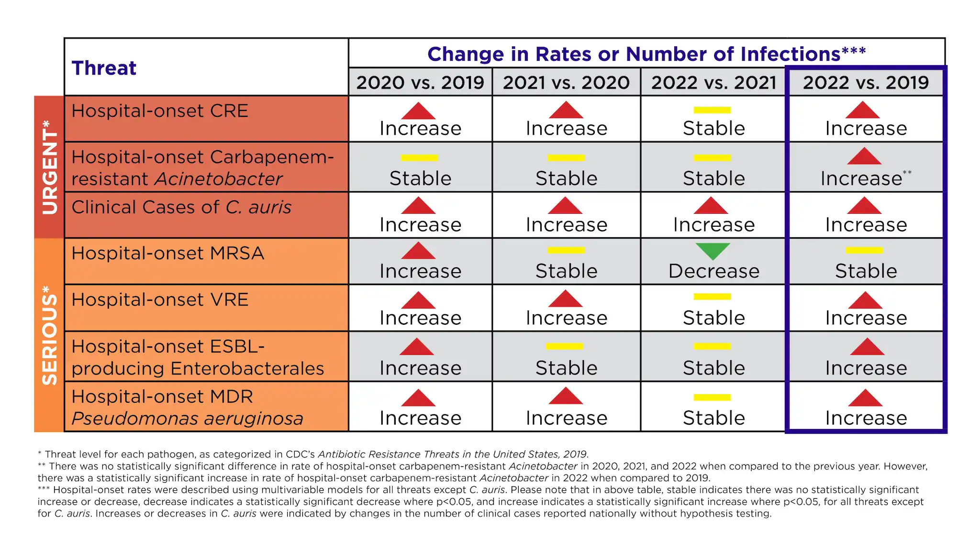
1
HAI/AR Program Background
01
More than 2.8 million antimicrobial-resistant infection occur in the U.S. each year
02
This results in approximately 35,000 deaths each year
03
MDRO infections cost the US a minimum of $4.6 billion annually to treat and control
04
Since 2019, MDRO cases have increased by 20% and Candida auris cases have increased 5-fold
Sources:
CDC 2019 AR Threat Report
CDC 2021-2022 AR Threat Report

Slide 5
1
HAI/AR Program Background
Causes for antimicrobial resistance can include:
01
Random genetic mutations during bacterial lifecycle and reproduction
02
Inappropriate antimicrobial use in:
- Humans
Long-term care: 40-75%
Acute care: 30-50%
Outpatient: 30%
- Animals (livestock and companion)
- Environmental (crops and water treatment)

Slide 6
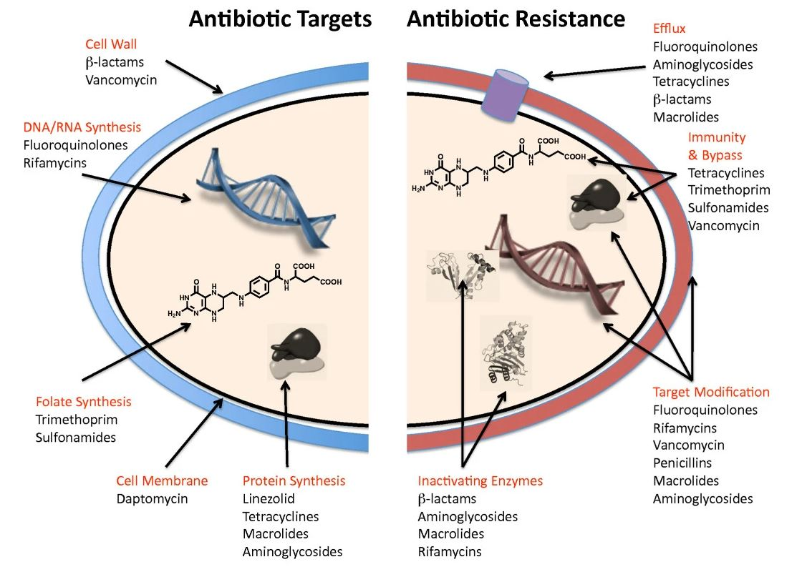
1
HAI/AR Program Background
How do bacteria fight back?
How do antibiotics work?

Slide 7
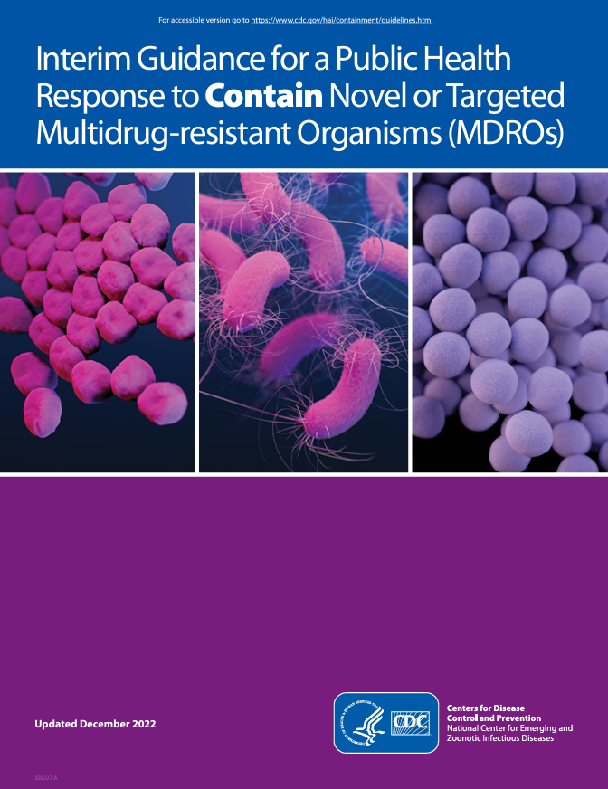
1
HAI/AR Program Background
Carbapenem-Resistant Organisms (CROs):
01
Carbapenems are one of the broadest spectrum classes of antibiotics
02
Resistance to carbapenems cause increases in morbidity and mortality
03
Resistance to carbapenems limits treatment options, resulting in patients receiving:
- Less effective treatment
- More toxic side-effects
- Increased costs of care
Source:
CDC Interim Response Guidance for MDROs

Slide 8
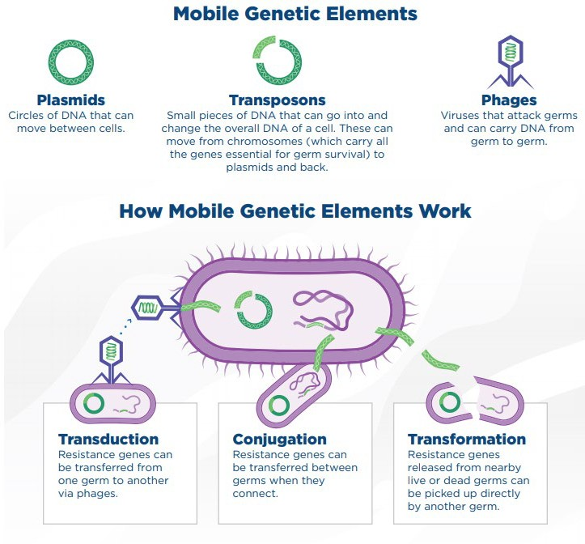
1
HAI/AR Program Background
Carbapenemase-Producing Organisms (CPOs):
01
Resistance to carbapenems may happen more than one way
02
Resistance caused by a carbapenemase (enzyme) tends to be the most concerning
03
Carbapenemases can often be found on mobile genetic elements of DNA
04
Resistance on MGE increase the potential to spread resistance, even to different species

Slide 9
1
HAI/AR Program Background
Carbapenemase-Producing Organisms (CPOs):
01
Common types of carbapenemases include:
KPC – Klebsiella pneumoniae Carbapenemase
OXA – Oxacillinase-type β-Lactamase
NDM – New Delhi Metallo-β-Lactamase
VIM – Verona Integron-encoded Metallo-β-Lactamase
IMP – Imipenemase Metallo-β-Lactamase
02
These carbapenemase genes are commonly found in:
- Enterobacterales (E. coli, Klebsiella species, etc.)
- Pseudomonas aeruginosa
- Acinetobacter baumannii

Slide 10
1
HAI/AR Program Background
01
Risk factors for CRE include:
- Indwelling medical devices (urinary and/or IV catheters)
- Prolonged antibiotic courses and exposure
- Extensive healthcare exposure
- Previous surgery in the past 6 months
Source:
CDC 2019 AR Threat Report
CDC CRE Information for Facilities Handout

Slide 11
1
HAI/AR Program Background
01
Risk factors for CRAB include:
- Extensive healthcare exposure
- Severe of chronic open wounds
- Recent history of antibiotic exposure in the past 90 days
- Same environmental exposure as a known CRAB case
Source:
CDC 2019 AR Threat Report
CDC CRAB Information for Facilities Handout

Slide 12
1
HAI/AR Program Background
01
Risk factors for C. auris include:
- History of CRE infection and/or colonization
- Prolonged healthcare exposure
Especially in LTACHs and vSNF
- Indwelling medical devices (urinary and/or IV catheters)
Source:
CDC 2019 AR Threat Report
CDC Clinical Overview of Candida auris

Slide 13
1
HAI/AR Program Background
01
Risk factors for CRPA include:
- Extensive healthcare exposure
- Severe or chronic open wounds
- Same environmental exposure as a known CRPA case
- Recent history of antibiotic exposure in the past 90 days
Source:
CDC 2019 AR Threat Report
CDC CRPA Information for Facilities Handout

Slide 14
HAI/AR Program Core Functions

Slide 15
1
HAI/AR Program Background
01
The HAI/AR Program is currently 100% funded through federal grants from CDC
- ELC Core Project H
- SHARP (ends 07/2026)
- SHARP 2 (ends 07/2027)
02
Program duties are inclusive of 3 major areas of focus:
- Epidemiology
- Infection Prevention and Control
- Antimicrobial Stewardship

Slide 16
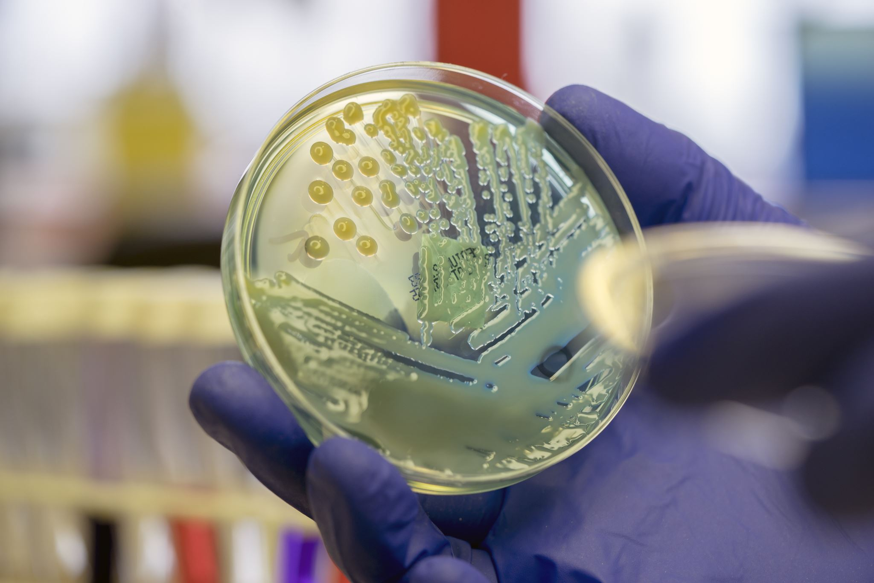
1
HAI/AR Program Background
Epidemiology
Infection Prevention
Antimicrobial Stewardship
Review MDRO reports for response and/or outreach needs
Track MDRO-related healthcare facility transfers for containment and education efforts
Coordinate with MSPHL and ARLN partner (MNPHL) are testing/screening needs
Assess and address gaps in IPC practices for all healthcare settings
Use data-driven prevention strategies to promote and improve IPC practices across the state
Coordinate IP education for healthcare facilities and collaborative healthcare organizations
Facilitate improvements in AS practices for all healthcare settings
Track and report on antibiotic utilization across the spectrum of healthcare within the state
Coordinate AS education for healthcare facilities and collaborative healthcare organizations

Slide 17
1
HAI/AR Program Background
Is surveillance required for HAI/AR conditions?
01
CROs, especially CPOs, and C auris are some conditions are to be monitored as requirements from federal grants
02
Missouri state mandates also exist related to reporting these organism types
 | MO 19 CSR 20-20.020 Novel and/emerging diseases should be reported immediately upon identification |  | MO 19 CSR 20-20.020 Any suspected outbreak, including HAIs, should be reported within 24hrs of identification |  | MO SB 579 Aggregate CRE cases from healthcare facilities should be reported quarterly
Source:
MO List of Reportable Diseases and Conditions

Slide 18
HAI/AR Program Case Monitoring

Slide 19
3
HAI/AR Program Case Monitoring
01
Historically, HAI/AR case jurisdiction was assigned by jurisdiction of healthcare facility since this is how investigations/responses occur. CDC recently shifted this for CPOs, assigning case jurisdiction based on patient residence. C. auris case jurisdiction is based on healthcare facility jurisdiction.
02
In 2025, the HAI/AR Program began efforts to capture both CPO cases by patient residence and CPO investigations by healthcare facility jurisdiction. However, CPO case data from prior years does include non-Missouri residents if the report was identified from Missouri healthcare facilities.
03
CPO and C. auris conditions will be included in later ShowMe WorldCare implementation

Slide 20
3
HAI/AR Program Case Monitoring
*FY25 data only includes data collected through 12/31/24
Notes:
Preliminary Q1 data as of 3/27 is a total of 205, meaning in three quarters we have done as many investigations as all of FY24.

Slide 21
3
HAI/AR Program Case Monitoring

Slide 22
3
HAI/AR Program Case Monitoring
* 1 clinical case was reported for Q4-2020, but from a patient with an out-of-state residence

Slide 23
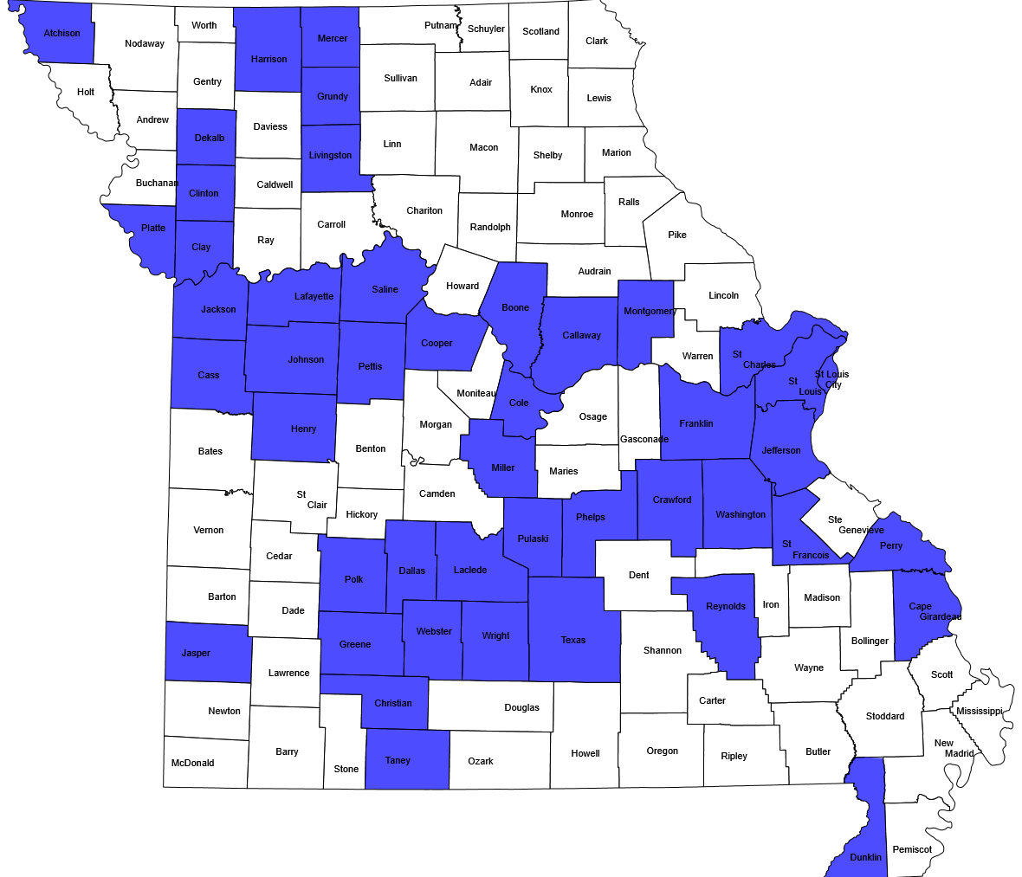
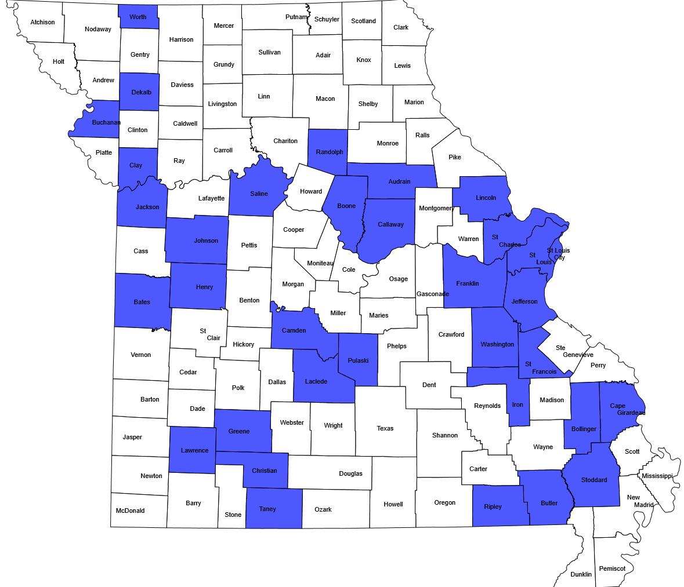
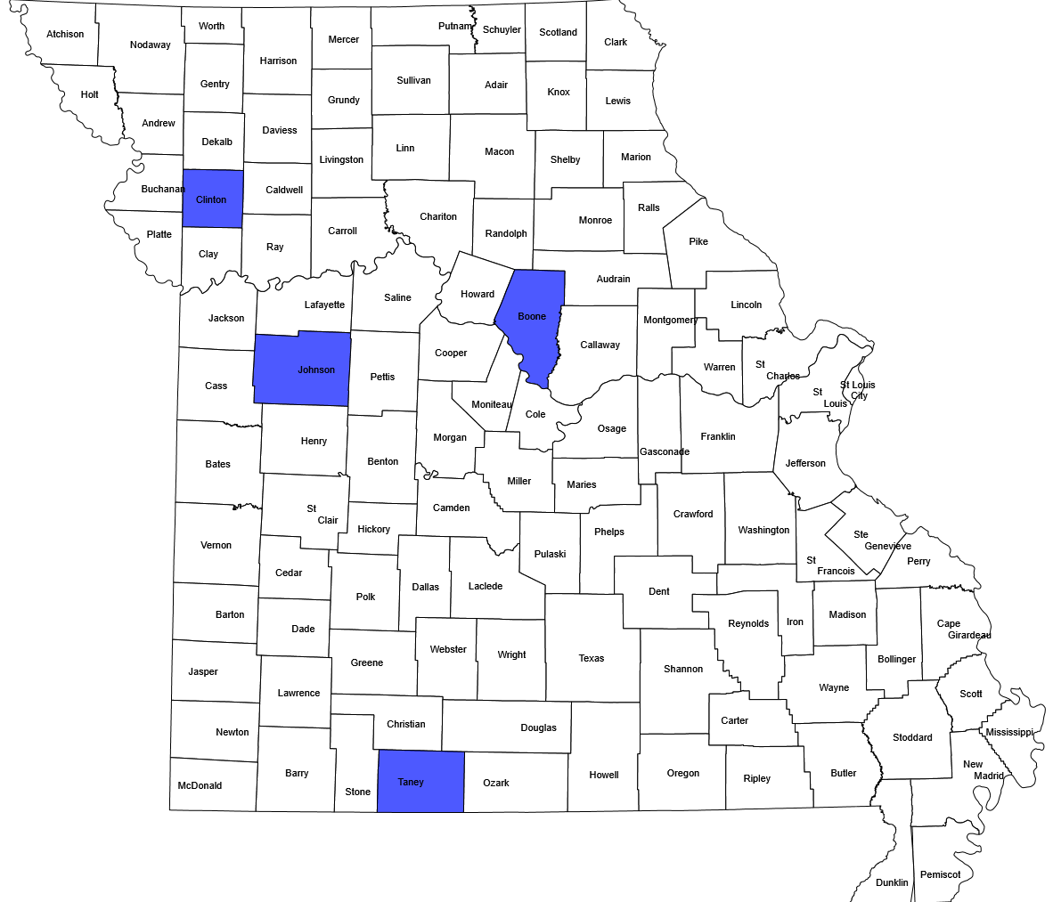
3
HAI/AR Program Case Monitoring
Distribution of Reported CPOs by County
Patient Residence by County – CP-CRAB
Patient Residence by County – CP-CRE
Patient Residence by County – CP-PA

Slide 24
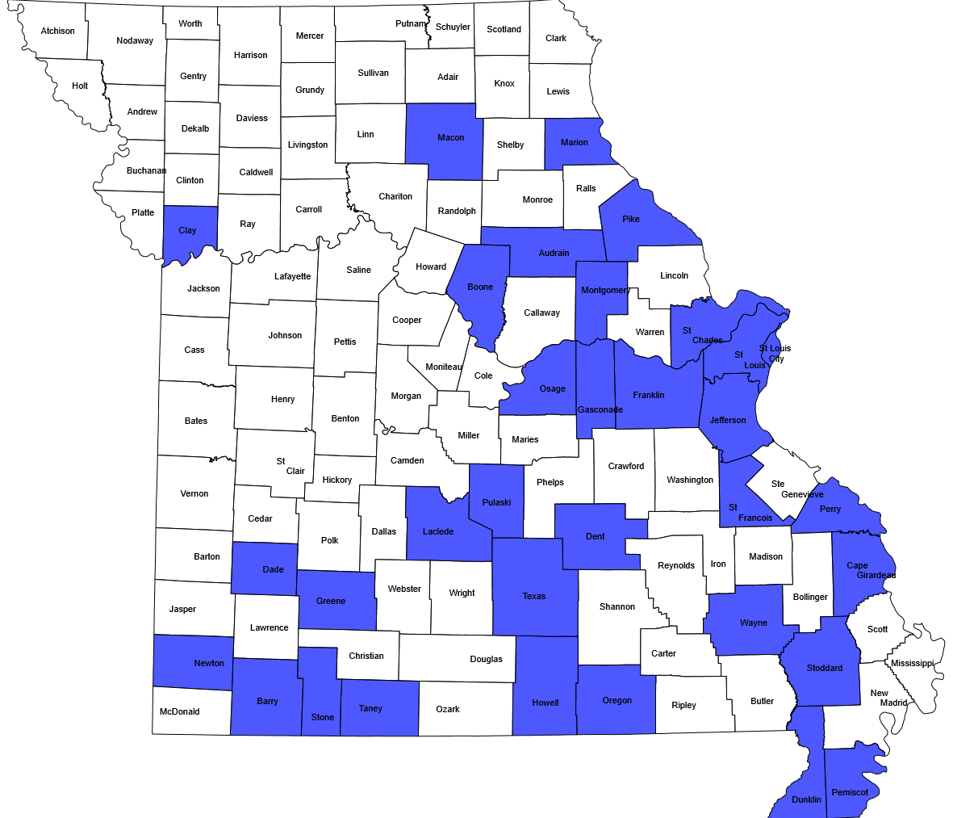
3
HAI/AR Program Case Monitoring
Distribution of Reported Candida auris by County
Patient Residence by County – Candida auris

Slide 25
HAI/AR Program IP and AS Efforts

Slide 26
4
HAI/AR Program IP & AS Efforts
01
In addition to HAI and MDRO epidemiology, the HAI/AR Program has subject matter expertise available for:
- Infection Prevention and Control
- Antimicrobial Stewardship
02
The HAI/AR Program Infection Preventionist can help:
- Discuss appropriate personal protective equipment (PPE) use
- Conduct Infection Control Assessment and Response (ICAR) visits
- Coordinate infection prevention and control education
- Assist with HAI reporting requirements
03
The HAI/AR Program Antimicrobial Stewardship Pharmacist can help:
- Conduct antimicrobial stewardship assessments
- Coordinate antimicrobial stewardship education
- Assist with antimicrobial stewardship reporting requirements
- Discuss implementation strategies for antimicrobial stewardship

Slide 27
HAI/AR for LPHAs

Slide 28
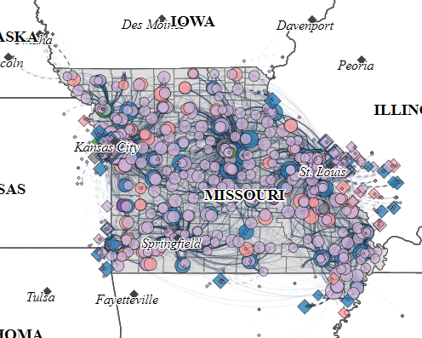
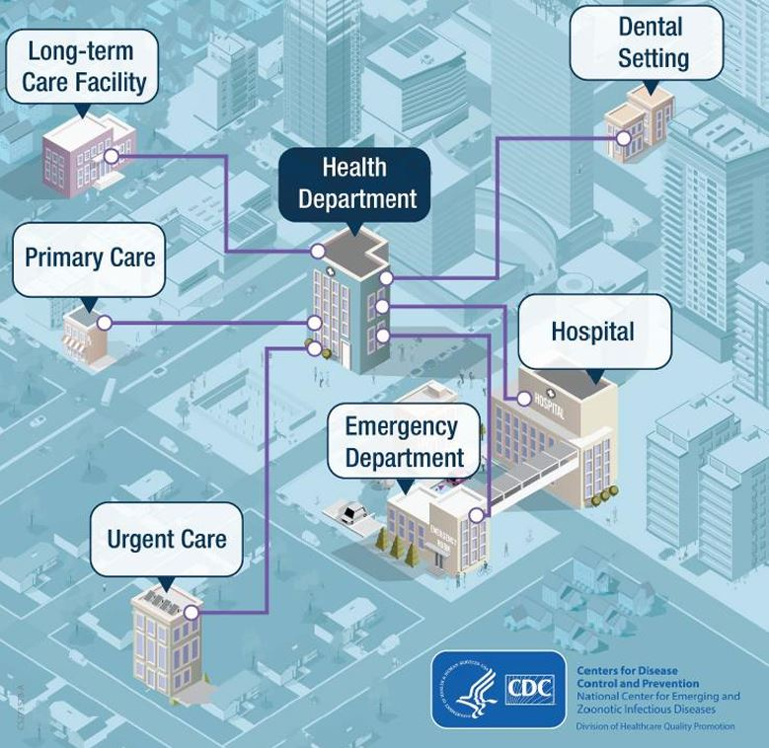
5
HAI/AR for LPHAs
Why should LPHAs care about HAIs and/or AR?
01
We are all connected, even across jurisdictional lines

Slide 29
5
HAI/AR for LPHAs
How can LPHAs help address HAIs and AR in Missouri?
01
Help alert the HAI/AR Program if you receive reports of MDRO cases and/or outbreaks in your jurisdiction
02
Assist with HAI/AR Program jurisdictional outbreak response efforts
03
Aid in conducting preventative ICAR visits with jurisdictional healthcare facilities

Slide 30
5
HAI/AR for LPHAs
HAI/AR Program CPO/Candida auris Investigation Process
*
†
*
Notification of positive test result
Reportable conditions sent to state for data collection and response
Epi Review Records
Investigation team identifies if case is repeat, known positive, or new condition
1° Outreach to Collection Facility
Contact current facility for case investigation, education, and PPS/ ICAR.
2° Outreach to Facility/ Programs
Contact historical and pending discharge facilities; contact OOS partners
ICAR and Screening
ICAR or organism screening are conducted; Screening continued as needed
Reporting & Data
Case findings and response reported to CDC; Data aggregated for Annual Governor Report
*ICAR and PPS offered to all contacted Missouri facilities for prevention and response-based actions
†In cases of outbreaks or unusual circumstances, we can also utilize WGS through the ARLN

Slide 31
5
HAI/AR for LPHAs
HAI/AR Program CPO/Candida auris Investigation Process
01
The HAI/AR Program utilizes CDC established case definitions for CPOs
02
CPO case definition is based on established laboratory criteria
Positive phenotypic test result demonstrating carbapenemase production
OR
Positive molecular test result detecting a carbapenemase gene (w/wo organism identification)
OR
Detection of carbapenemase gene by next generation sequencing
Example carbapenemase genes: bla-KPC, bla-OXA, bla-NDM, bla-VIM, bla-IMP

Slide 32
5
HAI/AR for LPHAs
HAI/AR Program CPO/Candida auris Investigation Process
01
Phenotypic tests can include, but are not limited to:
- Metallo-β-Lactamase Test
- Modified Hodge Test
- Carba-NP
- Carbapenem Inactivation Method (CIM)
including modified CIM (mCIM) and EDTA-modified CIM (eCIM)
- Immunochromatography Tests
02
Molecular tests can include, but are not limited to:
- Cepheid Xpert Carba-R
- BioFire multiplex PCR panels
- Verigene Assays
- validated laboratory-developed NAAT

Slide 33
5
HAI/AR for LPHAs
HAI/AR Program CPO/Candida auris Investigation Process
01
The HAI/AR Program utilizes CDC established case definitions for Candida auris
02
Candida auris case definition is also based on established laboratory criteria
Detection of Candida auris (culture or validated culture-independent test) from:
Swab obtained for the purpose of colonization screening
OR
Clinical specimen collected during the normal course of care for diagnosis/treatment

Slide 34
5
HAI/AR for LPHAs
HAI/AR Program CPO/Candida auris Investigation Process
01
Helpful resources regarding identifying/classifying CPOs and Candida auris cases are available below.
2023 CDC Case Definition - Carbapenemase-Producing Organism
2022 CSTE Position Statement 22-ID-04: Carbapenemase-Producing Organisms
2023 CDC Case Definition - Candida auris
2022 CSTE Position Statement 22-ID-05: Candida auris

Slide 35
5
HAI/AR for LPHAs
HAI/AR Program ICAR Process
01
The ICAR process is a collaborative, consultative process with a healthcare facility’s infection prevention program to discuss facility infection prevention and control practices and to assist with identifying potential opportunities for improvement to help align facility practices with nationally-recognized, evidence-based guidance.
02
Ready-made ICAR tools are available from CDC and include a variety of healthcare settings:
- Acute Care
- Long-Term Care
- Ambulatory/Outpatient Care
- Outpatient Dialysis

Slide 36
5
HAI/AR for LPHAs
HAI/AR Program ICAR Process
01
The ICAR tool consists of 12 different modules:
1) Demographics (by setting)
2) Training, Audits, & Feedback
3) Hand Hygiene*
4) Transmission-Based Precautions*
5) Environmental Services*
6) High-Level Disinfection and Sterilization*
7) Injection Safety*
8) Point-of-Care Blood Testing*
9) Wound Care*
10) Healthcare Laundry*
11) Antimicrobial Stewardship
12) Water Exposure*
*
Modules also include direct observation opportunities/activities

Slide 37
5
HAI/AR for LPHAs
HAI/AR Program ICAR Process
01
ICAR modules are extensive, so limiting the ICAR process to the top 4-5 preferred modules is beneficial
02
As a result of the ICAR visit, the participating facility receives a detailed summary letter recapping the visit, listing any identified opportunities for improvement, and providing recommendations to address any identified opportunities
03
Over time, commonly identified opportunities can be used to create tailored infection prevention and control education for healthcare facilities

Slide 38
HAI/AR Recap

Slide 39
5
HAI/AR for LPHAs
HAI/AR Program Recap
Program Background
Emerging Threats
Technical Assistance
Core Priority Areas:
Epidemiology
Infection Prevention
Antimicrobial Stewardship
Targeted MDROs:
Antimicrobial Resistance
Carbapenemase Producers
Candida auris
HAI Team Offers:
Outbreak & Case Response
ICAR & Prevention Screening
Antimicrobial Stewardship
Program Goals:
Prevent emergence and control spread of threats
Advance detection, response and containment of HAI/AR
Promote Antibiotic Stewardship
Protect patients and HCP
Reportable Threats:
HAIs are significant cause of illness and death and have serious emotional, financial, and medical consequences.
Most recent data reports increases in targeted–MDRO focus areas.
Resources Available:
With federal funding and lab partners, we offer Missouri healthcare facilities technical assistance through our core priority areas to meet program goals and better serve our communities.

Slide 40
Interested in learning more about HAIs, MDRO, CPOs/Candida auris, and/or the ICAR process?
Reach out to the HAI/AR Program!
573-751-6113
HAI_Reporting@health.mo.gov

