Slide 1

6+++++
An Invitation to Mathematical Modelling
John Fieno PhD
Health Economist, DHSS
6 August 2026

Slide 2


Slide 3
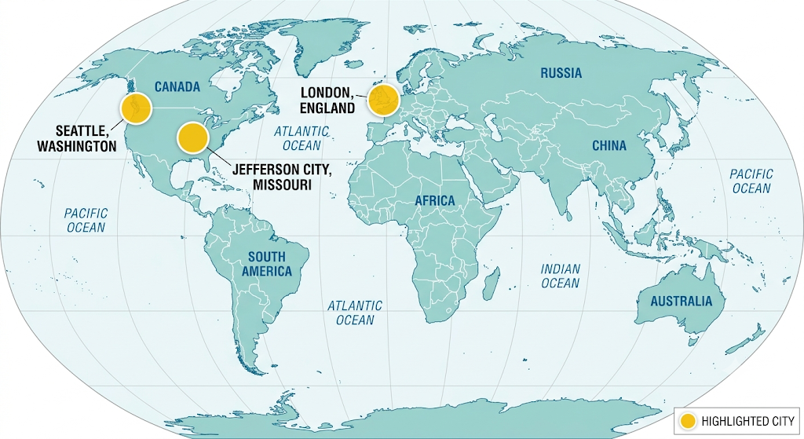

Slide 4
Today’s Agenda
Introducing Your Instructor
Introducing Mathematical Modelling (MM)
Markov Chains
Every Picture Tells a Story, Don’t It?*
Translating a Picture into an Excel File

Slide 5
How this lesson will proceed
  Math is our friend… this is FUN
  My introduction
  Open an Excel file on the other screen or window
  I will take questions during the session; please use the chat to ask them
  We are all colleagues—first name basis please

Slide 6

Your Instructor …
John Fieno PhD
Health Economist, MO-DHSS
Certificate in Modeling, Imperial College-London
Designed Models of Note
  HIV
  HAI-MDROs
  GLP-1

Slide 7
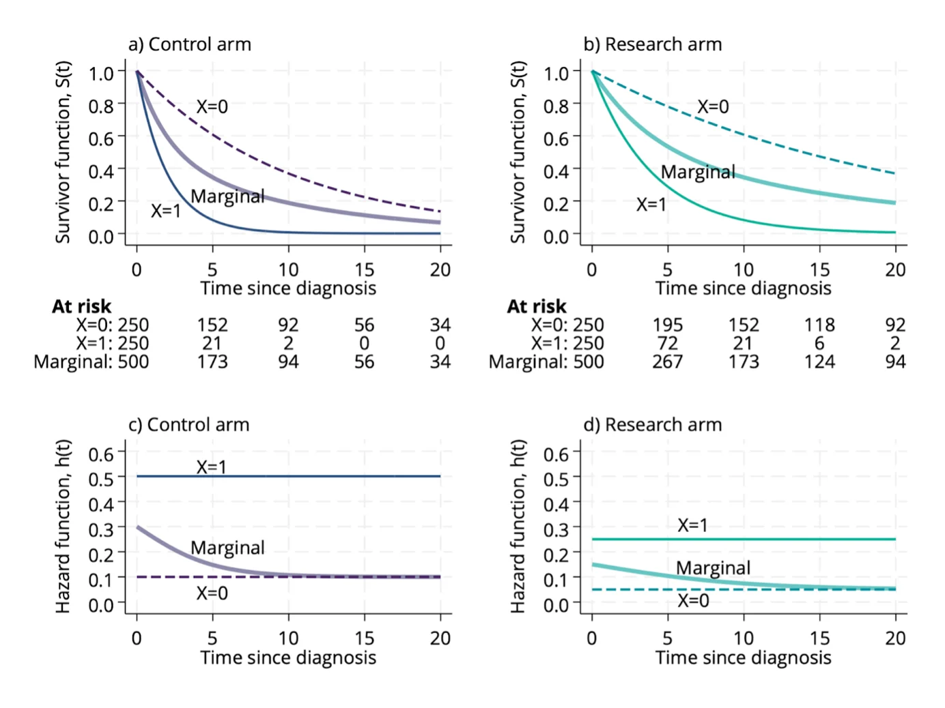
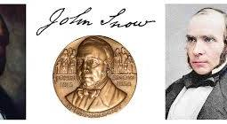
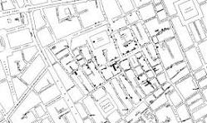
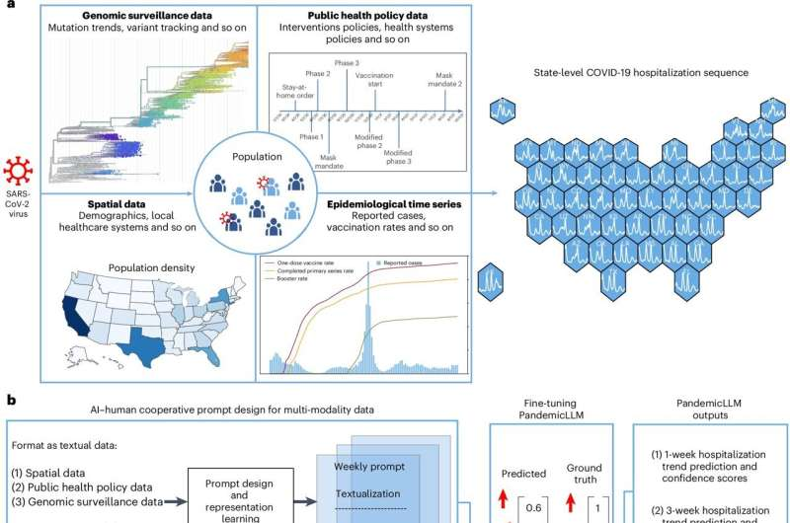
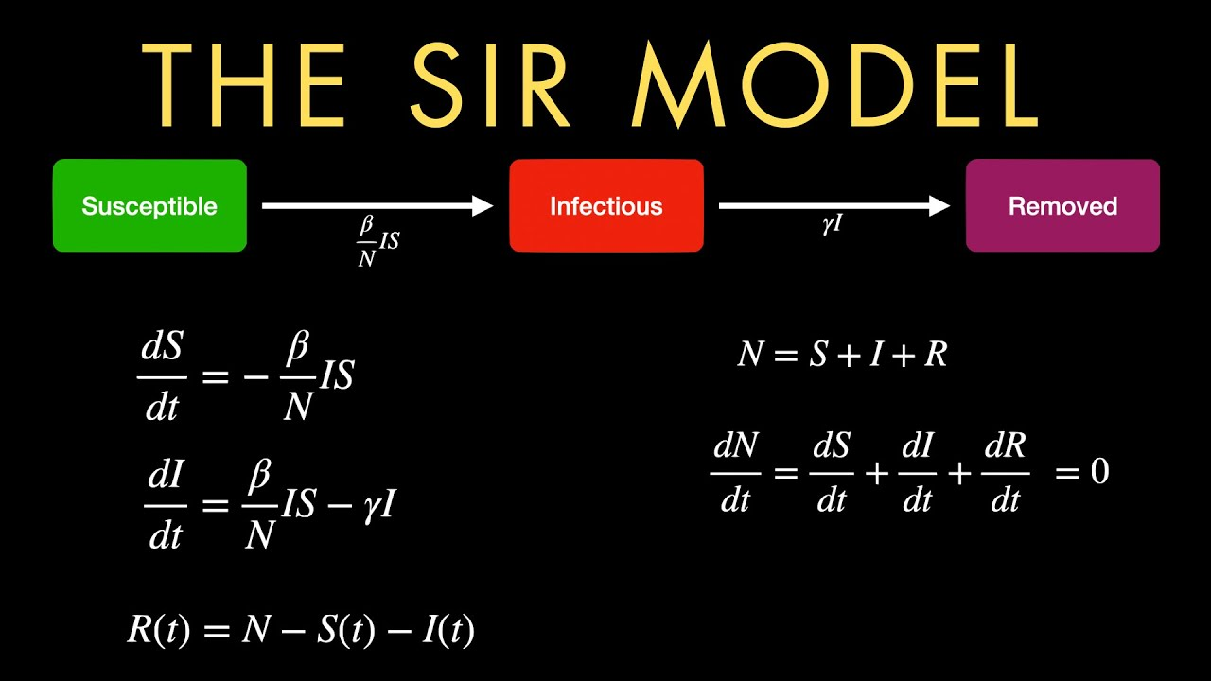
2.0
Eras of Epidemiology
1.0
3.0
4.0

Slide 8


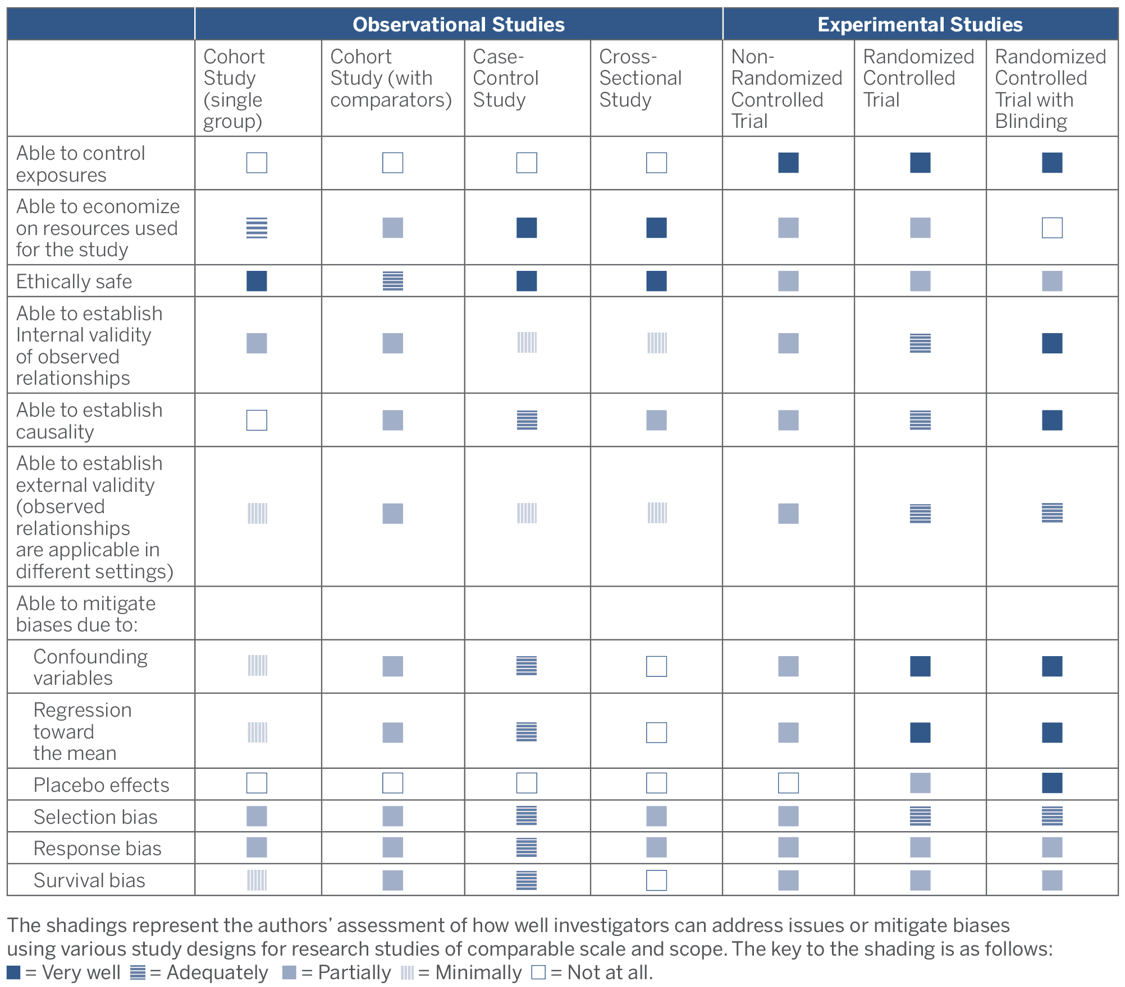
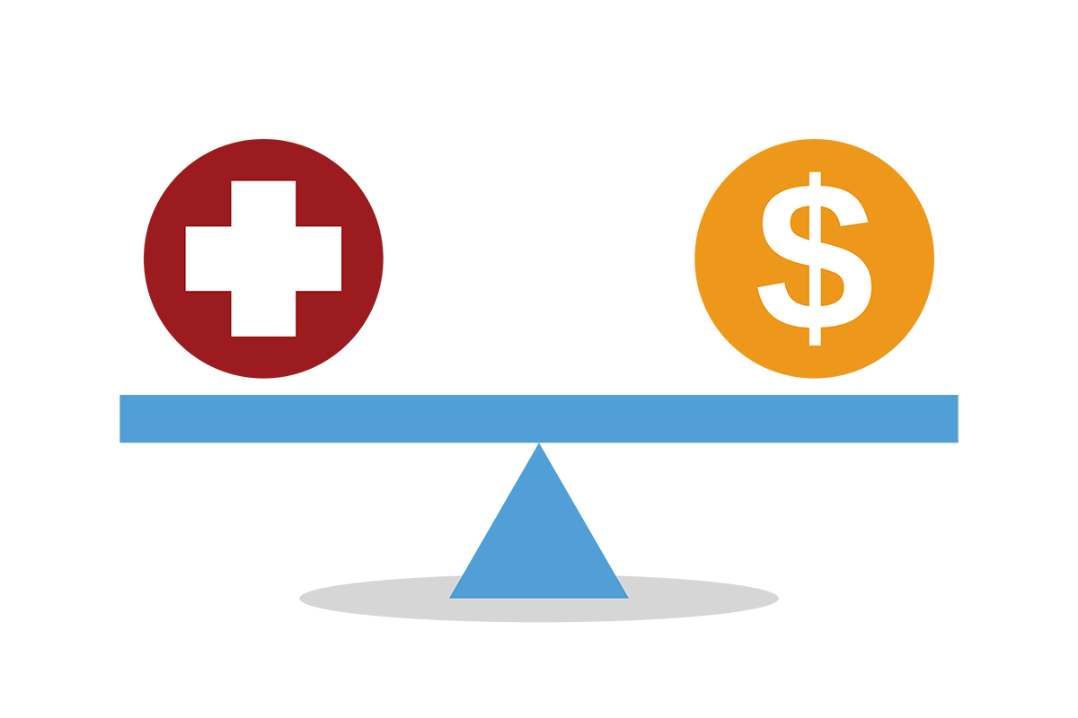
Why do we perform MM?

Slide 9
Why do we perform MM?
  Predict the prevalence of a disease over time
  Project the effect of various interventions and to better inform planning
  Use for purposes of economic evaluation
    Cost-Effectiveness Analysis (CEA)
    Budget Impact Analysis
    Costing Analysis
  Substitute for a randomized control trial (RCT) that might be too expensive or impractical to conduct

Slide 10
Examples of MM
  Designed for Infectious Diseases
    HIV/AIDS, TB, Malaria, Neglected Tropical Diseases, COVID, MDROs, Influenza, Alpha-Gal(?)
  Increasingly Used with Chronic Diseases
    Diabetes, Cardiovascular Disease, Substance Use Disorder
  Extraordinary Life Events (?)
    Overdoses, Suicide, Gun Violence

Slide 11

Core Elements of MM
States or Conditions
Transitional Probabilities

Slide 12
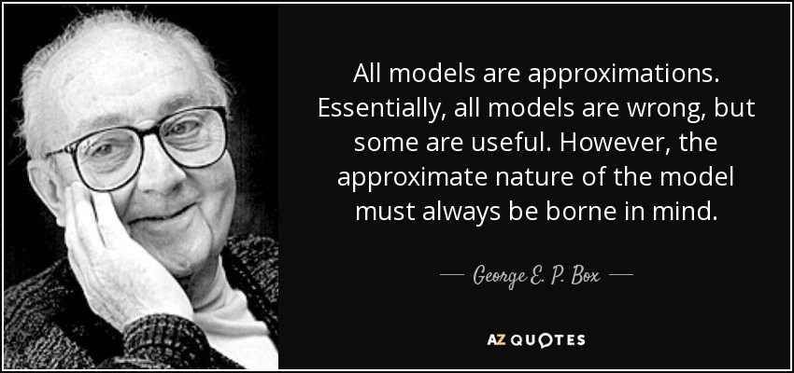
Why Mathematical Modelling?

Slide 13
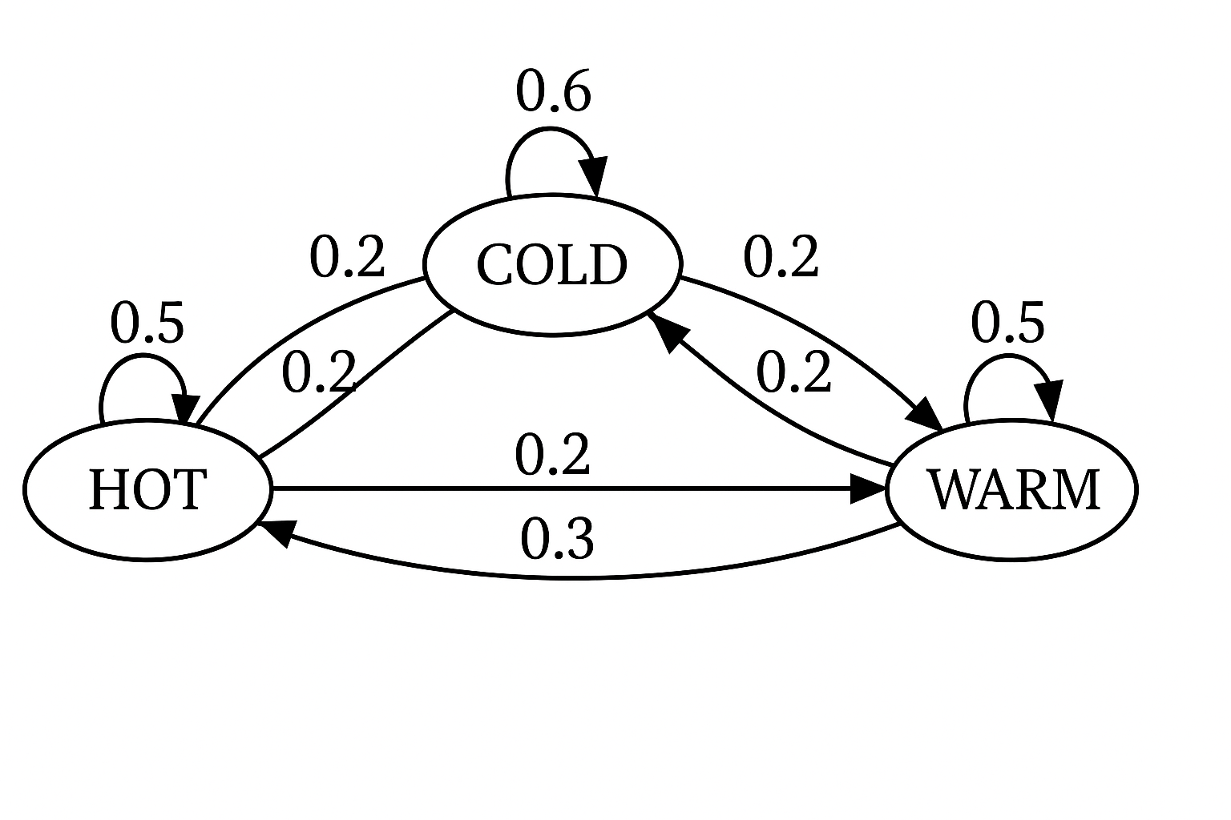
Markov Chains
0.3

Slide 14
Two types of MM
Deterministic
  The values of the transitional probabilities are known, and they might change over time
  Uncertainty might be addressed through sensitivity analysis
Stochastic
  The values of the transitional probabilities are not known, but they are bounded by a distribution
  Values are generated through simulation via Monte Carlo Studies, to be run 10,000 times

Slide 15
What information do you need to perform MM?
Knowledge of the disease path or progression
  Drawing a picture of it would be very helpful
  A Clear Understanding of Transmission Dynamics
Identification of transitional probabilities
Identification of initial or baseline values
Ancillary questions (Your judgement)
  What is the unit of time to be used?
  What is the time horizon?
  What are the interventions to be analyzed?
    How would they affect the disease progression?

Slide 16
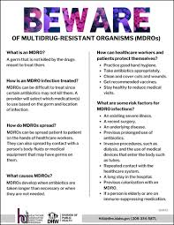
Healthcare Acquired Infections-Multi-Drug Resistant Organisms
HAI-MDROs

Slide 17

Public Health Example of a Markov Chain
  HAI-MDROs
Infected: Poor Hand Hygiene
Top
Healthy
Death
Medium
Infected: Poor Environmental Cleaning
Low

Slide 18
A Clear Understanding of Transmission Dynamics
HAI-MDROs
  Poor hand hygiene
    Prevalence * (Patients|Facility) * (Rate of Infection) * (Visits) * (1-Level of Hand Hygiene)
  Poor environmental/terminal cleaning
    Prevalence * (Patients|Facility) * (Rate of Infection) * (Churn) * (1-Level of Room Cleaning)

Slide 19
Key Values
Number of Long-Term Nursing Facility Residents=35,000
  Top →33.3 percent\\60 percent level of hygiene
  Middle →33.3 percent\\40 percent level of hygiene
  Low → 33.3 percent\\20 percent level of hygiene
Number of Caregiver Visits per week=84
Infection Rate--Candida Auris (CA)→0.00041
Initial Prevalence =0.0077
Churn=(Residents)*0.25/52
Death=0.40 * Infected
Infections, recorded in 2025-26 (52 weeks)→ 1,411

Slide 20
Transcribing Our Picture into an Excel File
Essentially your buckets are your key columns
  State columns
Transitional probabilities are also columns
  Likelihood columns
The products of these types of columns will produce the shifts
  Addition to or Subtraction from the State columns
Rows are your time periods
  Usually one year

Slide 21
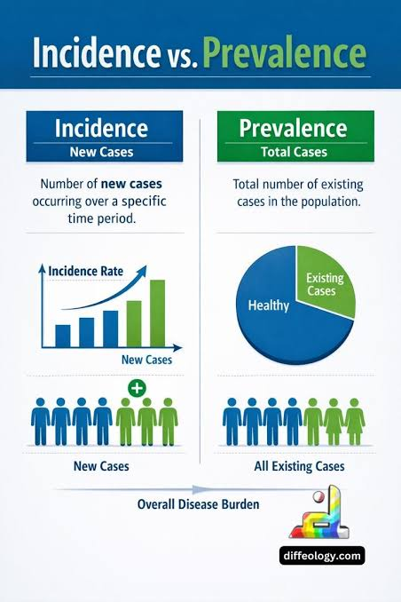
Key Terms
Incidence
Prevalence
Replacement Rate

Slide 22
How do know that is model is good?
Replicating the Epidemiological Curve
Specification of the Causal Mechanism
  Explain in the context of HIV
MM is not a proof
  Just because a model might predict a disease path accurately, it does not mean that your model is the only way to map it out

Slide 23
What’s Next
Diving into the SIR Model
  Susceptible
  Infected
  Recovered
When the patient does not recover …
Importance of Transmission Dynamics
Examples
  HIV
  COVID-19
  Influenza

Slide 24


Questions?
Suggestions?
Reflections?
John.Fieno@health.mo.gov

