Slide 1

Bureau of Environmental Epidemiology (BEE)
6+++++
Health and Risk Assessment Program (HRAP)

Slide 2

BEE-HRAP
Responsible for evaluating human exposure to hazardous substances in the environment, making health-protective recommendations regarding actions needed and educating communities about the possible adverse health effects of exposure to those hazardous substances.
Primary Functions
  Health Assessment - Public document used to identify possible harmful exposures and to recommend actions needed to protect public health.
  Risk Assessment - Technical document used in decision-making for site cleanups and other risk management strategies.

Slide 3
ATSDR Component 2 Focus Area Projects
5-year funding under our cooperative agreement with ATSDR
Environmental Health Indicators
Community Cancer Concerns
Private Wells and
Weather-Related Impacts
Partner with internal and external stakeholders to incorporate environmental health perspectives into new or existing programs, policies, and practices.
Develop a mapping tool for Missouri to visualize environmental health indicator data.
Develop educational materials to address cancer concerns.
Review and recommend changes to Missouri Cancer Inquiry Guidelines.
Develop standardized procedures and protocols to ensure an overall comprehensive coordinated response to community cancer concerns.
Develop educational materials for private well owners.
Increase awareness of private wells issues & increase testing of private wells.
Provide training to LPHAs to standardize water testing services, result reporting and interpretation.

Slide 4
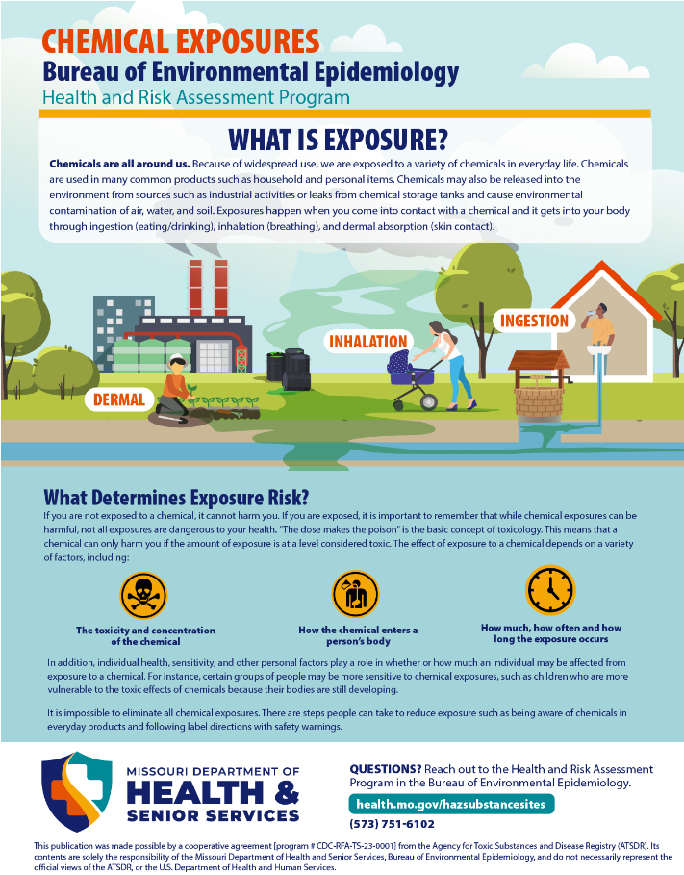
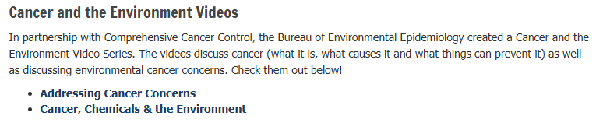
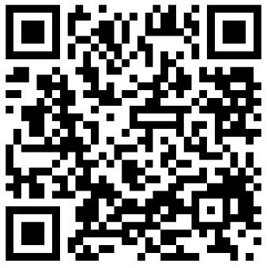
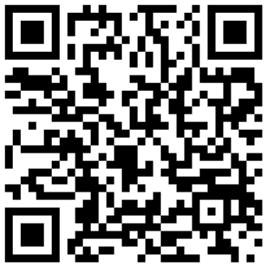
Addressing Community Concerns
https://www.youtube.com/watch?v=7p5DFOoLjV4
https://www.youtube.com/watch?v=n2NwXN8z7To

Slide 5


Thank you!
Health & Risk Assessment Program
Bureau of Environmental Epidemiology
Missouri Department of Health and Senior Services
Michelle Hartman, Health and Risk Assessment Program Manager
Chris Reeves, Environmental Specialist
573-751-6102
Health.Mo.Gov
This publication was made possible by a cooperative agreement [program # CDC-RFA-TS-23-0001] from the Agency for Toxic Substances and Disease Registry (ATSDR).
Its contents are solely the responsibility of the Missouri Department of Health and Senior Services, Bureau of Environmental Epidemiology, and do not necessarily represent the
official views of the ATSDR, or the U.S. Department of Health and Human Services.

