Slide 1

Title Slide
Division of Community and Public Health
Center for Local Public Health Services

Slide 2

CHIP H.S.I
6+++++

Slide 3
Outline of Discussion Points
Overview of Participation Agreement
CHIP H.S.I – what is it?
CHIP H.S.I - how did it start and how does it work?
CHIP H.S.I – what can I invoice for?
CHIP H.S.I – how do I invoice?
Q&A

Slide 4
Participation Agreement for State Investment in Local Public Health Services
A.K.A Participation Agreement OR Core Contract know
      Multi year agreement between DHSS and LPHAs
      Established to help support the delivery of public health services
      Funding sources for the Participation Agreement include:
          State General Revenue
          Federal funding - Children’s Health Insurance Program (CHIP),
    Health Services Initiative (H.S.I)
Notes:
*Reminder that the federal funding that comes in through CHIP, then mixes with state GR funding and becomes one line of funding distributed through the Participation Agreement. This funding is considered local funding – can be spent as locals choose
Current Core Agreement Dates – June 1, 2024 – May 31, 2027
When is next Core agreement dates – June 1, 2027 – May 31, 2028, = Will start prepping new contracts at the end of this year.
Core funding support is essential to the prevention of disease, promotion of healthy families, lifestyles and environments, and for protection from disease and disaster through an integrated and cooperative public health system in Missouri.
General Revenue appropriated annually =FY26 $5,686,508
Children’s Health Insurance Program (CHIP), Health Services Initiative (H.S.I) = FY26 $7,900,000
General Revenue + CHIP = Core Distribution TOTAL $13,586,508
General Revenue + CHIP = Core Distribution TOTAL $13,586,508

Slide 5
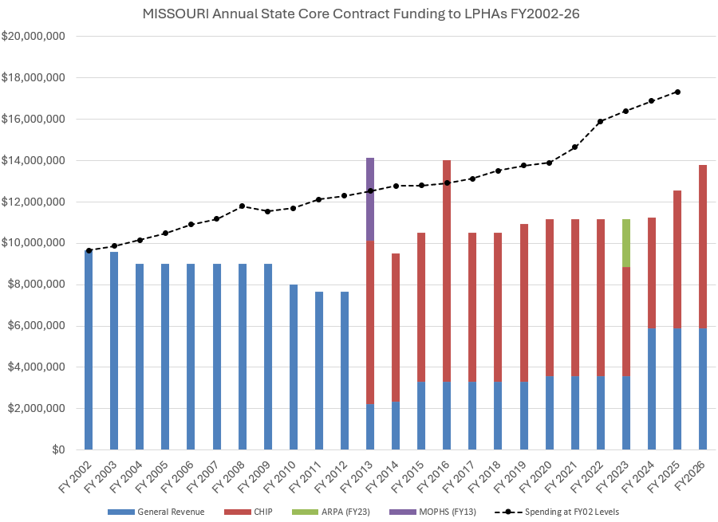
CHIP H.S.I
  BLURP ABOUT FUNDING CUTS IN 2013 & HOW chip came about

Slide 6
Children's Health Insurance Program (CHIP)
CHIP H.S.I
CHIP provides health coverage to uninsured children (up to age 19) in families with incomes too high to qualify for Medicaid but too low to afford private health insurance.
CHIP has significantly reduced the number of uninsured children in the U.S. and improved access to healthcare for millions of children.
Health Services Initiative (HSI)
HSI is a component of CHIP that focuses on expanding access to health services for children, particularly through innovative and community-based health initiatives.
States can utilize HSI to develop programs that address specific health needs in their communities, such as preventative care, health education, and outreach efforts.

Slide 7
CHIP H.S.I
When did it start? How does it work?
  In 2012, Missouri received Federal approval from the Centers for Medicare and Medicaid (CMS) for an amendment to the Missouri Title XIX State Plan to include “Health Services Initiatives” in the Missouri State Plan
  This amendment to include Health Services Initiatives, allowed Missouri to utilize unreimbursed local expenditures tied to four specific approved programs, to draw down federal funding.
  Unreimbursed expenditures are expenses associated with services performed that cannot and are not claimed from any other funding source (Medicaid, other insurers, fees from participants, other federal funds)
  The four specifically approved programs (for children age 0-19) are:
  1. Immunizations
  2. Lead Testing and Prevention
  3. Newborn Services
  4. Screening, Diagnosis and Education of Public Health Issues
Notes:
CHIP H.S.I Program Cost – Revenues = Excess Local Expenditures
IMPORTANT: Once identified and submitted as CHIP H.S.I expenditure, those dollars are considered federal match dollars and cannot be used as match for any other program

Slide 8
CHIP H.S.I PROGRAMS
Immunization Program:
LPHAs provide a vital role in immunizing children and promoting immunizations among hard to reach families and communities.
Examples of Allowable Expenditures:
Staff time to provide immunizations
Immunization record review
Immunization data entered into Show-Me Vax
Needle Disposal Service
Postage and/or reminder cards
Interpreter service cost for communicating with families regarding immunizations
The cost for vaccines funded through the Vaccines for Children (VFC) program or any other funding source, should not be claimed as a CHIP H.S.I. expenditure. The cost for vaccines paid with local funds is an allowable expenditure.

Slide 9
CHIP H.S.I PROGRAMS
Lead Program:
LPHAs are the forefront of monitoring and managing lead poisoning among children
Examples of Allowable Expenditures:
Outreach/Educating families about lead poisoning and prevention
Lead case management
Lead screening
Completing risk screening forms and providing referrals based on screening forms
Lead testing and outreach
Interpreter service cost for communicating with families regarding Lead
Postage cost for sending lead testing/prevention educational materials to schools, pre-schools and pediatricians
Cost for postage to notify parents of elevated blood lead
Travel expenses for lead testing, providing education or case management services

Slide 10
CHIP H.S.I PROGRAMS
Newborn Services Program:
LPHAs offer a variety of services to newborns and their parents, including newborn care education and support to high-risk families, and prenatal care management. These services can be provided in health facilities, families’ homes, and/or other settings. Clinical staff and other trained professionals provide a range of services to young families to ensure the healthy development of infants and toddlers
Examples of Allowable Expenditures:
Parenting or counseling programs for high-risk, low-income parents and children
Parenting or counseling programs for first time parents
Case management
Development toys for developmentally delayed children
Providing car seats and baby cribs would not be examples of allowable cost.
High Risk includes a variety of issues such as physical health problems, developmental delays, abuse/neglect, low-income, first-time parents and /or single parents, etc.…

Slide 11
CHIP H.S.I PROGRAMS
Screening, Diagnosis and Education of Public Health Issues (formerly known as School Health) Program:
LPHAs provide health related services to children under the age of 19 in a wide variety of settings, including health department facilities, schools, preschools, day care centers, churches, community centers, homes and other settings. Services include health education, screenings, diagnosis, maintenance of health records, basic nursing services and referrals as needed to other health care providers. These services are distinct and different from the services provided in schools as part of special education services authorized under IDEA.
Examples of Allowable Expenditures:
Health screenings
Health education
Basic nursing care
Education/Training for students, teachers, and parents (including preparation time for trainings)
Maintenance of health records
Immunization compliance
State mandated reports and referrals
Dental screening
Cafeteria inspections of schools and daycares

Slide 12
CHIP H.S.I PROGRAMS
Screening, Diagnosis and Education of Public Health Issues (formerly known as School Health) Program CONT:
Examples of Allowable Expenditures:
Food safety/handling classes provided for schools for cafeteria staff
Asthma, nutrition, STD or any related health educations trainings
Educational materials cost and postage cost for sending to schools, preschools, day care centers, churches, community centers, homes and other settings.
Back-to-school fairs where health education is being provided
Qualifying Child Care Health Consultation (CCHC) services not reimbursed under the CCHC contract.

Slide 13
CHIP H.S.I
HOW ARE EXPENSES REPORTED?
The invoicing form utilized for CHIP H.S.I is referred to as the CHIP H.S.I Expenditure Report
LPHA’s submit CHIP H.S.I net expenses to the Center quarterly (email reminders are provided by the Center).
The CHIP H.S.I report is due to the Center the month following the closing of the quarter.
  January – March (due in April)
  April – June (due in July)
  July – September (due in October)
  October – December (due in January)
CLPHS submits LPHA Expenditures (claims) to Center for Medicare and Medicaid (CMS quarterly).
Notes:
*Explain the NET expenses piece to ensure understanding
Complete only the most recent quarter
Previous quarters remain blank unless there are net changes
Reporting is on a cash-basis and should be reported in the quarter in which the expenditure incurred or the revenue was received. Do no use estimates.

Slide 14
CHIP H.S.I
REPORTING AND DOCUMENTATION REMINDERS
When completing the CHIP H.S.I Expenditure Report, only report on the most recent quarter
Leave previous quarters blank unless there are net changes
Reporting is on a cash-basis and should be reported in the quarter in which the expenditure incurred
LPHAs must maintain back-up documentation of reported expenditures for five years past the end of the contract.
  Types of documentation consist of the follow but not limited to;
    Timesheets (position title, salary, # of hours spent on CHIP H.S.I program, fringe benefits).
    Travel cost incurred while providing CHIP H.S.I program services (mileage, lodging, meals).
    Invoices/Receipts/Proof of payment for other types of expenditures
    Contracted Services – contract expenses directly related to the CHIP H.S.I program(s)

Slide 15
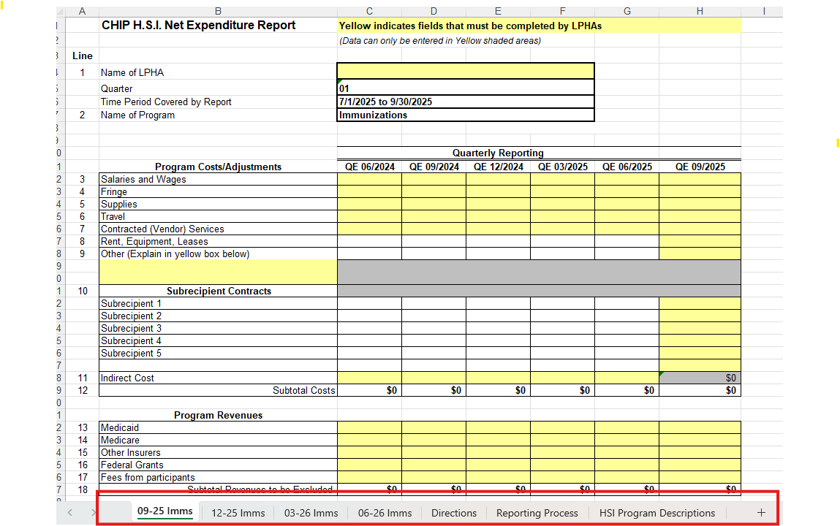
CHIP H.S.I Expenditure Reports
Prior to filling out the Net Expenditure Report, be sure you are on the correct quarter’s tab.
For example: we’ll assume that we are in the quarter ending September 2025. So, we would need to be on the “09-25 Imms” tab. NOTICE there are “Directions,” “Reporting Process” and “HSI Program Descriptions” tabs for additional guidance (see outlined boxes above).

Slide 16
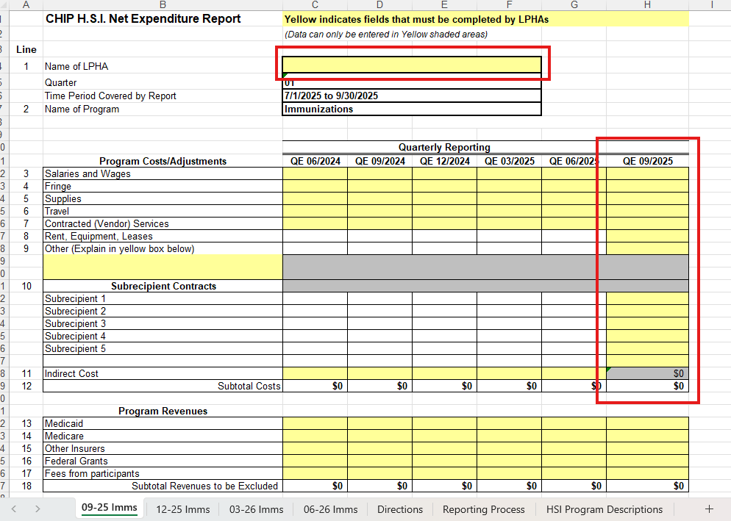
CHIP H.S.I Expenditure Reports
Enter LPHA name and total amount of expenditures for the specified program in the current quarter ending column (see outlined boxes above).

Slide 17
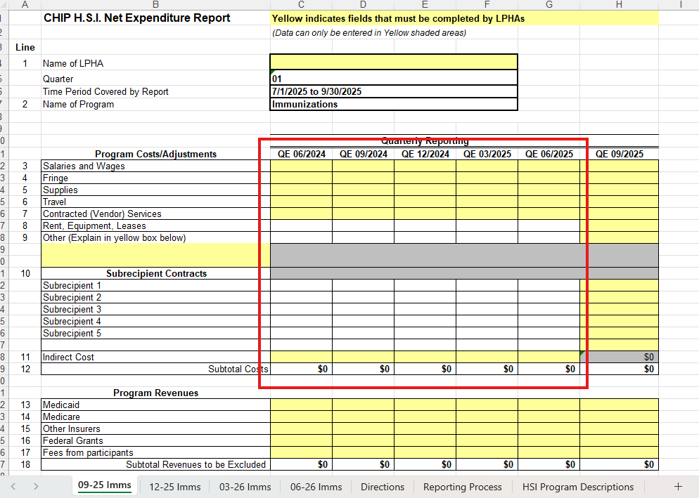
CHIP H.S.I Expenditure Reports
The only time previous quarters should have expenditures listed is if there is a net change to what was previously reported. If there are no changes to expenditures reported previously, these boxes should remain blank.

Slide 18
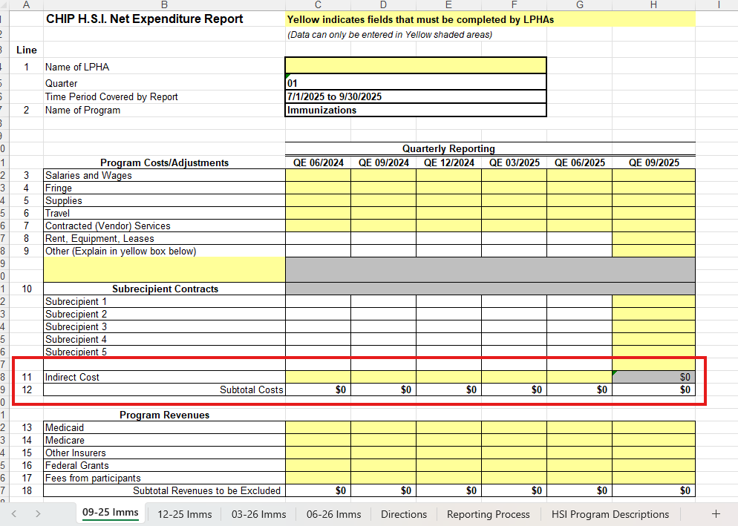
CHIP H.S.I Expenditure Reports
Indirect Cost and Subtotal of Program Costs are automatically calculated. DO NOT TRY TO CHANGE THE NUMBERS IN THESE FIELDS

Slide 19
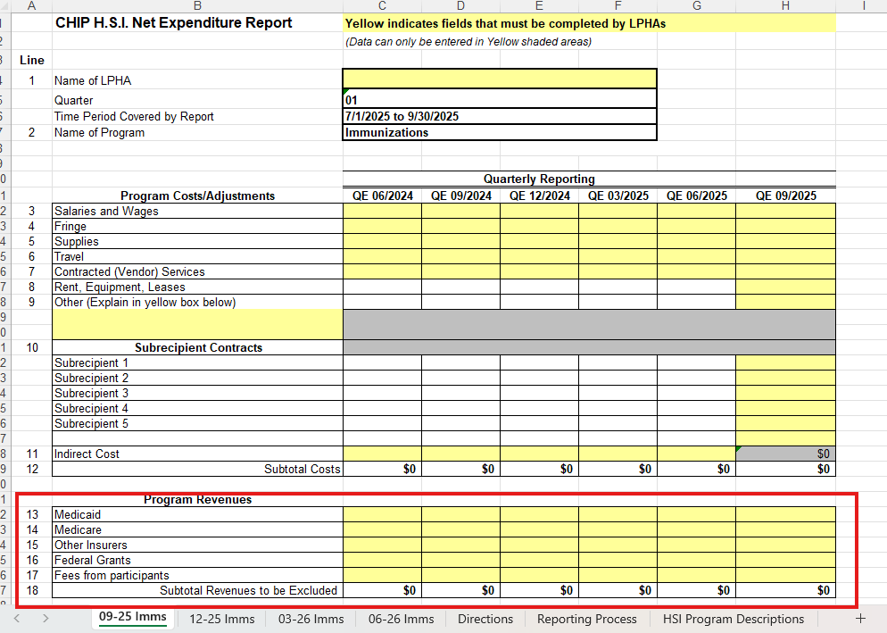
CHIP H.S.I Expenditure Reports
If the LPHA billed Medicaid, Medicare, Other Insurers or received revenue from Federal Grants for program services, these amounts are entered into the appropriate quarter.

Slide 20
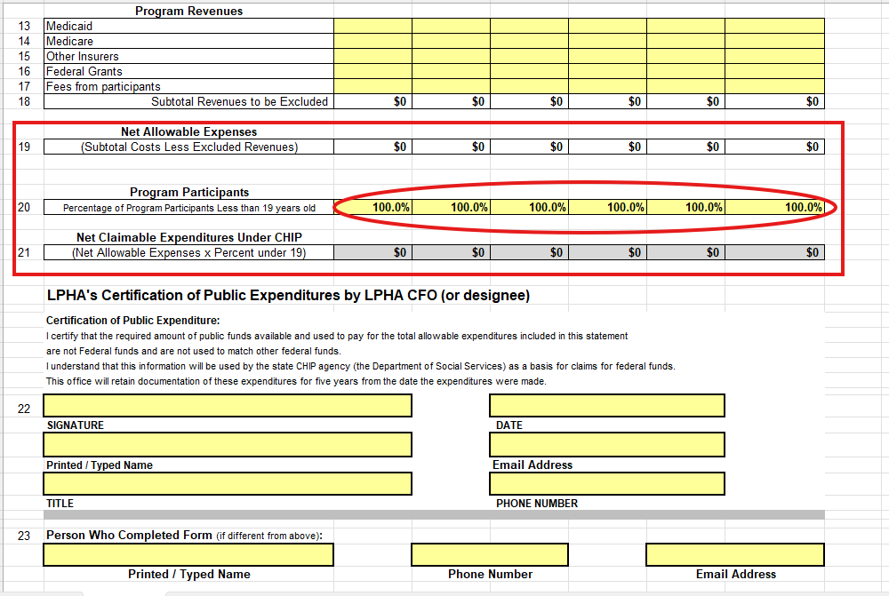
CHIP H.S.I Expenditure Reports
The Net Allowable Expenses and Net Claimable Expenditures will auto calculate. However, LPHAs must insert the percentage of Program Participants who are less than 19 years old (circled in red above), if percentage is different than 100%.

Slide 21
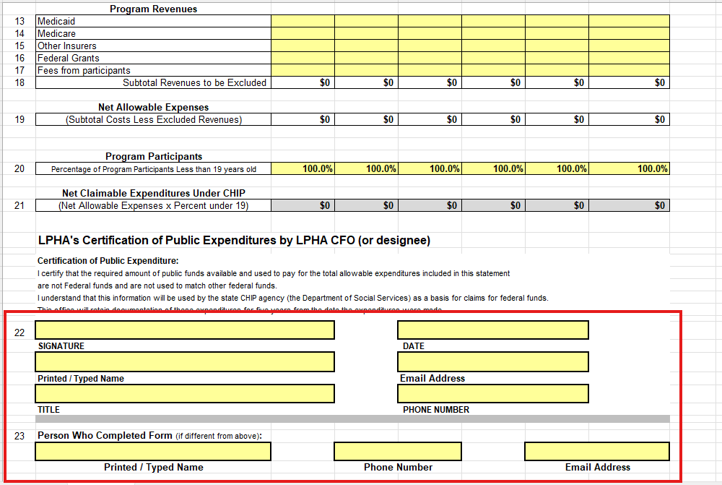
CHIP H.S.I Expenditure Reports
Complete the bottom of the report. The Certification of Public Expenditure must be signed by the LPHA’s Chief Financial Officer (or designee).

Slide 22
CHIP H.S.I
Importance in Expenditure Reporting
CMS provides reimbursement back to the state at a specific “match rate” of net expenditures claimed. Currently, that match rate is 75.72%
The CHIP H.S.I. funds received are then distributed to all 115 LPHAs through the “Participation Agreement”.
The total amount of CHIP H.S.I. funding available for the Participation Agreement is variable each year. If reported expenditures decline due to lack of participation or allowable claims, CHIP H.S.I funding declines. The same is true if reported expenditures increase.
Notes:
Add info about report sent to DSS.

Slide 23
CHIP H.S.I
  BLURP ABOUT FUNDING CUTS IN 2013 & HOW chip came about
FY2025 Total - $10,471,757
IMMS - $6,672,823 = 64%
Lead - $755,566 = 7%
Screening - $2,471,493 = 24%
Newborn - $571,874 = 5%
Notes:
As a reminder of importance, due to reported expenditures we were able to last year increase the CORE contract last year due to CHIP.
IMMS – 1ST in reporting
Lead- 2nd
Screening – 3rd
Newborn – 4th

Slide 24




QUESTIONS?
Contacts - Nicole Cooper,
Public Health Program Supervisor,
Center for Local Public Health Services
Nicole.Cooper@health.mo.gov
(573) 526-6960
Health.Mo.Gov

