Slide 1





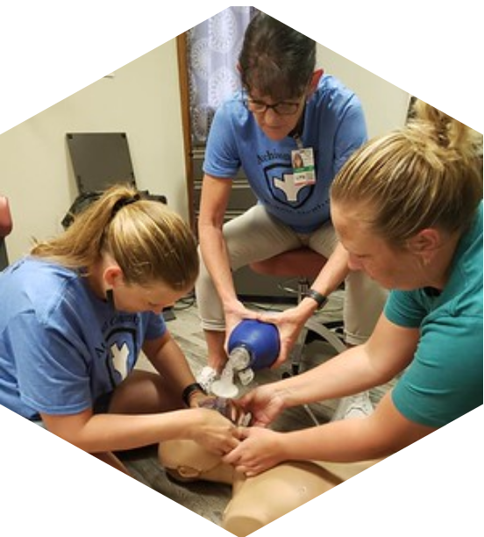

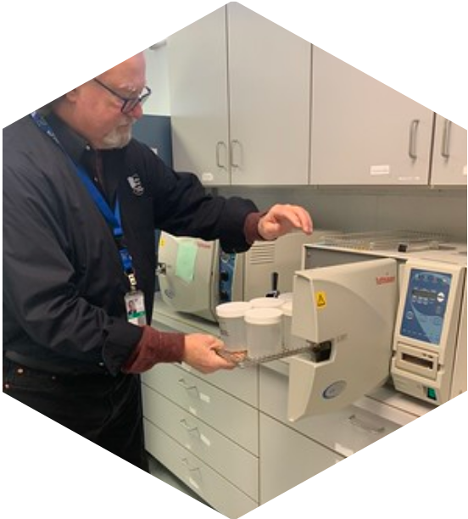

Tools for Strategic Resource Allocation
Daniel Bogle, Health Policy Director
Brenna Davidson, Operational Excellence Leader

Slide 2








Project Timeline
Strategic Decision-Making
Project Reimagine V1
JUNE 2025
Creating the DHSS Service Portfolio, prioritizing the work
Project Reimagine at DHSS
Creating a comprehensive inventory of services known as the DHSS Service Portfolio, broken down into service components and supporting activities
Prioritizing each service with Missourians in mind
Assembling key information for each service in a "single source of truth" to enable rapid analysis and decision-making
Identifying alternative service delivery options, opportunities to cross-train teams, and optimize resources
PHAB Tool Development
FEBRUARY 2026
Feedback from small group of states, "Premium Tool" available at a cost
LPHA Interest and SPARK Tool Development
MARCH 2026
Feedback and piloting to follow regional meetings
Service/Program Priority Levels
Project Reimagine V2
JUNE 2026
Leveraging the DHSS Service Portfolio for strategic decisions
Great to Have
Indispensable
Valuable
Optional
Pause

Slide 3

The SPARK Tool is...
The SPARK Tool is NOT...
Free to LPHAs
A "best of both worlds" approach blending elements of the PHAB Tool and the DHSS Service Portfolio
Uniquely tailored to public health in Missouri and LPHA needs
Adaptable to each LPHA's operations
In need of your feedback and piloting!
Intended to make decisions for an LPHA
Your only source of analysis for programmatic or operational decisions
Required or mandatory for LPHAs
Intended for submission to DHSS

Slide 4


Time for a sneak peek!

Slide 5





Share Your Feedback
Pilot LPHAs Wanted!
Content of the SPARK Tool
Do you see yourself using this tool?
Do we have the right elements to consider for each program?
Are there too many considerations? Not enough?
Help us refine and improve the beta version of the SPARK Tool!
Pilot participants would be asked to complete the SPARK Tool with their team or governing entity then report back to DHSS on the experience.
Pilot feedback will shape the format of the SPARK Tool 1.0 release statewide.
Process of Completing the SPARK Tool
Is the guidance clear?
Do you feel like you could use this tool as is?
What other resources do you think you will need?
What changes would you make to tailor it to your LPHA?
Do you see yourself involving your team or governing entity in the work?
Email Brenna and Daniel if you're interested!

