Slide 1


Title Slide
Health.Mo.Gov
DonateLifeMissouri.org

Slide 2

Notes:
Maintain a statewide, confidential registry of potential donors
Develop and implement statewide donation awareness programs for the education of the general public
Implement donation awareness programs within secondary schools
The Organ and Tissue Donor program works with partners across the state to increase organ, eye and tissue donation awareness.

Slide 3
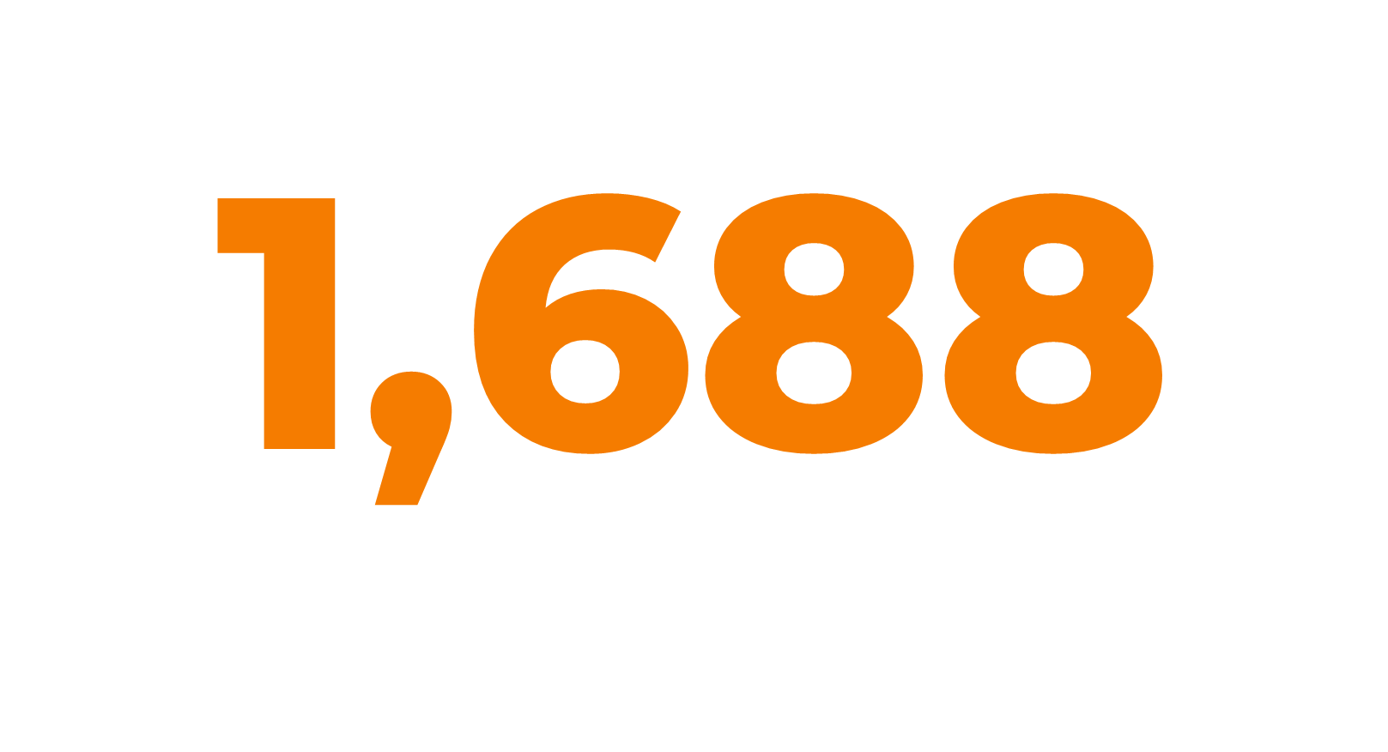
Notes:
Currently 1,688 Missourians are waiting for a life extending organ transplant. (as of 1/31/2026)
Kidneys represent highest need at 1,418 that is 84 percent of those on the transplant waiting list.
In the US 103,223 are on the wait list for an organ transplant (as of 2/20/2026, organ donor.gov)
Every day 17 people die while waiting, every 8 minutes a person is added to the wait list

Slide 4
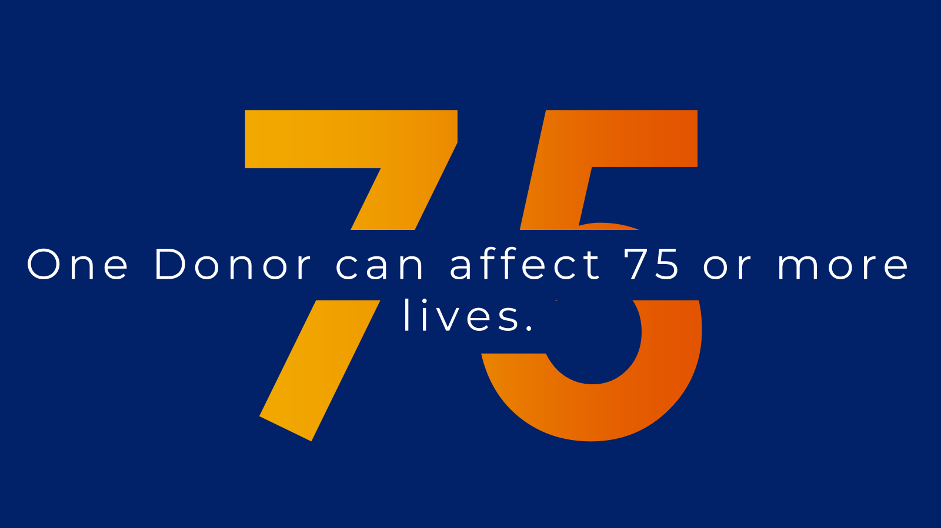
75
Notes:
One donor can affect the lives of 75 or more people through organ, eye and tissue donation.

Slide 5
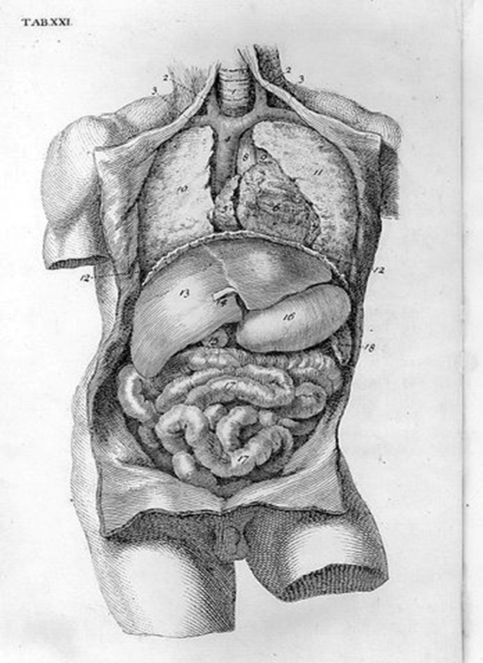
Heart
Lungs
Liver
Kidneys
Pancreas
Intestines

Slide 6
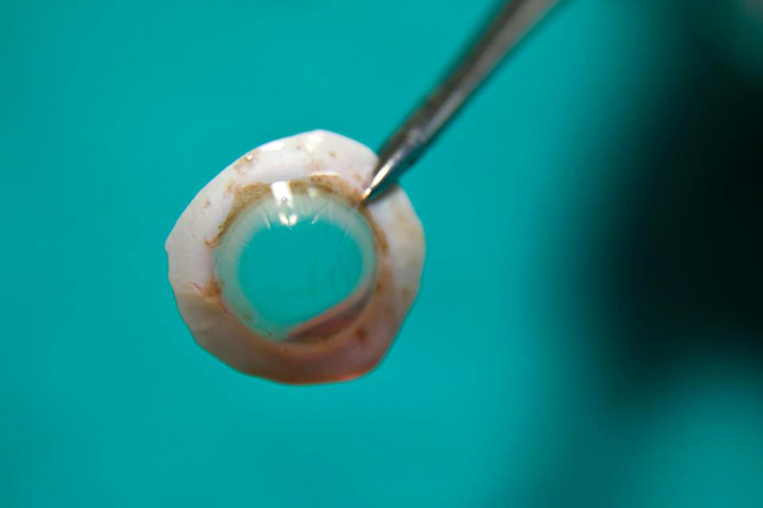
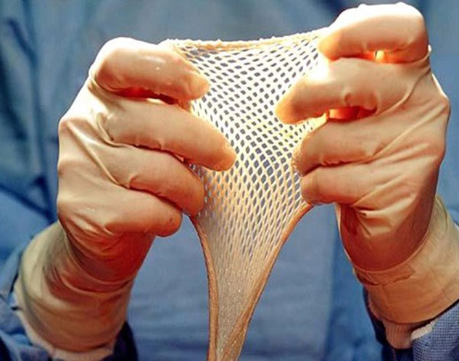
Corneas
Long Bone
Skin
Heart Valves
Veins
Tendons
Notes:
Corneas represent the most commonly recovered tissue.

Slide 7
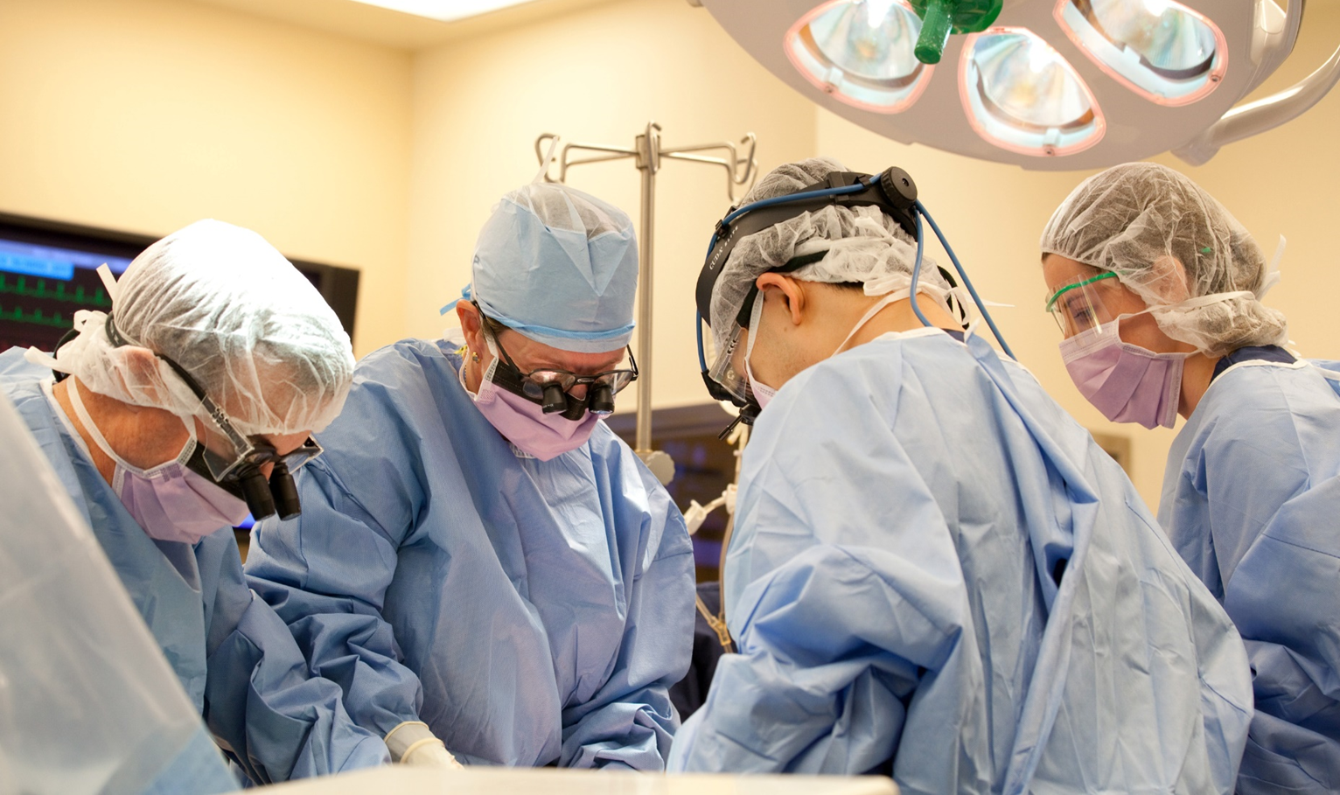

Slide 8
Referral to the Organ Procurement Organization (OPO)
Lab work
UNOS/Organs Allocated
OR scheduled
Recovery

Slide 9

Federal law requires hospitals to refer all deaths to OPO’s as possible donors.
This includes patient that:
Declaration of brain death
Patient that meet criteria for DCD donation
GCS of <5

Slide 10
Evaluate potential donors.
Determine if the Donor is in the Registry.
Discuss donation with families.
Evaluation (medical and social medical history)
Arrange surgical removal of organs and tissue.
Coordinate with UNOS to place organs with recipients.
Notes:
The OPO will access the Missouri and national registry to determine if the potential donor is registered. An individual does not need to be registered to become a donor.
Hospital staff and OPO staff are two different entities and should be treated as such. Hospital staff approaching families about donation can create mistrust of the healthcare team and reduce or eliminate the chance for donation.
Mid-America Transplant- Eastern Missouri, Western Illinois, and Northern Arkansas
Midwest Transplant Network- Western Missouri and Kansas
Saving Sight – Eye Bank, Missouri and Kansas
OPOs are regulated by CMS

Slide 11
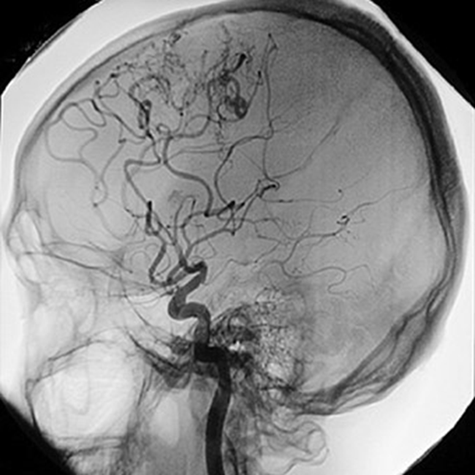
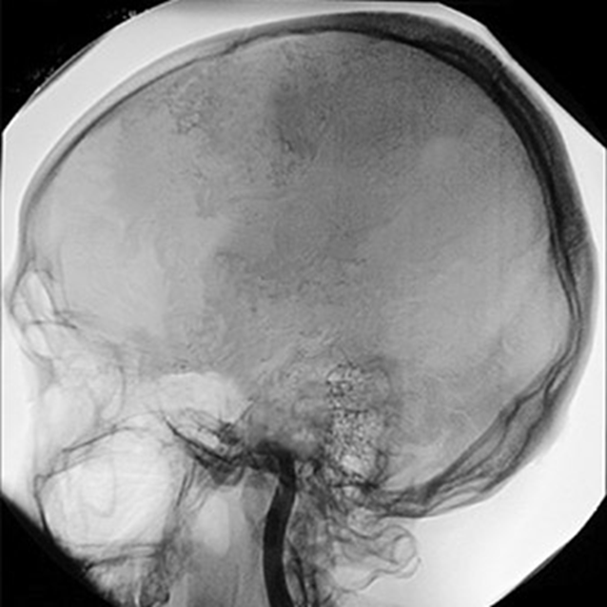
Brain Death is irreversible cessation of all functions of the brain including the brain stem.
Notes:
Diagnosis of brain death must follow certain criteria:
Absence of response to noxious stimuli
GCS of 5 or less
Lack of spontaneous movement
Absence of pupillary response to bright light
Absence of corneal reflexes
Absence of ocularvestibular reflexes
Absence of respiratory effort
Failure of the heart to increase more than 5 beats after IV atropine
Nuclear medicine and perfusion testing may be performed as well
OPO staff and recovery surgeons/physicians do not perform or participate in determining brain death.

Slide 12
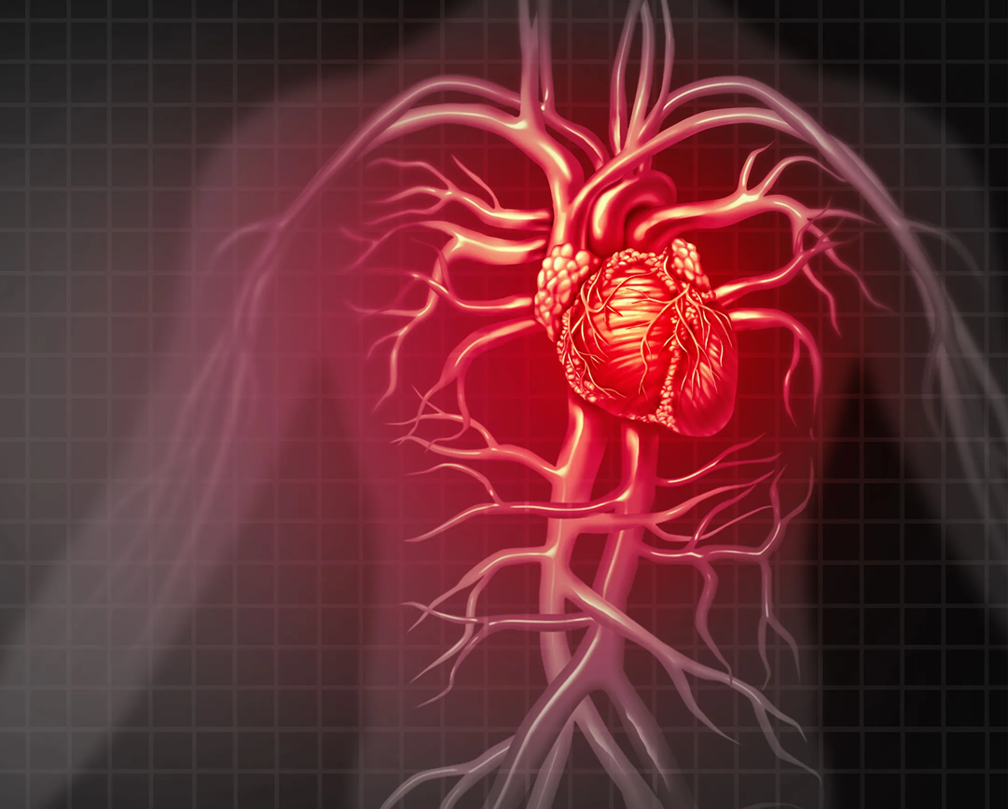
Controlled
Uncontrolled
Controlled
Uncontrolled
Notes:
Controlled: Potential donor taken to OR and extubated with a predetermined mandatory waiting time after cessation of cardiac and respiratory function. If autoresuscitation occurs the patient will be moved back to the ICU or other designated area. If autoresuscitation does not occur organ recovery will begin. The organ recovery team is not present during extubation and wait time.
Uncontrolled: Death outside of the hospital, tissue is the primarily recovered from this type of donor.
DCD referral is only done when family or legal decision maker approaches hospital personnel about wanting to donate organs. This is not hospital initiated (referred by law).

Slide 13
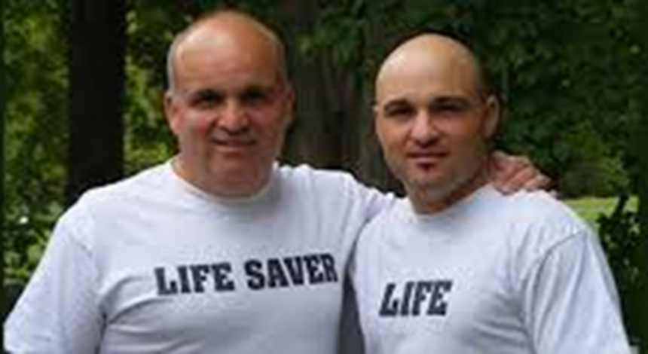
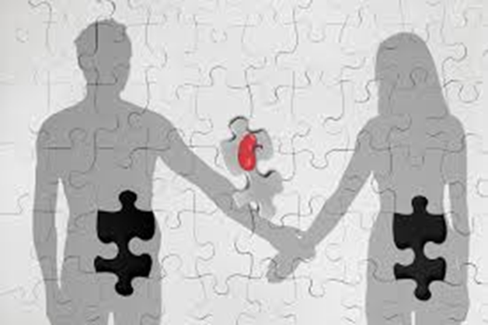
The kidney is the most commonly transplanted organ from a living organ donor.
The donor does not need to be a relative!
Notes:
Living donation is done through a transplant center, not through OPOs
Paired Donor.
Donor Chain.
Donor does not need to be relative and may or may not know recipient.
Social media has played a role in pairing live donors with recipients.

Slide 14



Notes:
Here are two common myths the program receives phone calls about or that may be portrayed on a television show or movie.

Slide 15
If doctors and EMT/Paramedics know I am a donor they will not save my life.
Only healthy people can donate organs and tissue.
Many religions forbid organ and tissue donation.
Living donors must be family.
Only the young can be organ and tissue donors.
Only those that are wealthy or have celebrity status can receive an organ transplant.
Open casket funerals can not take place after organ donation.
Notes:
An EMT’s, Paramedic’s, and Doctor’s priority is to save life regardless of donor registry status.
Any person and any health status can be considered a potential donor, health status changes over time. The OPO will determine if your health prevents donation at the time of death.
Most religions see donation as the ultimate sacrifice and a selfless gift.
Living donors do not need to be family, in fact a recipient may not know their donor.
A person of any age can be a donor, there have been donors in their 90’s
Wealth and celebrity status are not part of the organ allocation process. Time on waiting list, severity of illness, blood type, size of organ, and geographic location are used to allocate organs.
Organ donation does not prevent open casket funerals, the OPO’s and funeral home take great care of the donor body.

Slide 16







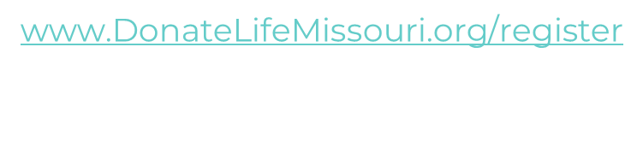
Accessible Line Chart
Insert your awesome subtitle here
Notes:
There are three ways to register to be an organ, eye, and tissue donor.
Simply say yes when asked if you want to be an organ donor at the driver’s license office. Be sure to say yes each time to keep your registration up to date.
Register online at www.DonateLifeMissouri.org
Request a paper enrollment form by calling 888-497-4564, paper forms are available online as well.

Slide 17
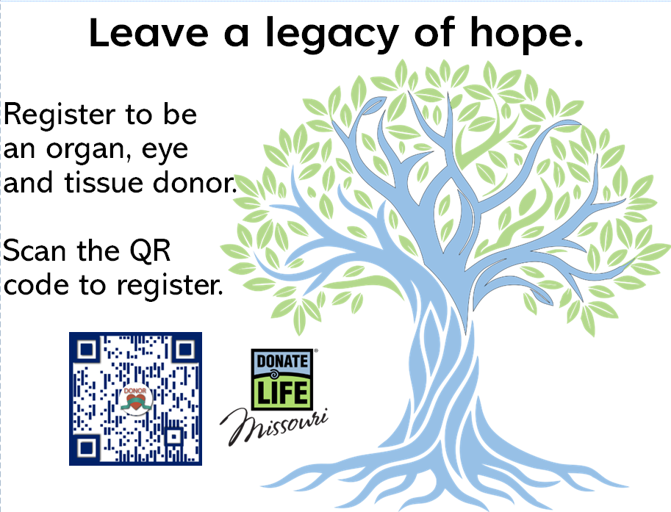

Slide 18

Questions

