Slide 1
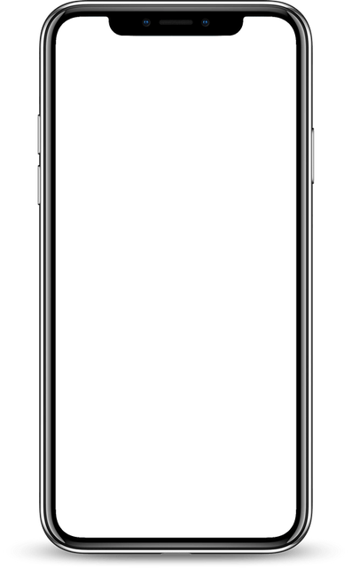
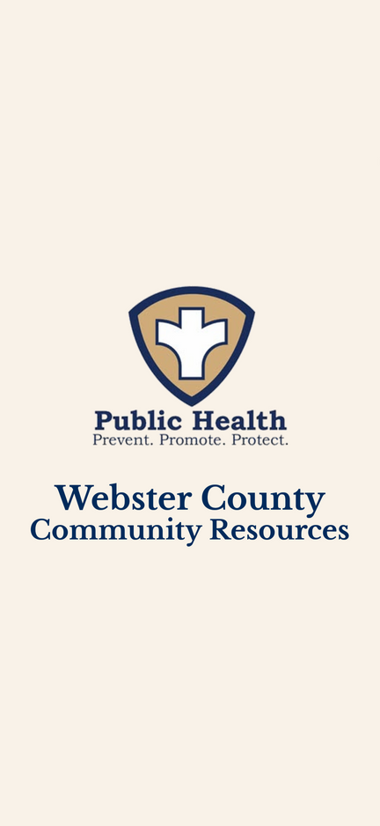
Webster County Resource App
Notes:
Good morning/afternoon. Today we are going to talk about the Webster County Resource App.

Slide 2
Agenda
1
Introduction
2
Why a resource app?
3
What can you find on the app?
4
Community Engagement
5
Q&A
Notes:
Here is our agenda for the time.

Slide 3

Introduction
Jennifer Steen, Business Manager
Lora Smith, Health Educator
Louise Bigley, Health Education Coordinator
Notes:
My name is .........., and I work with the Webster County Health Unit. Explain what you do at the Health Unit.

Slide 4
Why a Resource app?
Lack of knowledge around resources
Professionals asking for an updated resource guide
Connection to resources
Centralized approach
Notes:
During the research grant diversion to care, the conversations heard, along with surveys conducted in the community, showed that people were asking for these four things. Many residents have missed out on vital resources due to not knowing where to look. We found that the traditional methods of finding help, like word of mouth, printed brochures, or outdated websites, simply were not cutting it in today’s fast-paced, mobile-first world.
Professionals across Webster County frequently face the challenge of navigating scattered information when attempting to connect individuals or families with the appropriate support.
So, we built Webster County Resources—a simple, user-friendly app that brings everything together in one place. Whether you're helping a neighbor, supporting a client, or just looking for answers yourself, this tool makes it easier to find what you need, when you need it.

Slide 5
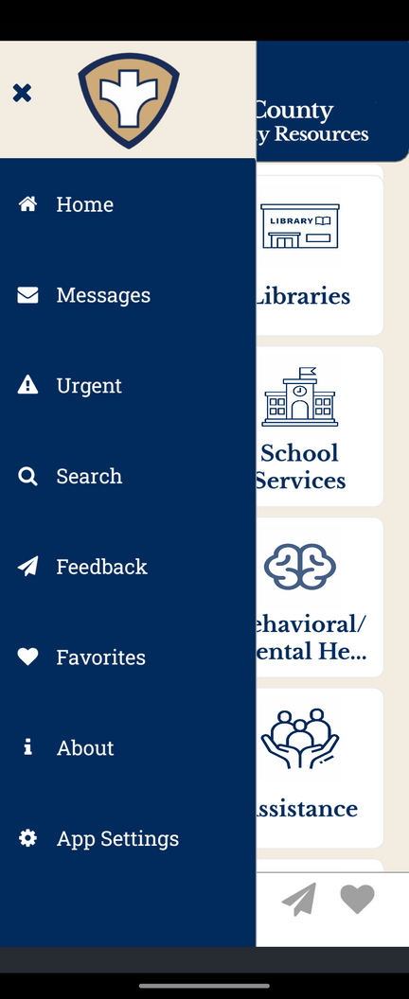
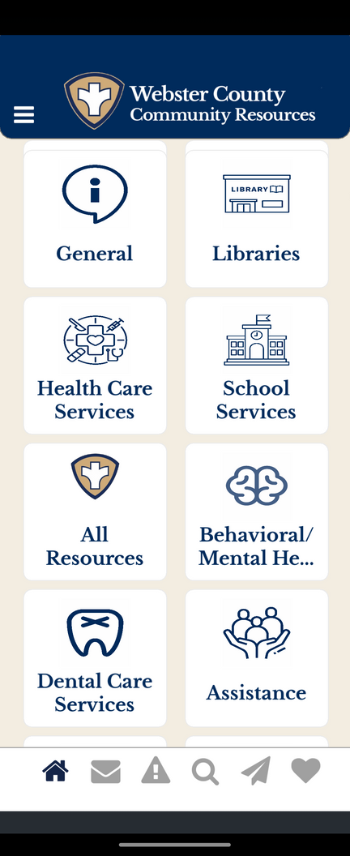
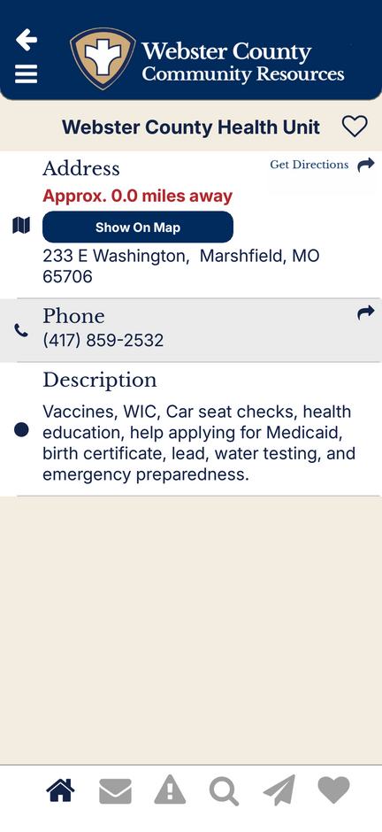
What can you find on the app?
What can you find on the app?
Key Features
Resource profiles with contact info, hours, address, required documents, distance tracking, calling features, and service details
Search by organization, location, subject, populations served
Demolition of the app - What can you find on the app?
Favorite a resource you use often
Updated resources as information changes, the app can be updated immediately
Notes:
Webster County Resource app helps professionals and community members quickly identify where resources are located (whether in our county or a surrounding county) and who provides them. From crisis intervention and housing support to food assistance, senior services, and healthcare access, the app connects professionals and community members with a full spectrum of local resources.

Slide 6
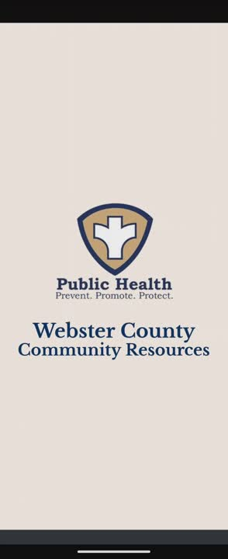
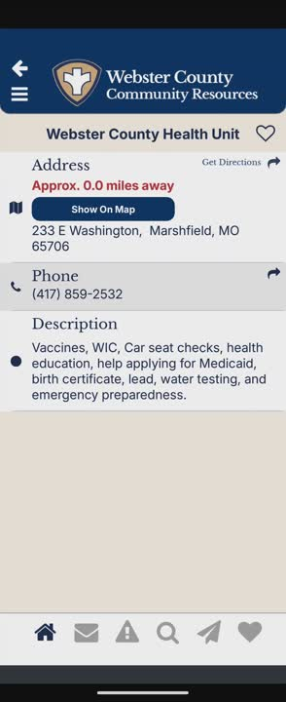
Notes:
The first I will show you is of the features of the home page
The second video I will show is shows the features of clicking in the resource.

Slide 7
Community Engagment
Educational opportunities
Partnerships
Flyers
Skill Building Taskforce
One-pagers
Community Cares
Power Points
CommUNITY Partnership
Community Members

Slide 8
App Development and Overview
Initial design and function meetings
Developers work their magic
  Develop architecture, database schemas, construct CMS, design/develop web interface
  Testing, debugging, changes
Submission to Apple and Google app stores.
  Rejected by Apple for design/function issues.
    Reworked and submitted twice
  Rejected by Google for violation of Impersonation Policy
    Provided explanation of the use of the NACCHO public health shield.
Notes:
Initial meetings with developers involved going through example apps and marking things we liked and did not like.
Ex apps: Revive AR and Alaska Community Resources
From those meetings, developers worked their magic
CMS = Centralized Database and Content Management System
Programming language and code remarks for future support and scalability.
HIPAA compliant
Submission to Apple and Google App Stores
Something else we learned? There is a spelling error in our app description. We cannot change that without pushing a full app update.
How much did we spend? Total for development and to get the apps published: $32,250 (extra development required) Monthly maintenance $99 (negotiated price with developer)

Slide 9
Q & A

Slide 10
Thank you!
Write contact details

