Slide 1


Title Slide
Health.Mo.Gov

Slide 2

Maternal Child Health (MCH) Services Contract Budget and Invoicing Overview
August 6, 2026
        Sara Gorman MSN, RN
        Program Manager, MCH Services Program

Slide 3

In the Next Thirty Minutes
  Contract Purpose and Eligibility
  Budget and Funding Provisions
  Invoicing and Payment
  Amendments and Reports

Slide 4



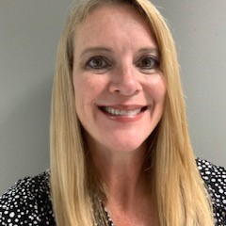
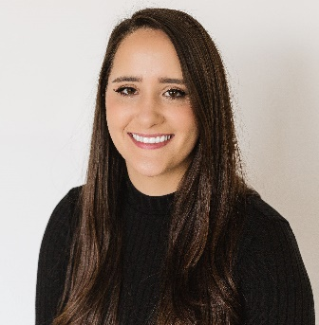
Meet the Team
MCH Services Program
Sara Gorman MSN, RN
Program Manager
Amy Bradshaw BSN, RN
East/Southeast DNC
Lindsey Cobb MSN, RN
Southwest DNC
Macey Shinn, MPH, BSN, RN, CHES
West Central DNC
Sara Thompson BSN, RN
Northern DNC

Slide 5
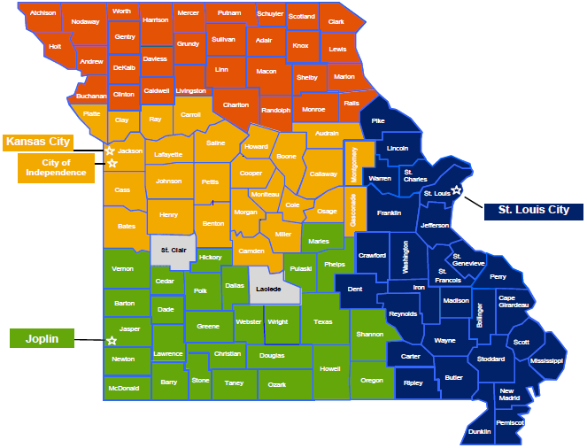
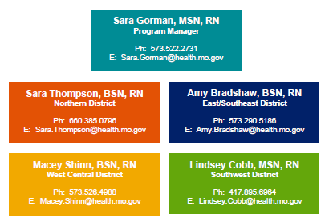
Photo Slide
MCH District Nurse Consultant Map

Slide 6
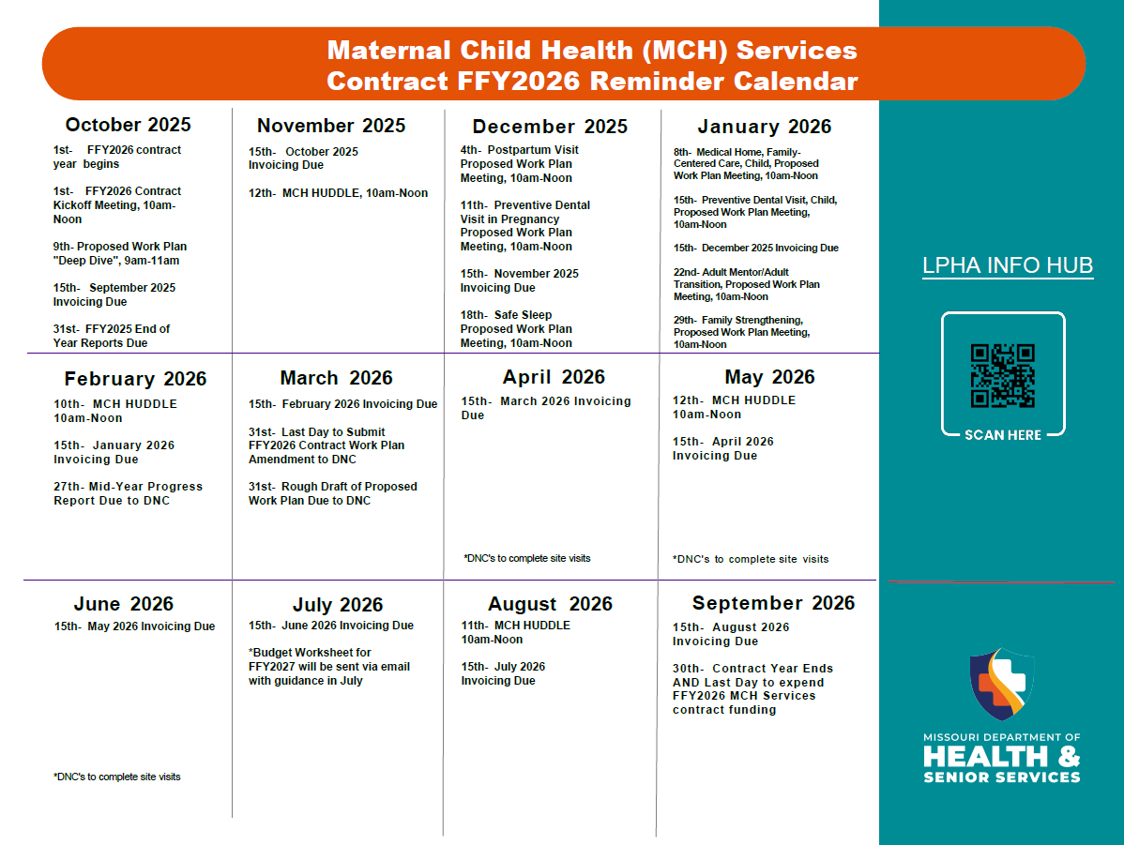
Photo Slide

Slide 7
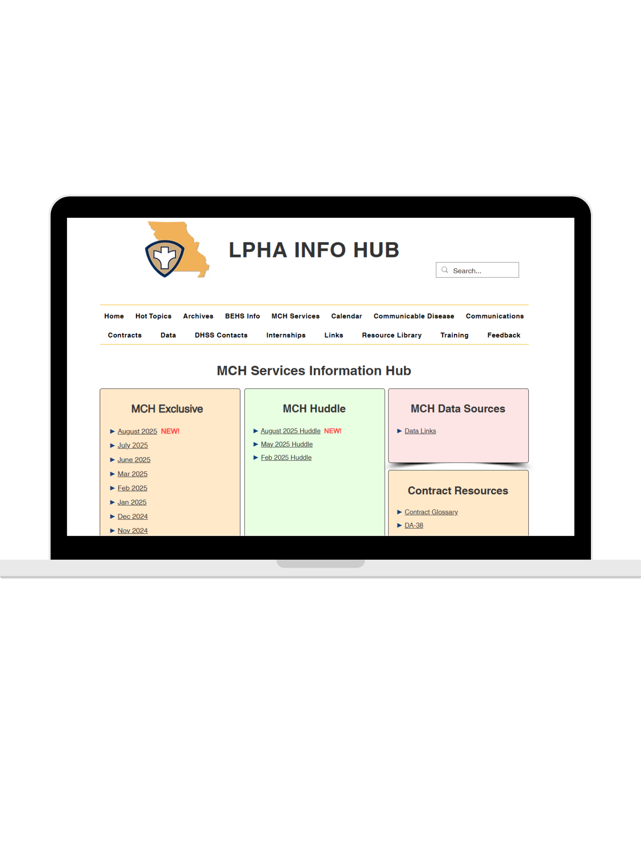

https://www.mo-lpha.com/mch-services-info-hub

Slide 8
Contract Purpose
and
Eligibility

Slide 9
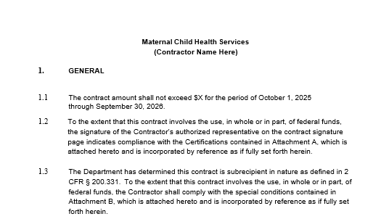
Scope of Work
MCH Services Contract
Is part of the contract agreement where the work to be performed is described
Reviewed/updated each contract year, to include any changes in language, expectations and contractor award amount
FFY2026

Slide 10
Purpose
MCH Services Contract
Promote the health of mothers and infants by assuring prenatal, delivery, and postpartum care for low income, at-risk pregnant women AND Promote the health of children by providing preventive and primary care services for low-income children.
To support a state and local partnership, supporting a leadership role for local public health agencies at the local level.
To build community-based systems and expand the resources those systems have, to respond to priority maternal child health issues.
Provide and assure mothers and children (in particular, those with low income or with limited availability of health services) access to quality MCH services; reduce health disparities for women, infants, and children, including those with special health care needs.
Notes:
I want to point out that our partnership with you at the local level is so important.
The challenges we face are too large for any one individual, one organization or even one state to tackle by themselves. It is integral that Missouri collaborate with stakeholders at the local level to achieve change.
Where Does Change Come From?
Why we use the Spectrum of Prevention as the Work Plan framework.
• Policy
• Systems
• Environment
• Population Needs
• Community-engaged work
• Change agents
• Activation of leaders

Slide 11
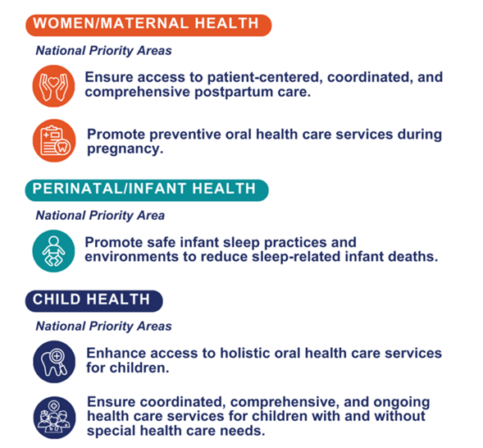
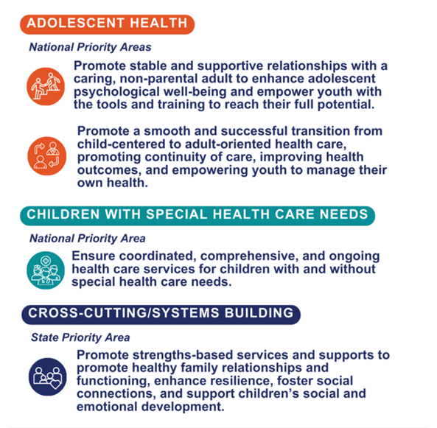
Missouri MCH State Action Plan
National and State Priorities

Slide 12
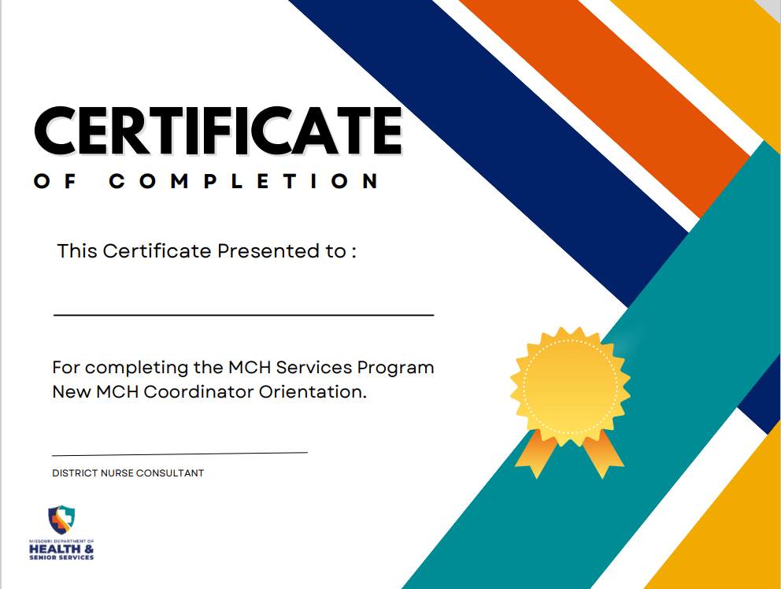
Who We Are
Scope of Work 5.7
The Contractor shall recruit and retain qualified public health professionals to assure a workforce that possesses the knowledge, skills and attitudes to meet unique MCH population needs. All Contractor employees, including subcontracted employees, supported with MCH Services contract funding shall complete designated MCH orientation and initial and ongoing MCH training requirements within required time frames as directed by the MCH Services Program Manager. Documentation of training completion shall be maintained on file and submitted as part of contract reporting..

Slide 13
Budget and
Funding Provisions
V

Slide 14
Funding Formula
MCH Services Contract
Component 1
Component 2
Component 3
Result
Combined Poverty Index Score determined for each county in Missouri by the Bureau of Vital Statistics
  Maternal-Infant Indicator (the unduplicated count of births to mothers younger than 18, infant and fetal deaths, and low birth weight births)
  (2) Female/Child Poverty Proportions (estimated population of women of childbearing age (15-44), males under age 18, and females under age 15 at 185% of the federal poverty level)
The base-funding amount of $15,000 is multiplied by 113 (# of LPHAs accepting the contract) and subtracted from the total funding amount for the contract
The difference is then multiplied by the Combined Poverty Index Score for each county and added to the base-funding
Total FFY Contract Award for each LPHA is determined
Notes:
Speak to the program receiving level-funding as a result of the state receiving level-funding.

Slide 15
Budget and Funding Provisions
MCH Services Contract
Funding for this contract is awarded for a one-year funding period only (October 1-September 30) and shall be expended during the applicable contract period.
Cost-reimbursement contract NOT fixed price contract.
The Contractor shall invoice and be reimbursed for actual and reasonable travel expenses either at the Contiguous US Per Diem Rates (CONUS) or the travel reimbursement rates set by the Contractor’s internal policy, whichever is lower.
Funds must be used to expand or enhance activities that improve the health of the maternal and child health population, and to address local maternal and child health issues.
Funding for this contract shall NOT be used for:
Cash payments to intended recipients of MCH services (cash, check, gift cards, gift certificates, etc.).
Purchase of land, buildings, or major medical equipment.
The purpose of performing, assisting, or encouraging abortion.
To directly, or indirectly, subsidize abortion services.
Payor of last resort.
Funding for this contract shall be used to expand or enhance activities that improve the health of the maternal and child health population, and to address local maternal and child health issues.
A minimum of 60% of contract funding MUST be spent on implementing the approved contract work plan to address the selected priority health issue(s).
The Contiguous US Per Diem Rates (CONUS) can be found by clicking on the link for “Per Diem Rates” at the following Internet address: http://www.gsa.gov .
A maximum of 40% of contract funding may be spent to expand or enhance other specific MCH initiatives/activities that improve the health of the maternal and child health population and address local maternal and child health issues.
Notes:
Appropriates funds to states and territories (59 in total)
Requires that the State’s Designated Health Agency administers the MCH Block Grant; hence why it comes out of Missouri DHSS
States must match every $4 of federal Title V money that they receive by at least $3 of non-federal dollars- has to be demonstrated during block grant reporting.
30-30-10: At least 30% of funds are used for primary and preventative care services for children; at least 30% of funds are used for children and youth with special health care needs (CYSHCN); no more than 10% towards administration. Administrative costs fall under Indirect costs are those things associated with management and oversight of any organization. These may include things such as utilities, rent, administrative salaries, financial staff salaries, and building maintenance. The Indirect Cost is built into your Invoicing Tool- with the maximum percentage to claim being 10%. It is important that you do not alter your invoicing tool so that it appropriately calculates the monthly indirect rate.
Contract funds must be expended with the contract year- October 1, 2025 through September 30, 2026.
Speak to cost-reimbursement – invoice for October should include expenses incurred in the month of October- incur means date the services was provided/charge occurred not necessarily the date it was paid out.

Slide 16
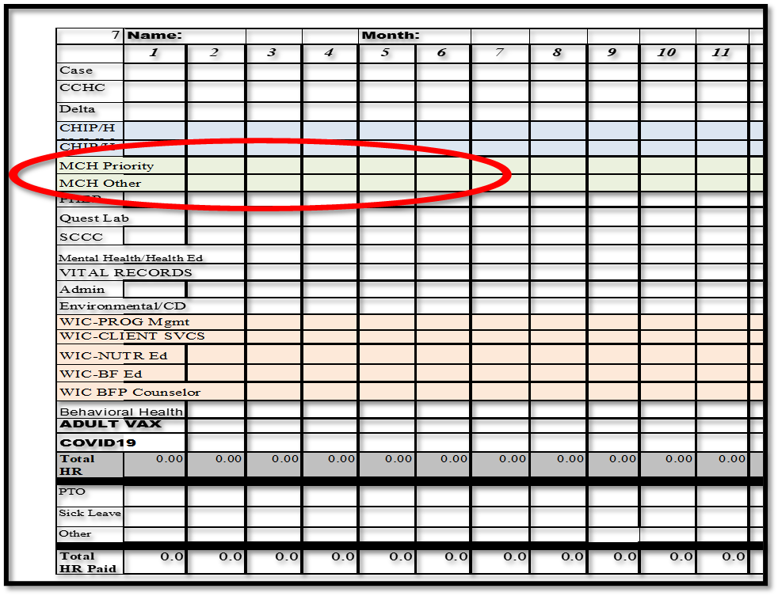
Time Accounting
MCH Services Contract
Time worked on the MCH Services contract should be delineated by hours worked toward the priority health issue and hours worked to expand or enhance other specific MCH initiatives
Is necessary for accurate cost allocation
Compliance and audit readiness
Responsible fund management
Example
Notes:
Speak to the 60/40 is not time worked and 60% of it invoiced to tab 1 and 40% of it invoiced to tab 2- that time should be accounted for accordingly.

Slide 17
Invoicing
and
Payment

Slide 18
Contract Invoicing
MCH Services Contract
Cost-reimbursement contract with monthly invoicing
Submit invoicing tool AND Vendor Request for Payment form via email by the 15th day of the month following the month in which services are provided/expenses incurred to mchservicesprogram@health.mo.gov
$0 Invoices
  If a specific month has $0 in expenditures, please send an invoicing tool and vendor request for payment form with an amount requested of $0
  If 100% of funding has been expended, you do not need to continue to send an invoicing tool and vendor request for payment form with a $0 request

Slide 19
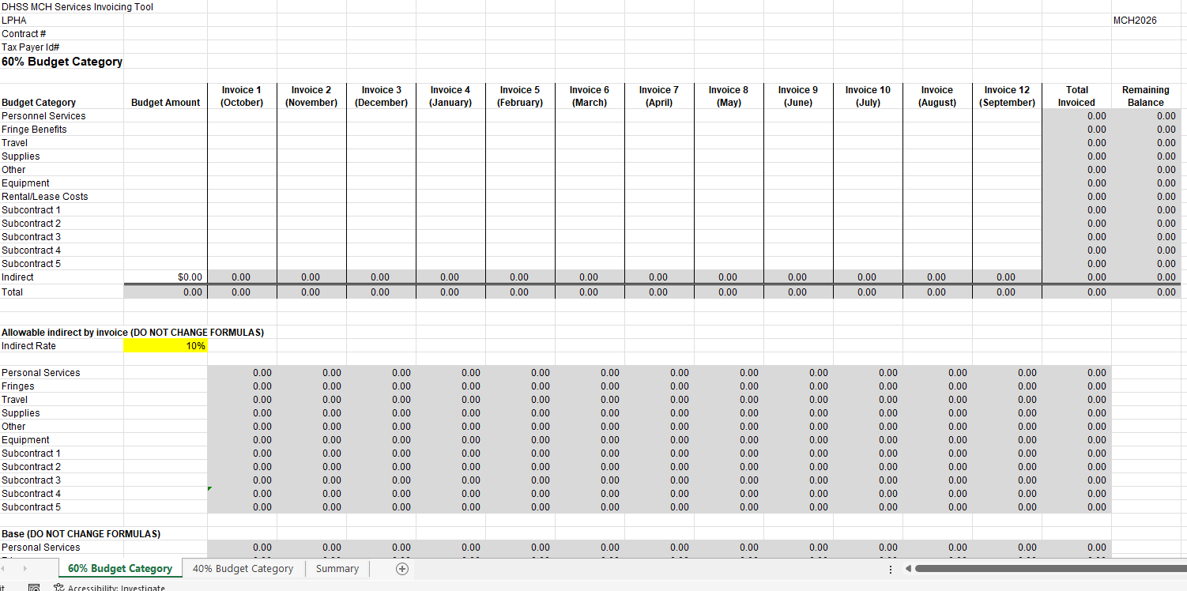

Slide 20
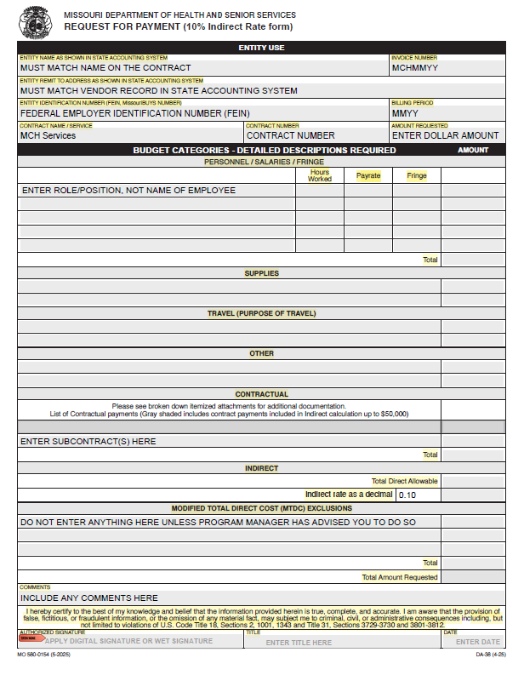
Vendor Request for Payment

Slide 21
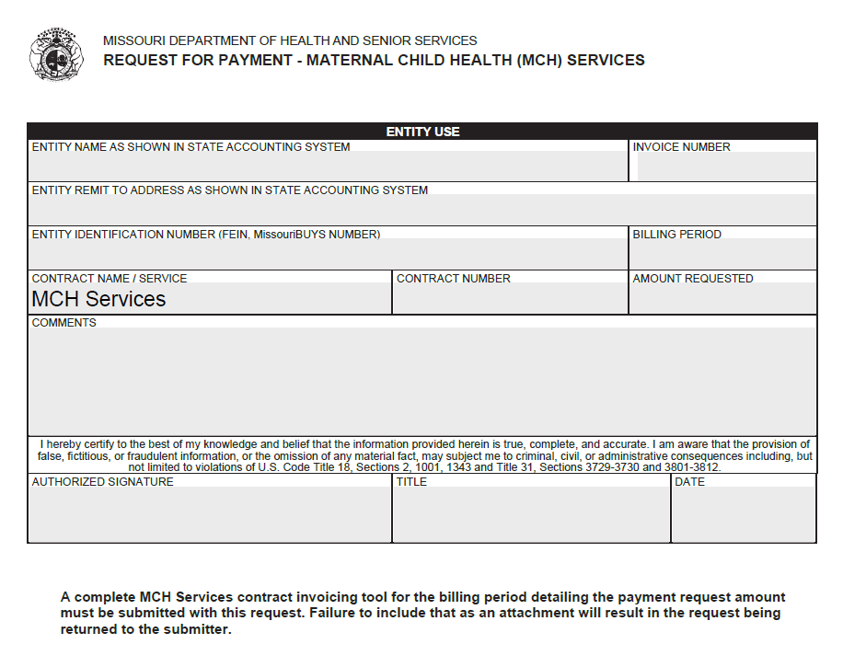
Vendor Request for Payment

Slide 22
Amendments and
Reports
V

Slide 23
Contract Amendments
MCH Services Contract
Budget vs. Work Plan
Budget
Budget
Work Plan
When In Doubt, Reach Out.
If reallocation exceeds 10% of the total contract award or you need to add or remove subcontracting, send a request via email to the Program Manager.
If reallocation falls within 10% of total contract award (cumulatively), you may use the same invoicing tool to reallocate on your own IF you already have approval for the expenditure(s) (if not, please email Program Manager).
Need to revise outcomes and/or activities.
Must be submitted by March 31st of contract year.
If you need to reallocate between the 60% and 40% budget categories, please work with Program Manager.
Submit request via email to DNC.

Slide 24
Contract Reporting
MCH Services Contract
Mid-Year Progress Report
Contract Outcomes Report and
End of Year Progress Report
Due last day of February
Activities completed and progress made from October 1 – January 31
Due October 31
Includes end-of-year progress report
Description of what has changed in the community as a result of addressing the selected priority health issue over the last five years
Conclusions

Slide 25

Quote Slide
“Doing the best at this moment puts you in the best place for the next moment.”
-Oprah Winfrey

Slide 26
Frequently Asked Questions
1
2
3
4
Do you provide training for all staff?
How long do I need to keep MCH Services contract
documents?
Is the Indirect rate on federal awards increasing to 15%?
Does the MCH Coordinator have to be a registered nurse?
NO
YES
3 years past the last activity/audit- whichever is later
The Title V MCH Block Grant has a restriction of 10% maximum indirect rate and the MCH Services contract will not change

Slide 27




QUESTIONS?
Sara.Gorman@health.mo.gov
573.522.2731
Health.Mo.Gov
This project is/was funded in part by the Missouri Department of Health and Senior Services Title V Maternal Child Health Services Block Grant and is/was supported by the Health Resources Services Administration (HRSA) of the U.S. Department of Health and Human Services (HHS) under grant #B04MC52935, Maternal and Child Health Services for $12,742,189, of which $0 is from non-governmental sources. This information or content and conclusions are those of the author and should not be construed as the official position or policy of, nor should any endorsements be inferred by HRSA, HHS or the U.S. Government.

