Slide 1


Title slide
WIC.Mo.Gov
Health.Mo.Gov

Slide 2
LPHA All-In Meeting
        WIC Contracts, Budgets and Claims

Slide 3

Points of interest
WIC Local Agency Portal.
Onboarding guides.
WIC federal funding allocations.
LA budget process.
In-kind reimbursement.
Reimbursed vs. in-kind remaining.
WebGrants.

Slide 4
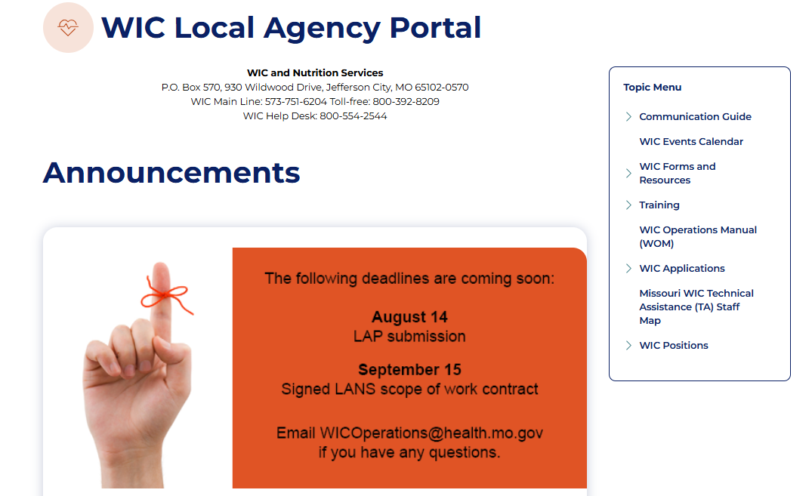
WIC Local Agency Portal
Notes:
Link to the portal in title

Slide 5
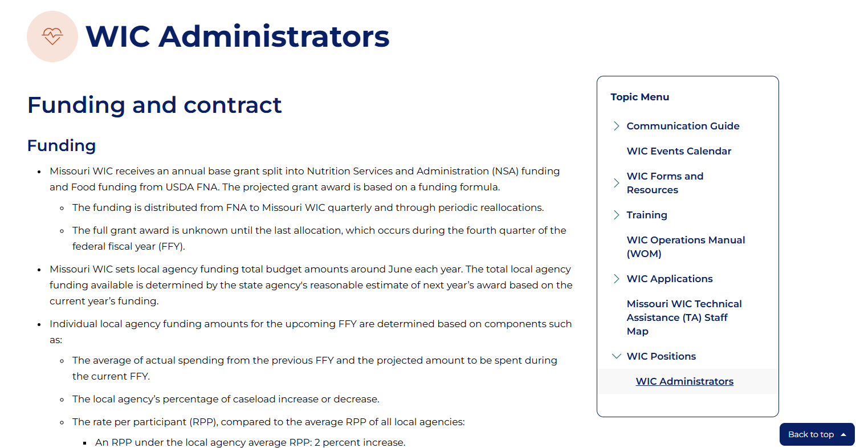
Onboarding guides
Notes:
Link to the WIC administrator’s guide in title

Slide 6
WIC federal funding allocations
Operational adjustment priorities
Request-based reallocation opportunities
Quarter 1
Oct-Dec
Quarter 2
Jan-Mar
Quarter 3
Apr-Jun
Quarter 4
Jul-Sep
August
Quarter 2 allocation:
1/4 in Jan
January reallocation
Quarter 3 allocation:
1/4 in April
April reallocation
and
Quarter 4 allocation:
1/4 in July
July reallocation
FFY annual appropriation and quarter 1 allocation:
1/3 in Oct
Build a funding formula for next year

Slide 7
LA budget process
Step 01
Step 02
Step 03
Step 04
Average the prior year’s budget and the current year’s projected budget.
Calculate the April 1 to March 31 actual annual caseload.
Use the RPP to apply a tiered budget adjustment.
Cap LA budgets at $50 RPP.
Notes:
Last 2 years average used
April 1 to March 31 actual caseload used because the budget calculations begin April 1
A separate column is used to see if there is a difference between what we are giving an LA and what the amount would be if each LA was given a $22 flat rate
Using the actual caseload from step 2, if the RPP is < $25, add 2 percent; if the RPP is > $25, add .05 percent.
No in-kind is reimbursed over $50 RPP

Slide 8
In-kind reimbursement
WIC expenses above the initial budget
LAs document all allowable WIC program costs.
  If the cost is covered by the initial budget, it is claimed as an expense.
  If the cost is paid from a non-WIC source or not in the original budget, it is documented as in-kind in the claim.
If additional federal funds are received, the SA may reimburse weighted portions of approved, documented, necessary WIC-allowable in-kind expenditures paid by non-WIC sources.
The in-kind reimbursement process is initiated by the SA. No contract amendment is required.

Slide 9
WIC expenses reimbursed vs. in-kind remaining
Notes:
Through 2018, budgets were set at a standard rate per participant. This was not ideal, as local agency per-participant expenses vary due to individual factors. In 2018, local agencies reported almost $2.5 million in unreimbursed (i.e., in-kind) WIC expenses. There was no mechanism in place to expediently reallocate administrative funding to the local agencies, so federal funding lapsed and was returned.
In 2019, local agencies submitted projected budgets, including all WIC expenses. The RPP was increased, though the initial local agency budgets didn’t cover all anticipated expenses. An area was included in the invoicing system to track WIC-allowable in-kind expenses incurred. A process was established to allow the state agency to increase initial budgets to reimburse in-kind expenditures without amending the contract if additional federal funding became available due to lower state administrative costs or reallocation of federal funds.
Now, local agency budgets for the upcoming federal fiscal year are calculated based on an average of the local agency’s previous two years’ ongoing expenses. Capital improvement and other large one-time expenses from previous years are not considered in the calculations. A per-participant rate limit is set for ongoing expenses and is considered when reimbursing in-kind expenses.

Slide 10
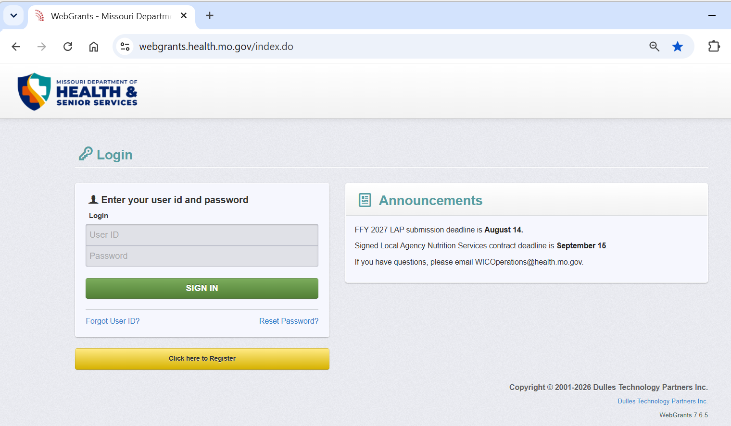
Photo Slide
Notes:
WebGrants link in picture

Slide 11



Questions?
WICOperations@health.mo.gov
WIC.Mo.Gov

Slide 12

Closing slide

