Slide 1

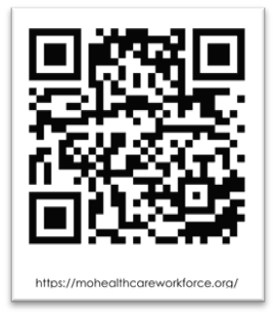

Informing Public Health Policy
Understanding Workforce Characteristics
| October/November 2025|
LPHA Regional Meetings
Notes:
First, I want to thank you for having us here today to discuss our Missouri Health Care Workforce Project.
Our presentation is purposefully titled ……
Our innovations in health care workforce analysis includes exciting developments such as integrating additional administrative data sources into our process of collecting and analyzing data on the workforce.
We are innovative in the type of Workforce Data Warehouse we are building with recent annual and monthly data pulls and we are excited to discuss these innovations with you.
Our work strives to build platforms in understanding the workforce characteristics so we can inform health policy.
We present, communicate, elucidate, and publish findings.
We developed web-based indicator dashboards utilized by those interested in or invested in understanding the workforce. Developed sophisticated cross-walks between minimum data sets across professions/occupations. Erudite
Thank you for being here today and let’s talk about the Missouri Health Care Workforce Project.

Slide 2
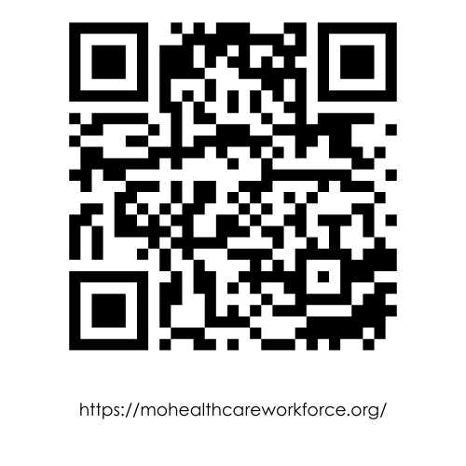
Mission
What?
Missouri Health Care Workforce Project
MU Center for Health (CHP) Policy:
Promote well-being and access to health care for all Missourians, particularly those with the greatest need.
Missouri Health Care Workforce Project (MHCWP):
Collect, analyze, and report data on Missouri’s health care workforce. Our work enables policymakers to make data-driven decisions and advocate for a robust health care workforce.
mohealthcareworkforce.org
Notes:
Our work is reliant on knowledge that provides us with:
Understanding and monitoring longitudinal trends in supply and distribution of healthcare professionals
Informing healthcare workforce policymakers and advocacy organizations (such as DHSS, MPCA, MHA)
Informing training programs that will determine quantity and distribution of healthcare professionals
Identify emerging healthcare workforce issues
Answering specific questions such as:
How many practicing licensed health care professionals such as physicians and nurses are there in Missouri? Where are they practicing? What are their experiences? What populations do they serve? Do they plan to continue practicing?
Where are the shortages and distribution or maldistribution if you will.
Will Missouri’s supply of dentists keep pace with projected population growth?
How many health professions trained in Missouri are retained?
Types and Conditions of services and questions of access and population health

Slide 3
Disclosures - Funding - Support
How?
2007
2008-2014
2014-2016
2017-2018
2019-2020
2027
2021-2022
2023-2027
MU School of Medicine ($)
MU Extension (In-kind)
Missouri Department of Commerce & Insurance
Missouri Division of Professional Registration
Missouri Department of Health & Senior Services (CDC PHIG)
Missouri Hospital Association
Health Forward
(Health Care Foundation of Greater Kansas City)
HRSA
Medical Student Education Program (MSEP)
The authors declare that there are no conflicts of interest, financial or otherwise, relevant to the content of this presentation.
“This work is supported by funds made available from the Centers for Disease Control and Prevention (CDC) of the U.S. Department of Health and Human Services (HHS), National Center for STLT Public Health Infrastructure and Workforce, through OE22-2203: Strengthening U.S. Public Health Infrastructure, Workforce, and Data Systems grant. The contents are those of the author(s) and do not necessarily represent the official views of, nor an endorsement, by CDC/HHS, or the U.S. Government.”

Slide 4
Missouri Health Care Workforce Project
Value
Value Proposition:
Policymakers, health system leaders,
workforce strategic planners, educators, and researchers
use its interactive dashboards and reports to identify
workforce shortages, allocate resources, monitor trends, and
advocate for policy interventions — enabling
data-driven decision-making to build a stronger
health care system for all Missourians.
Notes:
Evidence-based decision-making: Instead of relying on anecdote or outdated data, decision-makers have current metrics.
Efficiency & targeting: Helps target resources (funding, workforce incentives, training) to the places and professions that need them most.
Equity: Highlights geographic, demographic, or facility access inequalities so interventions can be designed to reduce disparities.
Forecasting and prevention of crisis: By monitoring trends (e.g. aging workforce, retirements), it lets the state anticipate shortages before they become severe.
Accountability & transparency: Publicly accessible dashboards provide measurable data for tracking progress and holding agencies/institutions responsible.

Slide 5
Center for Health Policy
Advancing Health Outcomes & Population Health
Community
Impacts
CHP responds to emerging health care issues through:
  Objective analysis, education, and strategic communication
  Inclusive engagement with stakeholders across Missouri
Key Focus Areas:
  Enhance MO HealthNet quality and efficiency
  Promote health literacy and reduce disparities
  Strengthen Missouri’s health care workforce
  Expand insurance coverage (public & private)
  Improve rural & urban access via telehealth (e.g., Show-Me ECHO)
  Address childhood obesity through community initiatives

Slide 6



Slide 7
Identify How We Can Help You
Understand Accessible Key Resources, Accomplishments, and Data Collection Process.
How we use findings to help you advocate for a robust health care workforce.
Discuss collaboration and partnership engagement.
Demonstrate interactive webtools on the Missouri Health Care Workforce Project webpage.

Slide 8
Data Collection/Analysis & Policy Engagement
Identify Policy Question(s) and Engagement
Identify data collection/analysis needed to address policy question(s)
Collect data from applicable federal and state sources
Merge and verify data using secure, sophisticated methods
Analyze workforce characteristics and trends
Develop/expand interactive dashboards-inform health policy
Publish findings to support
data-driven decision-making
Build/Maintain Missouri’s Health Care Workforce Data Repository
Empower policymakers' and strategic planners with actionable insights
Influence health care workforce policies across Missouri

Slide 9
Missouri Health Care Workforce Analysis
Current Projects
Maternal Child Health & Obstetrics Workforce:
(pregnancy support providers)
School Health Services Workforce
Long-Term Care Workforce
Trauma Centers
Population Health
Public Health Professional Workforce
Dental Workforce:
(Dentist, Dental Hygienist,
Dental Assistant)
Nursing Workforce:
(LPN, RN, APRN, DNP)
Physician Workforce:
(MD/DO/all specialties)

Slide 10
Addressing Workforce Policy Questions
Forecasting Future Needs: Workforce trend analysis enables data-driven predictions to guide strategic planning and policy development.
Identifying Gaps: Highlights employment trends and skill shortages to inform training and resource allocation.
Improving Access: Reveals workforce distribution across settings, helping target underserved areas and improve services.
Supporting Policy Action: Empowers policymakers to design responsive programs and anticipate emerging challenges.

Slide 11
  Use-Inspired Workforce Policy Questions
Listen - Develop
Analysis - Inform
  Collaborating with policymakers and partners to
    Identify the policy questions to make data driven decisions and
    Develop MDSs for professions/occupations not addressed by HRSA.
  Collecting workforce data from administrative sources and use agreements to
    Identify the workforce and
    Develop cross-walks between MDS across professions for comparability.
  Conducting analysis of the workforce data to
    Identify emerging workforce issues; current and projected trends,
    Develop aggregate relevant research publishing findings, policy analysis.
  Informing policymakers to
    Answer policy and research questions for policy/program planning.

Slide 12

Partnering to find solutions that improve lives
The goal is to develop interdisciplinary projects also involving faculty and students to address the challenges Missourians face in economic development, education, and health.

Slide 13
Partnership Participation
MO Area Health Education Centers
MO Hospital Association
MO Academy of Family Physicians
MO Primary Care Association
MO Nurses Association
MO Optometric Association
MO Rural Health Association
MO Credentialing Board
MO Dental Association
St. Louis University
Health Forward Foundation
Federation Physical Therapy State Boards
MO Public Health Association
MO Dental Association
MO Dental Hygienist Association
American Dental Association
American Medical Association
Health Resources Admin Services Association
Cecil G. Scheps Center for Health Services Research
MO Office of the Governor
National Governor’s Association
MO Department of Social Services
MO HealthNet Division
MO Department of Health/Senior Services
MO Division of Professional Registration
MO Board of Nursing
MO Dept Higher Ed/Workforce Development
MO Department of Mental Health
University of Missouri-Columbia
University of Missouri-Kansas City
National Rural Health Association
Missouri League of Nursing
National State Forum Nursing Workforce Centers
American Public Health Association
Notes:
This slide represents the groups that have been active in our collaborations and Advisory Group since the beginning of the healthcare workforce project. Most of these groups remain active. In addition to relying on evidence-based practices, we rely heavily on our partnerships and policymakers to inform our decisions as they relate to specific healthcare professions and to the specific needs of Missourians.

Slide 14
Missouri Workforce Analysis Framework
What About the Workforce?
Who?
Where?
What?
Workforce Composition/Characteristics | Practice & Service Delivery
What comprises the workforce? Who are they? Where are they located? | What are they doing in their practice? What are they experiencing? Current roles, responsibilities, and challenges faced in practice.
Workforce Structure Demographic overview (including age, gender, race/ethnicity) | Areas of practice Types of services provided, populations served, and community engagement.
Education & training Educational pathways, credentials, certifications, professional development. | Practice Characteristics Scope of practice, employment settings, and services.
Geographical distribution/characteristics Location-based workforce density and its impact on service accessibility and quality. | Work Environment & Future Plans Retirement trends, workforce transitions, and succession planning.
Why? | To address workforce policy questions
Notes:
We want to know the characteristics of the workforce, who they are, how they were trained, and where they are practicing.
By mapping where health care and public health practitioners and professionals graduated; where trained; their current practice characteristics we can provide analysis on the current workforce and track and trend trajectory from initial practice characteristics to current and how they move around from here.
By trending their trajectory, we can start to understand their employment changes in locations, settings, and specialties. We want to understand their career changes but also many practitioners, especially the physician workforce, are trained and licensed with multiple specialties and understanding how and when practitioners become specialists and how they practice under those specialties helps us understand the service provided and population needs.

Slide 15
Purpose of Work
To inform and guide workforce policy decisions by understanding:
Who comprises the workforce
What services they provide and where
How education and training shape their roles
What challenges and transitions they face
Notes:
We want to know the characteristics of the workforce, who they are, how they were trained, and where they are practicing.
By mapping where health care and public health practitioners and professionals graduated; where trained; their current practice characteristics we can provide analysis on the current workforce and track and trend trajectory from initial practice characteristics to current and how they move around from here.
By trending their trajectory, we can start to understand their employment changes in locations, settings, and specialties. We want to understand their career changes but also many practitioners, especially the physician workforce, are trained and licensed with multiple specialties and understanding how and when practitioners become specialists and how they practice under those specialties helps us understand the service provided and population needs.

Slide 16
  Model for Workforce Data Collection
Minimum Data Sets (MDS)
  Adapted From:
    HRSA – Bureau of Health Workforce Explore Health Workforce Data Policy | Bureau of Health Workforce
  HWTAC - Health Workforce Technical Assistance Center
Collaborative Development:
Developed with input from national boards and associations
Tailored to each profession’s standards and terminology
Supports consistent, comparable workforce data across sectors
https://bhw.hrsa.gov/data-research/explore-health-workforce-data-policy

Slide 17
  Federal Recommended MDS Models - developed with each applicable professional association/board association
HRSA Aligned MDS Model
Nurses:
National Council of State Boards Nursing, Forum State Nursing Workforce Centers
HRSA - Developed MDS
Physicians:
(allopathic and osteopathic) Federation of State Medical Boards
Physical Therapists:
American Physical Therapy Association, Fed State Boards Physical Therapy
Psychologists:
Association of State and Provincial Psychology Boards
Physician Assistants (PA):
nccPA Health Foundation, National Commission on Certification of PAs
Occupational Therapists:
National Board for Certification in Occupational Therapy
Occupational Therapist
Licensed Professional Counselors:
National Board for Certified Counselors, Inc. and Affiliates
Pharmacists:
American Association Colleges of Pharmacy, National Association Boards of Pharmacy
Pharmacist
Dental Hygienists:
American Dental Hygienists' Association
Substance Abuse/Addiction Counselors:
International Certification & Reciprocity Consortium, NAADAC, Association Addiction Professional Substance Abuse/Addiction

Slide 18
  Missouri Minimum Data Set (MDS) Model
  Includes More Professionals
HRSA Aligned MDS Model
Acupuncturist
Anesthesiologist Assistant
Applied Behavior Analyst / ABA Assistant
Assistant Physician
Athletic Trainer
Audiologist / Audiologist Assistant
Chiropractor
Community Health Worker
Dentist / Dental Specialist
Marriage and Family Therapist
Massage Therapist
Mental / Behavioral Health
Credentials
Occupational Therapist Assistant
Optometrist
Perfusionist
Pharmacy Technician
Podiatrist
Registered Dietitian
Respiratory Therapist
Social Worker
Speech-Language Pathologist / SLP Assistant

Slide 19
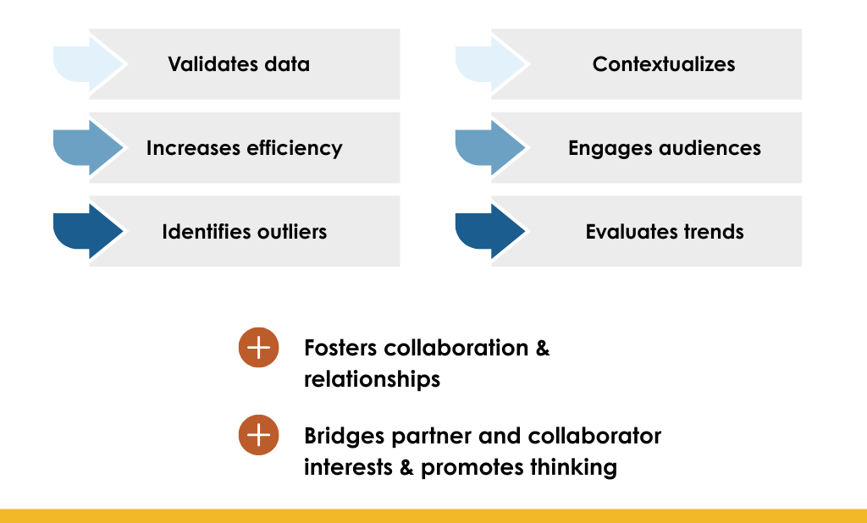
Value of a Multi-Faceted Approach

Slide 20
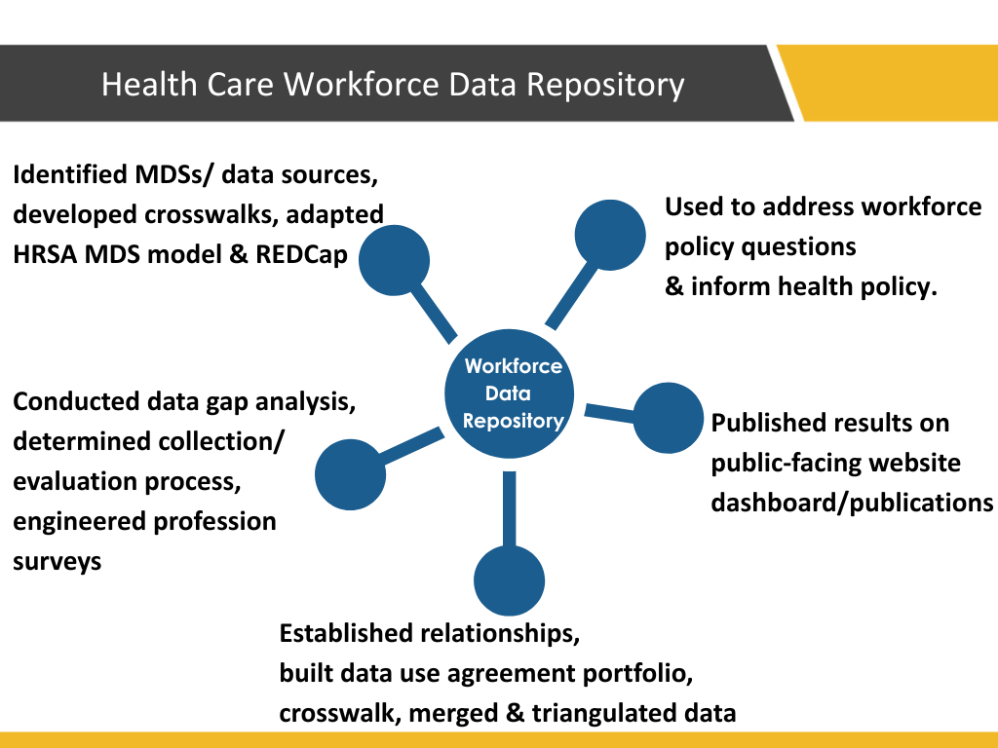
Serve as Data
Warehouse
Health Care Workforce Data Repository
Notes:
Not linear – more like satellites
Developed cross-walks between MDS across professions/occupations to ensure comparability.

Slide 21
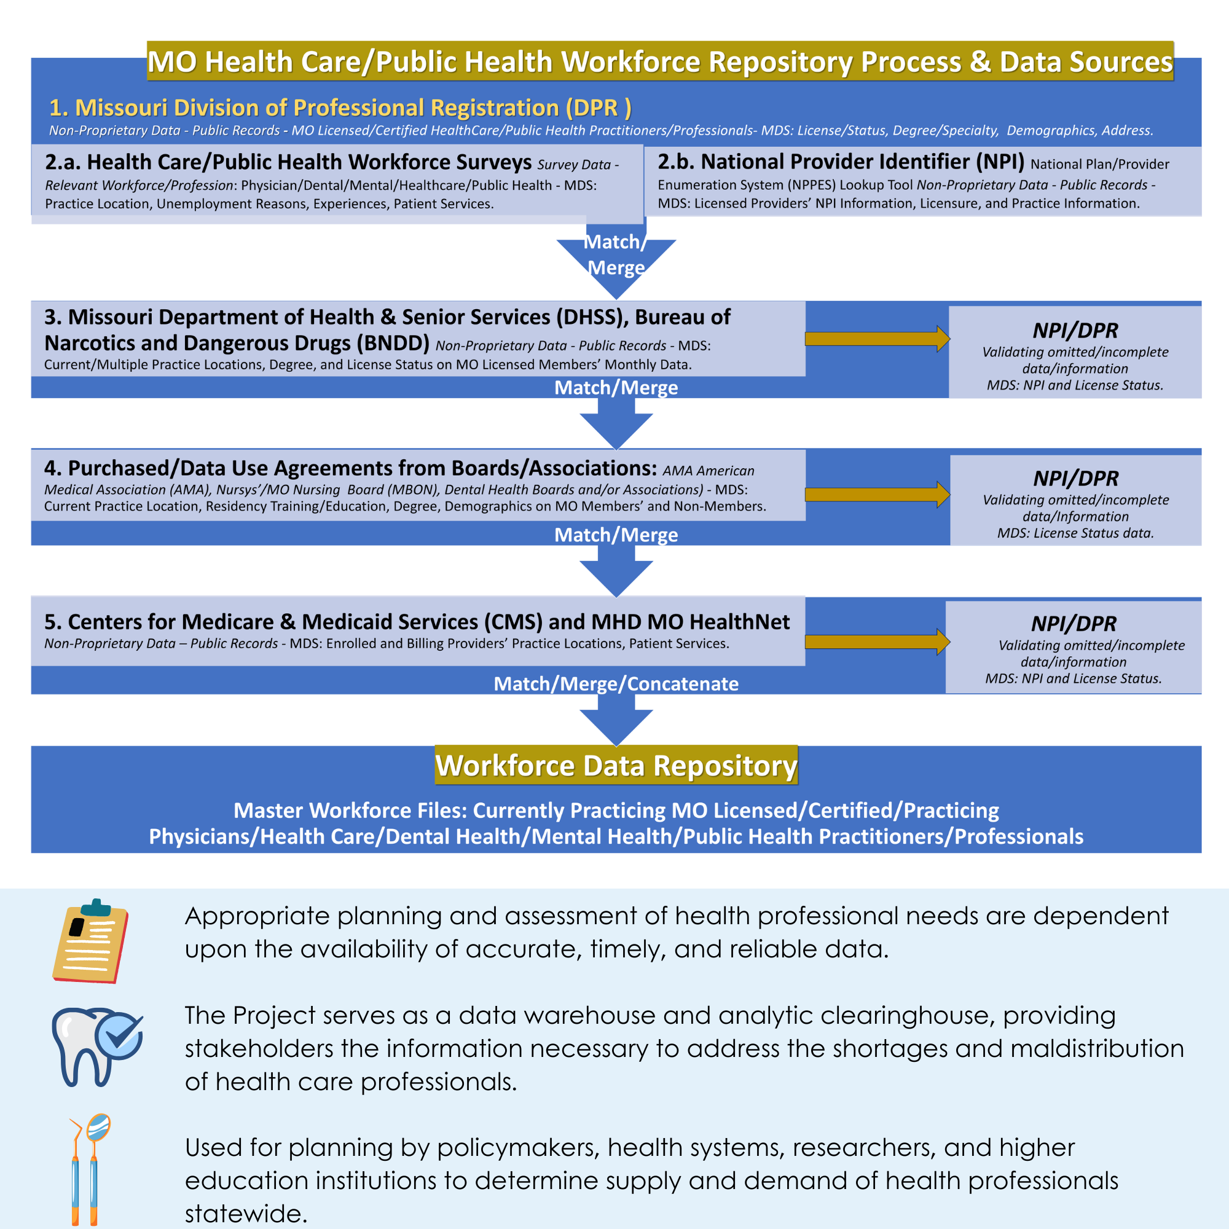
Missouri Health Care Workforce Project Partnership
Notes:
Sara
Slide data repository – describe utilizing administrative data and through data agreements data repository

Slide 22
Data Modernization Efforts
Integrating nonproprietary data ADA, MHD, CMS:
to improve workforce tracking and validation.
Accelerating data integration:
to improve workforce planning and real-time tracking.
Distinguish active MO license:
licensed/not practicing
from
licensed/practicing.

Slide 23
Publications
(What?)
Missouri Health Care Workforce Project
CHP maintains effective relationships with many valuable entities resulting in data-driven quantitative and qualitative evidenced-based:
          Indicator Dashboards | Missouri Health Care Workforce Project (mohealthcareworkforce.org)
          Publications | Missouri Health Care Workforce Project (mohealthcareworkforce.org)

Slide 24
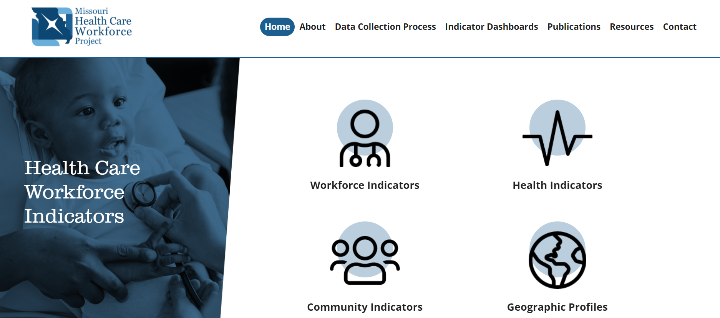

Utilizing Interactive Web Tools https://mohealthcareworkforce.org/
Home Page
Notes:
Our Home Page has a scroll bar at the bottom when selected/clicked it will populate this page– (click)
We are supporting policymakers and planners in understanding the current status and future trends of the healthcare workforce at the state, regional, and local levels.

Slide 25
Workforce Indicator Dashboards
Information Management Interactive Tool
Health Care Professionals/
Practitioners
MISSOURI HEALTH CARE WORKFORCE PROJECT WEBAPP
Physicians
Primary Care Physicians
Specialty Care Physicians
Nursing
Dental
Allied & Other Health Professions
Mental & Behavioral Health
Complementary Medicine
Notes:
This shows a list of the Workforce Indicator Dashboards. We built Tableau dashboards featuring Workforce, Health, and Community indicators. Geographic profiles show all selected indicators for a specific group of geographies.​
Indicators cover Demographic, Economic, and Education areas.

Slide 26
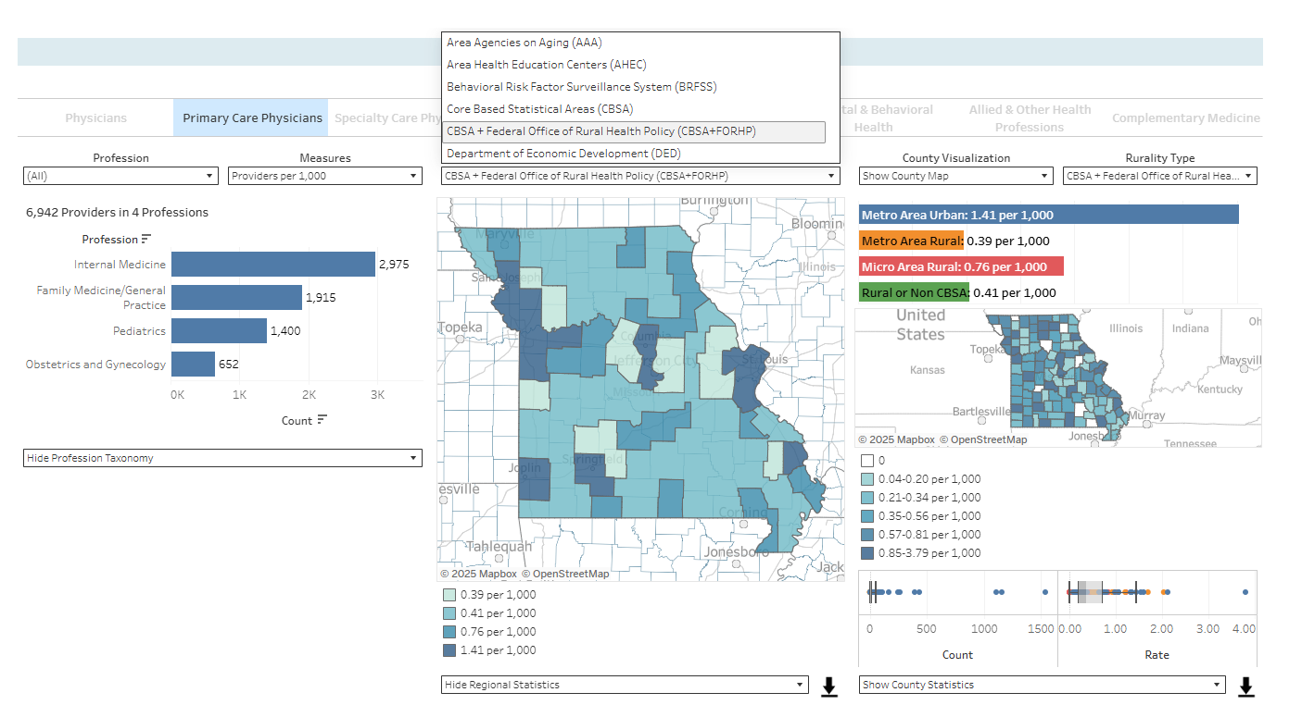
Indicator Dashboards
Primary Care

Slide 27
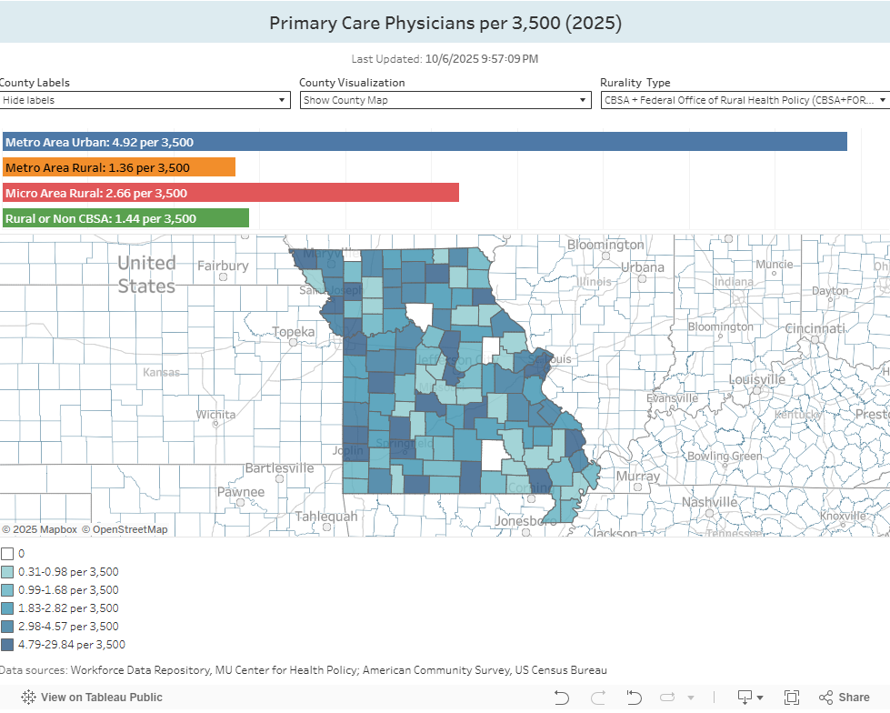

Slide 28
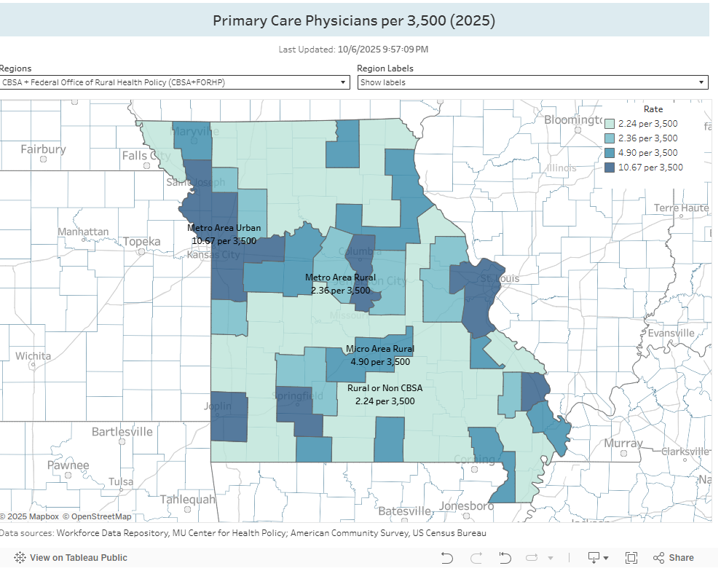
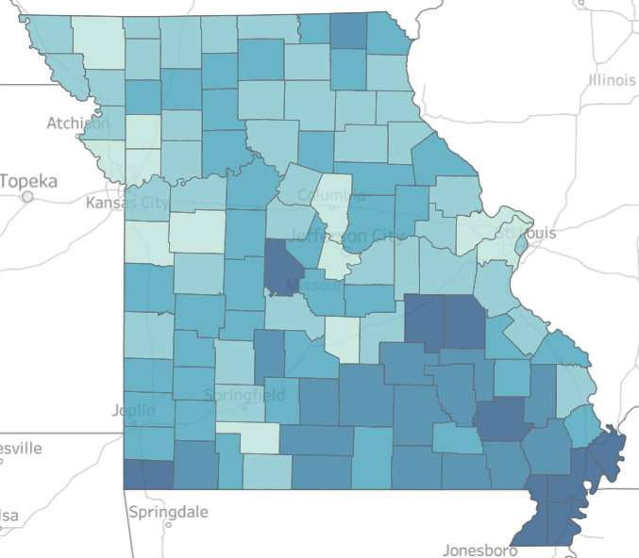
Workforce Indicator Dashboard
Physician Dashboard
Notes:
Screenshot of Tableau Workforce dashboard.
Data derived from publicly available licensure data from Division of Professional Registration AMA, BNDD, MHD, CMS.
All data is colored and scaled as Rate per 10kk for easy comparison between regions.
Healthcare Providers are grouped together, can select a single provider group and/or select individual providers types.
Select by region type - includes county, Area Health Education Centers, Behavioral Risk Factor Surveillance System and others. Region types were suggested by input from the advisory committee .
Tree map shows distribution of selected providers across the state or selected region.

Slide 29
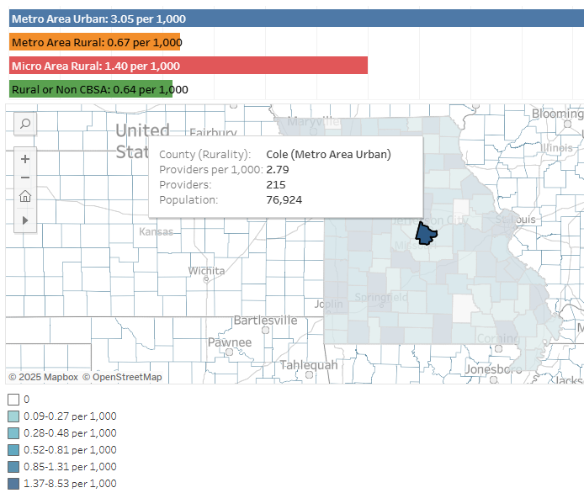
Primary Care
Notes:
Screenshot of Tableau Workforce dashboard.
Data derived from publicly available licensure data from Division of Professional Registration AMA, BNDD, MHD, CMS.
All data is colored and scaled as Rate per 10kk for easy comparison between regions.
Healthcare Providers are grouped together, can select a single provider group and/or select individual providers types.
Select by region type - includes county, Area Health Education Centers, Behavioral Risk Factor Surveillance System and others. Region types were suggested by input from the advisory committee .
Tree map shows distribution of selected providers across the state or selected region.

Slide 30
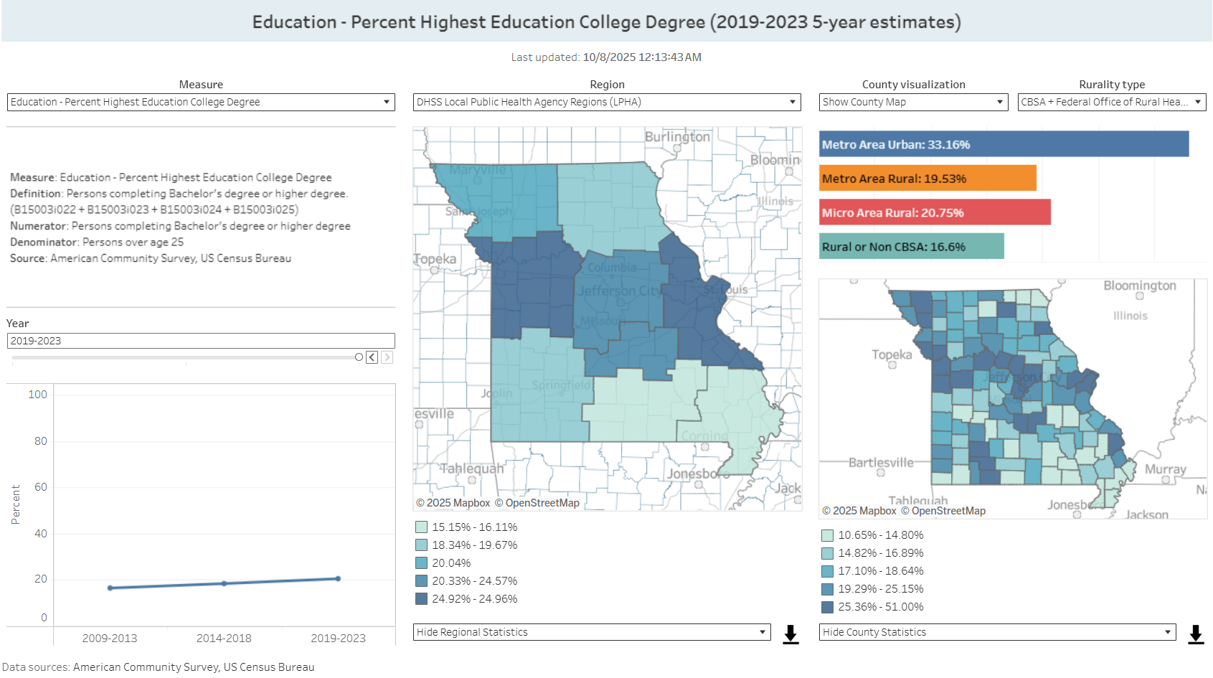
Community Indicators Dashboard
MISSOURI HEALTH CARE WORKFORCE PROJECT WEBAPP
Notes:
Community Indicator dashboard
Indicators cover Demographic, Economic, and Education areas.
Sourced from ACS (American Community Survey)
Community and Health indicators provides population health context to the Workforce data.

Slide 31
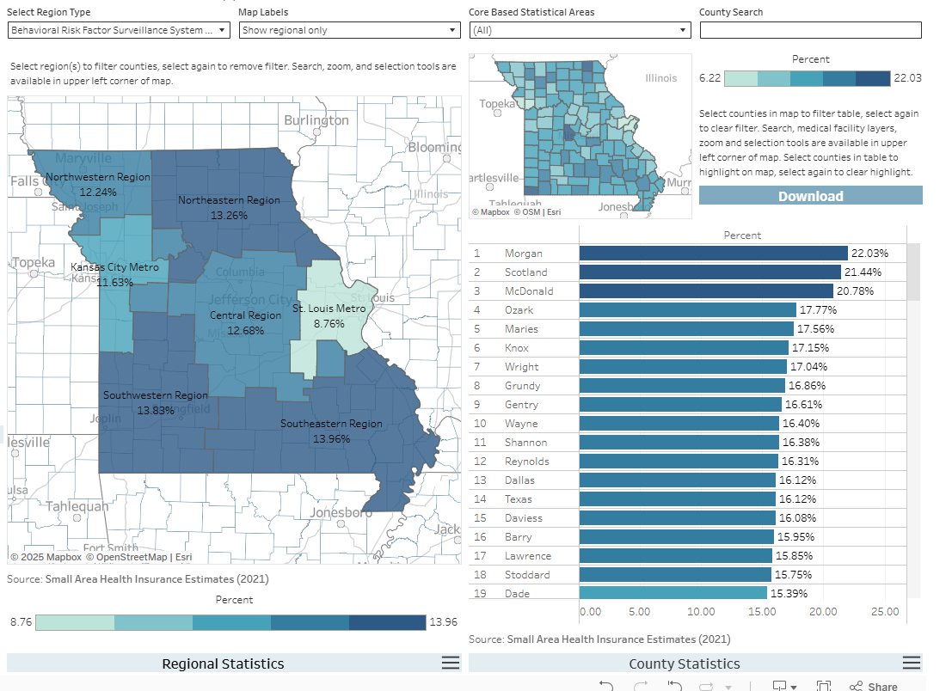
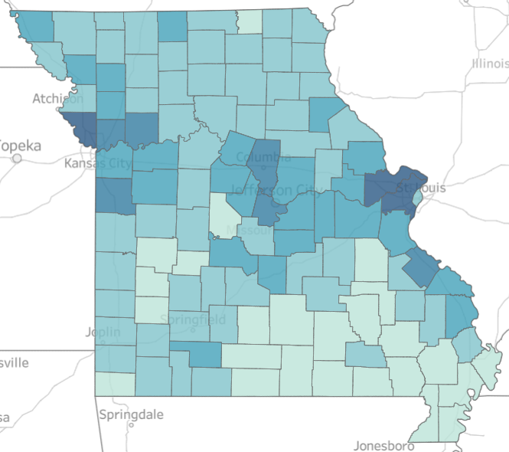
Health Indicators Dashboard
Notes:
Community and Health indicators provides population health context to the Workforce data.
Indicators cover Health Perceptions, Health Risks, and Health Status areas.
Sourced from MODHSS, Missouri County-Level Study/Behavioral Risk Factor Surveillance System, MOPHIMS (Missouri Public Health Information Management System), and SAHIE (Small Area Health Insurance Estimates)
The Health Indicators Dashboard Provides population health context to the workforce data.

Slide 32
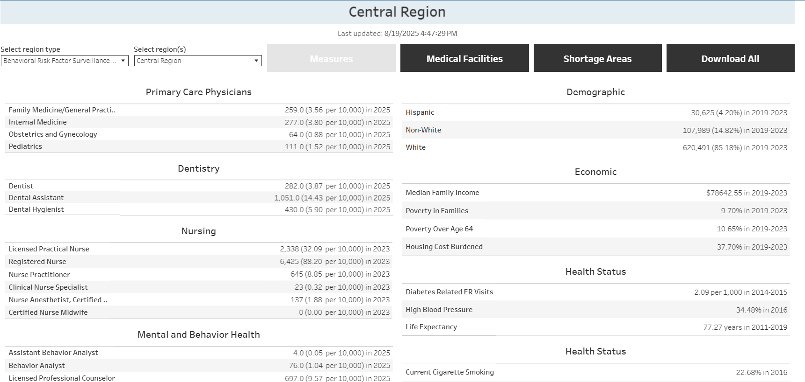
Geographic Profiles
Notes:
Geographic profiles show all selected indicators for a specific group of geographies.​
Indicators cover Demographic, Economic, and Education areas.
You can view a collection of all indicators from Workforce, Community, and Health domains for selected regions. And the Titles are links to specific dashboards.
Community and Health indicators provides population health context to the Workforce data.

Slide 33
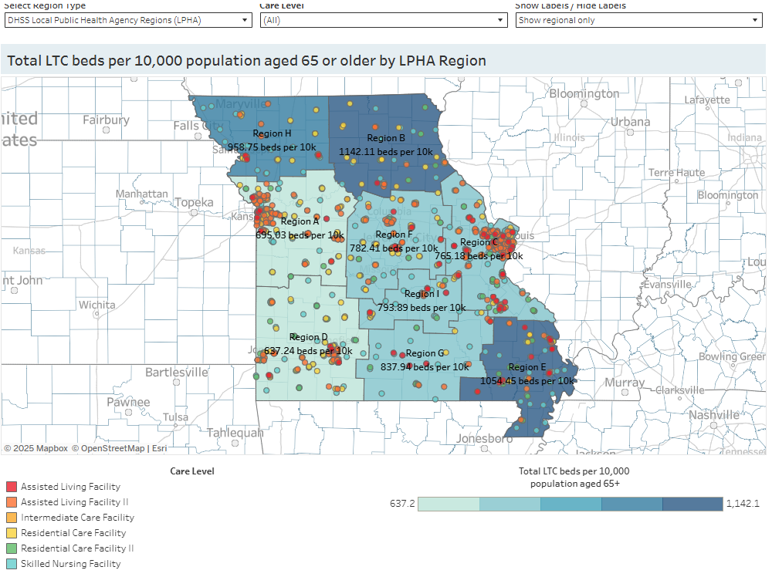
Medical Facilities Dashboard
MISSOURI HEALTH CARE WORKFORCE PROJECT WEBAPP
Notes:
The medical facilities dashboard includes Missouri’s Hospitals, Long Term Care Facilities, Federally Qualified Health Centers, and Rural Health Clinics, and including Emergency Hospitals and Critical Access Hospitals
You will notice that it shows the total beds per 10k population and the
LTC – total beds per 10k total population ages 65+ years by Care Level
FQHC – total number per 100,000 total population
RHC – total number per 100,000 total population
Data Sources include MSDIS (Missouri Spatial Data Information Service) GIS layers and Missouri DHSS (Missouri Department of Health and Senior Services)

Slide 34
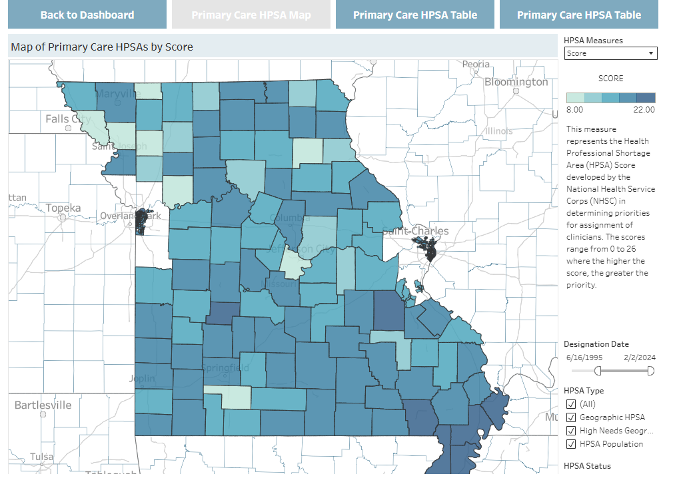
Health Professional Shortage Areas
MISSOURI HEALTH CARE WORKFORCE PROJECT WEBAPP
Notes:
These HPSA dashboards are from the HRSA HPSA designations, and you can view by Mental Health, Dental Health and Primary Care and view by shortage type Geographic, facility and low-income population. This provides context to the workforce data to understand the federally designated shortage areas, and the population health needs for those communities.

Slide 35
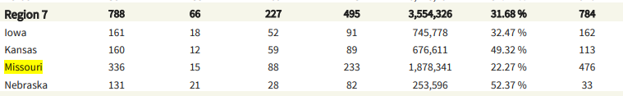
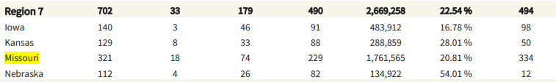
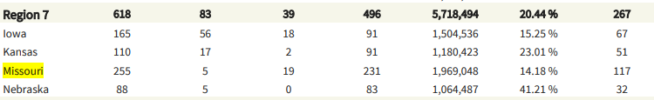
Health Professional Shortage Areas
MISSOURI HEALTH CARE WORKFORCE PROJECT WEBAPP
Notes:
These HPSA dashboards are from the HRSA HPSA designations, and you can view by Mental Health, Dental Health and Primary Care and view by shortage type Geographic, facility and low-income population. This provides context to the workforce data to understand the federally designated shortage areas, and the population health needs for those communities.

Slide 36
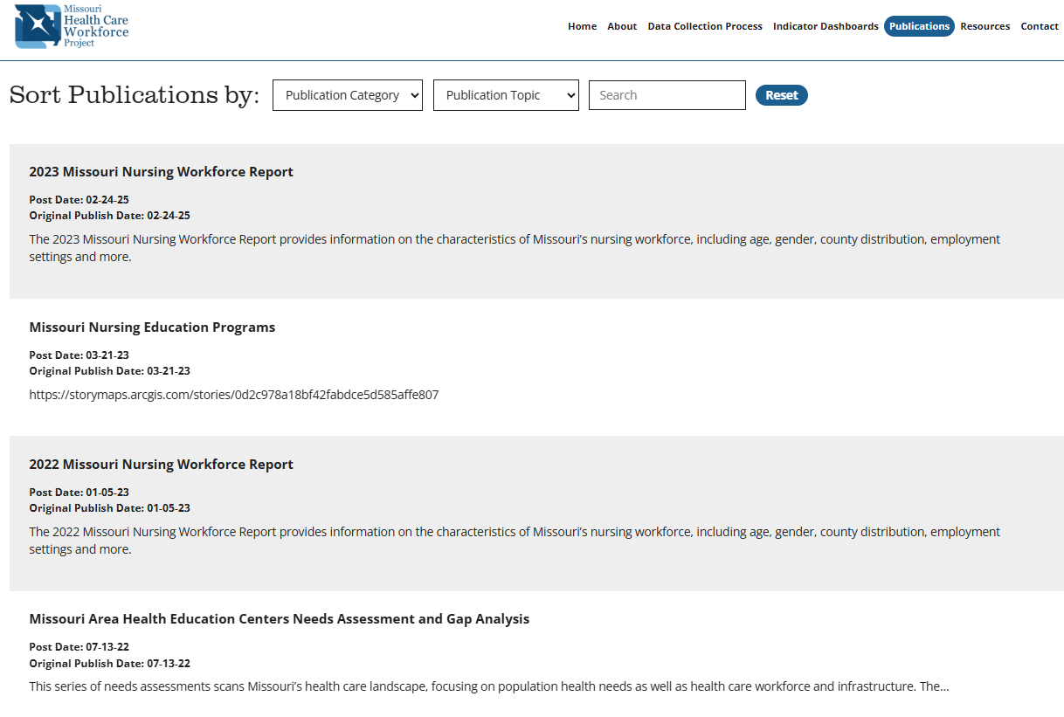
Publications
MISSOURI HEALTH CARE WORKFORCE PROJECT WEBAPP
Notes:
Publications are a listing of all internal reports (analytical reports, story maps) that are produced by the MHCWF project for dissemination to the public. These can be sorted by category or type (reports, story maps) and/or topic (nursing, physical therapy).

Slide 37
MHCWP Accomplishments
Developed MDS Model and Expanded Partnerships
Security Compliant Data Management Software
Launched Public-Facing Website, Dashboards, Aggregated Research and Publications
Modelled after HRSA. Developed MDS administrative resources and surveys for professions/occupations not currently addressed by HRSA.
Developed Workforce Data Repository
Developed cross-walks between MDS across professions/occupations to ensure comparability.
Ensured the safety and privacy of the data as well as the affordability and sustainability of the project.
Answering policy and research questions through partner collaborations and publications.

Slide 38


Public Health Workforce Interest and Needs
Survey (PH WINS) - https://www.phwins.org/dashboard
https://debeaumont.org/news/2025/ph-wins-2024-findings-and-tools-for-action/

Slide 39
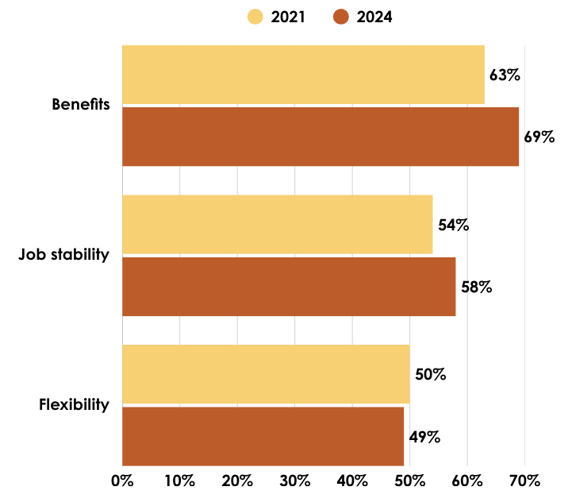
PHWINS- Top Reason for Staying
Staying for the Benefits Leaving for the Pay

Slide 40
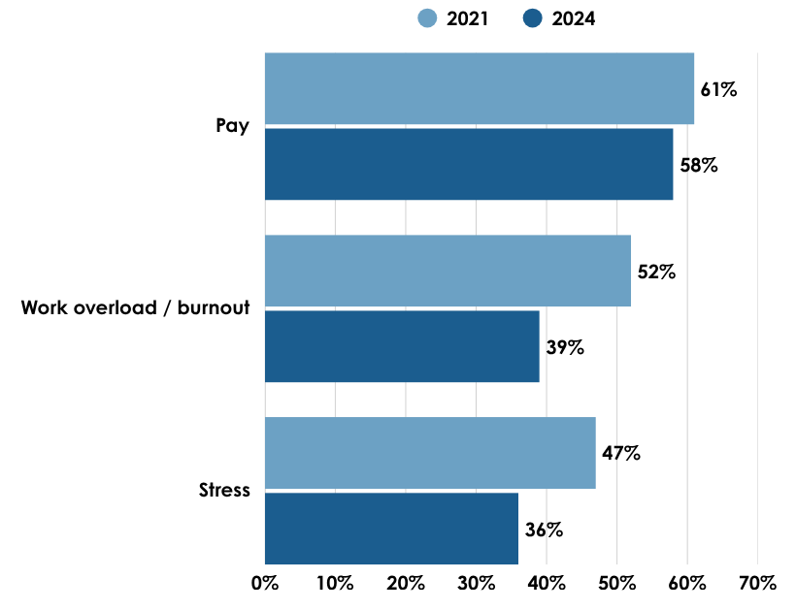
PHWINS- Top Reason for Leaving
Staying for the Benefits Leaving for the Pay

Slide 41
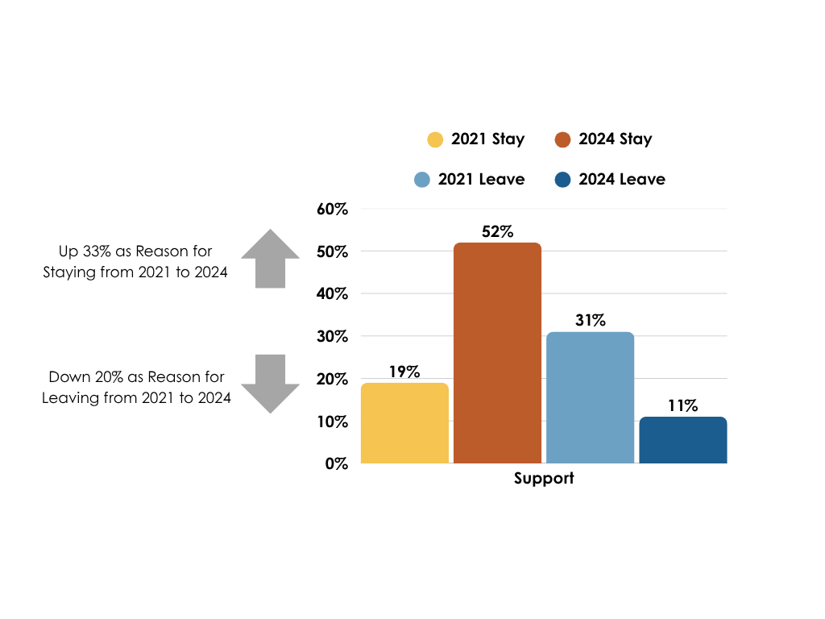
Support as Reason for Leaving/Staying

Slide 42
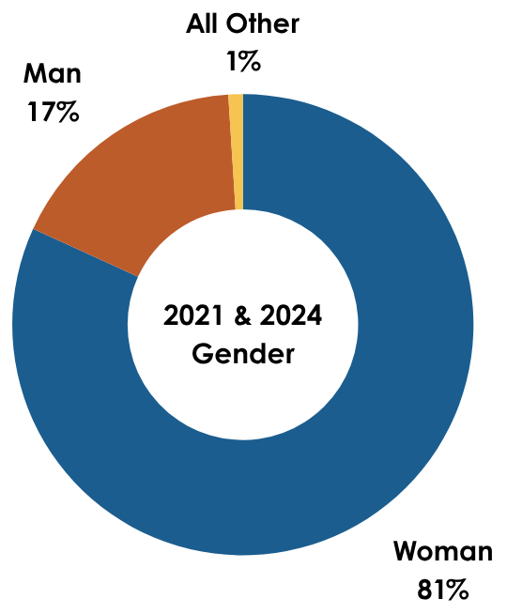
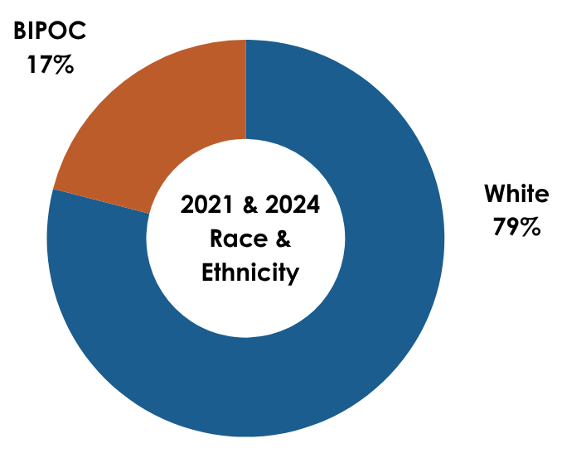
PHWINS Workforce – Demographics
2021/2024 Gender/Race/Ethnicity
no changes

Slide 43
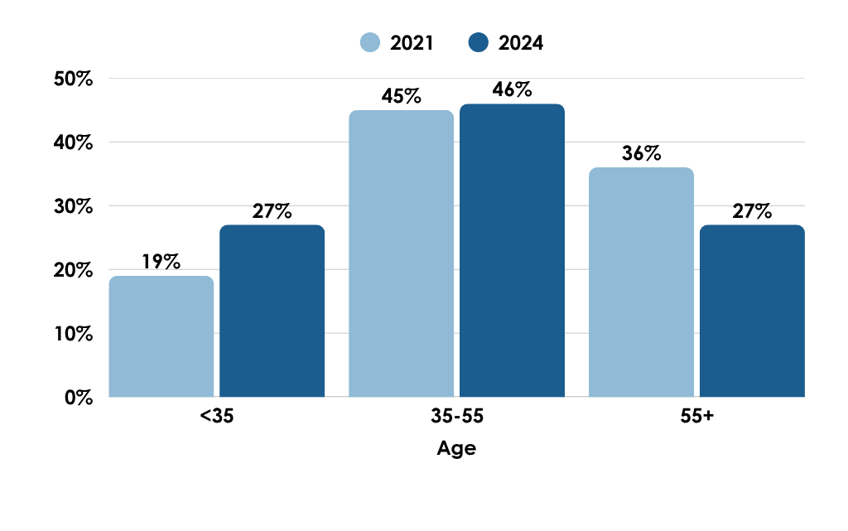
PHWINS- Age
From 2021-2024
8% Increase in workforce <35 years old
9% Decrease in workforce >55 years old

Slide 44
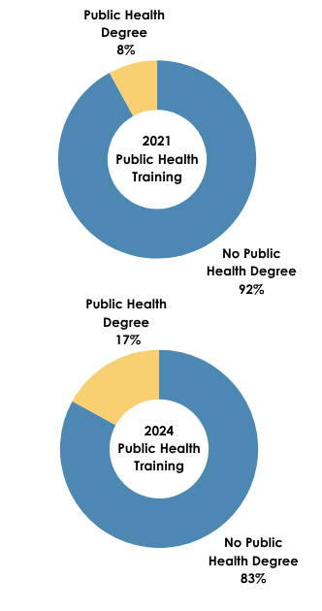
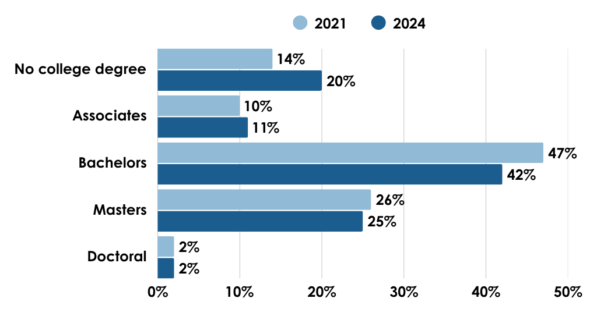
PHWINS - Workforce Education
From 2021 – 2024
9% increase of Public Health Degrees
7% decrease in bachelors degree.

Slide 45
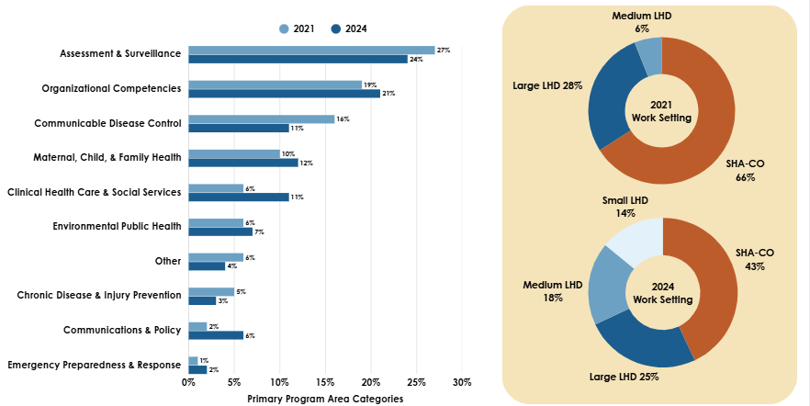
PHWINS - Workforce Program Area
LHD: Local Health Department
SHA-CO: State Health Department Central Office (Missouri Department of Health and Senior Services)
‘Small LHD’ category established in 2024.
  (25 or less employees or serving less than 25k)
Notes:
Large LHD = >25 Staff and >250K population
Medium LHD = >25 Staff and 25k-250k population
Small LHD = <25 Staff and <25k population

Slide 46
PHWINS - Workforce Program Area
Notes:
Large LHD = >25 Staff and >250K population
Medium LHD = >25 Staff and 25k-250k population
Small LHD = <25 Staff and <25k population

Slide 47
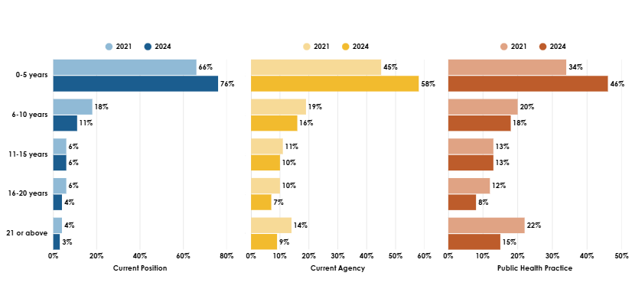
PHWINS – Workforce Tenure

Slide 48
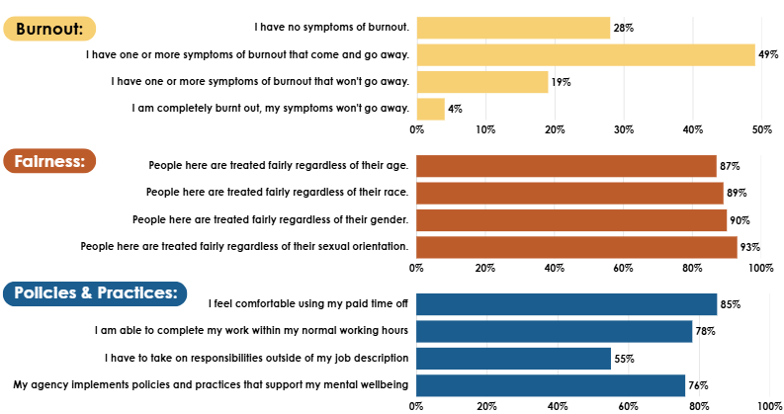
PHWINS – Workforce Experiences

Slide 49
Licensed Dental Workforce
Licensed Dental Workforce in Missouri (2025):
Dentists: 3,260
Dental Hygienists: 3,839
Dental Assistants: 6,230
Geographic Gaps in Access:
12 counties have no licensed dentists.
5 counties have no dental hygienists.
9 counties have no dental assistants.
Health Professional Shortage Areas (HPSAs):
Missouri requires 334 additional dentists to eliminate its dental HPSA designations.
Aggregated based on the entire State of Missouri.
(HPSA designations are based on a population-to-provider ratio of 5,000:1 [or 4,000:1 in high-need areas]).
(12.1% Public Health Dental Hygienists)
(12.1% Public Health Dentists)

Slide 50
Recent Workforce Trends
National Comparison:
Licensure Growth:
  Missouri ranks below average in dental workforce density per capita.
  States like Utah and Colorado lead in dental assistant employment per 1,000 jobs, highlighting potential models for Missouri.
Number of licensed dental assistants has grown, now exceeding dentists and hygienists.
Growth in dental hygienist licensure has been steady but slower compared to national trends.
Urban-Rural Disparities: Urban counties (e.g., St. Louis, Jackson, Greene) maintain higher provider-to-population ratios.
Rural counties continue to experience persistent shortages, with some counties reporting zero dental professionals.

Slide 51
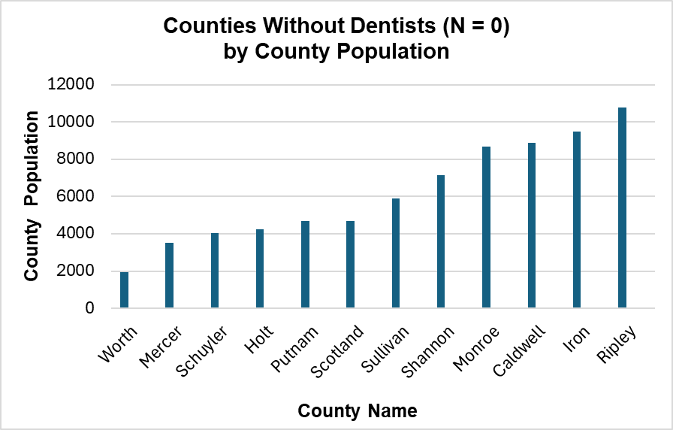
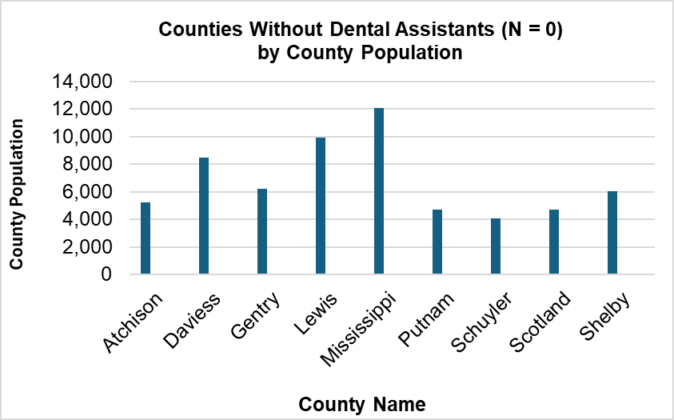
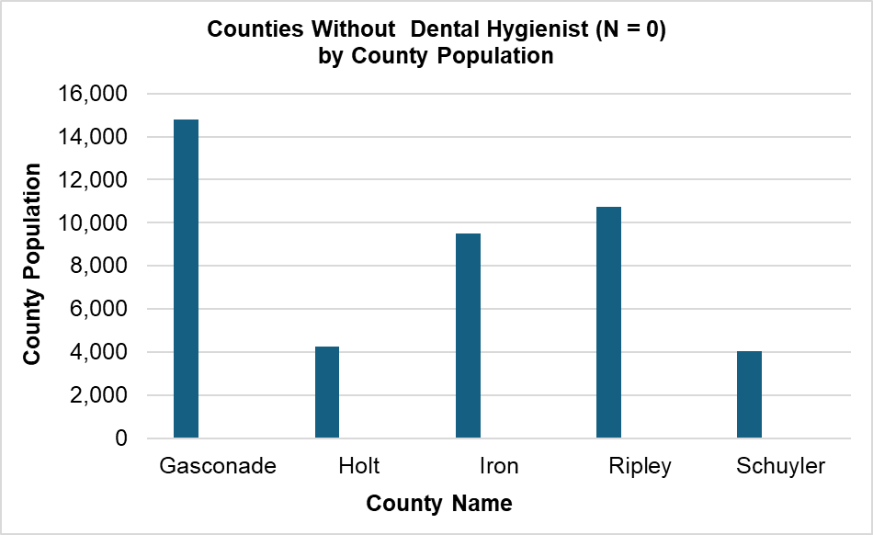

Slide 52
Inform Dental Health Policy
Policy Implications
Expand Recruitment & Retention in underserved counties through incentives, loan repayment, and rural residency programs. Engage health centers in policy design and implementation to ensure programs meet needs.
Support Tele-dentistry, mobile clinics, and school-based programs encouraging training to reach underserved populations in counties with no dental professionals. Support Dental Therapy Legislation. Promote roles like dental therapists to extend care capacity
Collaborate with Educational Institutions to align training pipelines with geographic needs. (Ohio’s Primary Care Workforce Initiative) Partner with dental schools and health centers to expose students early to community-based care.
Leverage Federal HPSA Designations to secure funding and prioritize resource allocation. Encourage Medicaid Managed Care Organizations to reinvest profits into dental workforce expansion, (Nebraska’s Project Access).

Slide 53




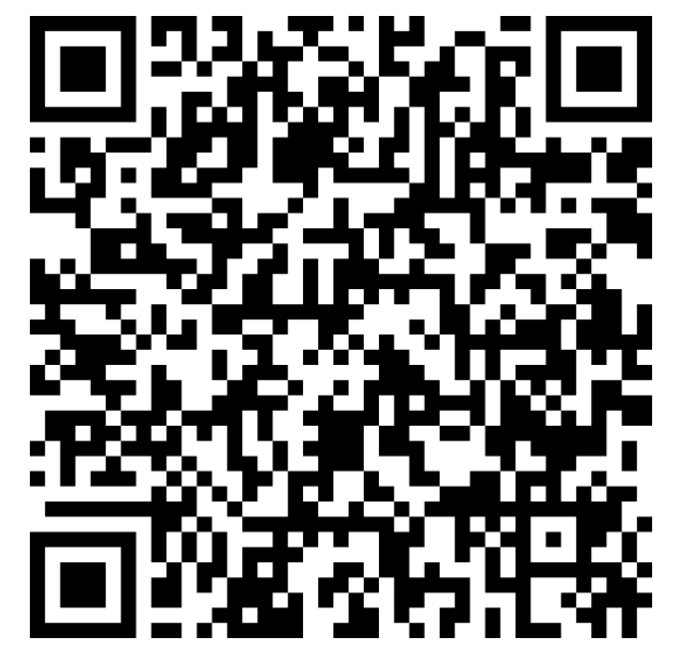
Workforce annual reporting on:
Demographic characteristics
Education and training
Employment characteristics
Workforce distribution and access
Informing policymakers on:
Workforce development
Training and education programs
Addressing access (HPSAs)
Recruitment and retention efforts
Ensuring workforce sustainability

Slide 54
How do we Compare to national aggregated?
State Licensure Comparability
LPN License Distribution
Missouri: LPNs comprise N = 20,796 (15%) of the total Missouri nursing workforce.
National: About N = 630,250 LPNs employed in the nation.
RN License Distribution
Missouri: RNs comprise N = 100,372 (75%) of the total Missouri nursing workforce
National: About N = 4.7 million RNs nationwide; 89% employed in nursing. Employment projected to grow by 5% from 2021 to 2031.
APRN License Distribution
Missouri: APRNs comprise N = 13,431 (10%) of the total nursing workforce. CNP (82%), CRNA (15.2%), CNS (1.6%), CNM (1.2%)
National: APRN roles are growing, with increasing demand in primary care and specialty areas.
(Missouri Healthcare Workforce, 2023)
(U.S. Bureau of Labor Statistics, 2023)

Slide 55
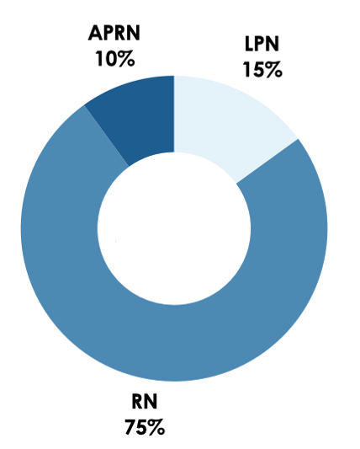
Missouri Nurses Provide Services to about
6.5M Missourians
(N = 134,599)
Examining the characteristics and distribution facilitates a better understanding:
  of the challenges the nursing workforce experiences and
  ways to inform policy to support a healthy nursing workforce.
License | % | n =
LPN | 15% | 20,796
RN | 75% | 100,372
APRN | 10% | 13,431
Notes:
Grace
The Annual Nursing report includes over 134 thousand practicing nurses, making up just over 2% of the Missouri Population.
The report uses this licensing data data to understand challenges and inform policy by examining characteristic and distribution patterns.
Out of these Missouri Nurses, Registered Nurse is the most common license type at 75%, followed by LPN and APRN.
transition to LTC defined

Slide 56
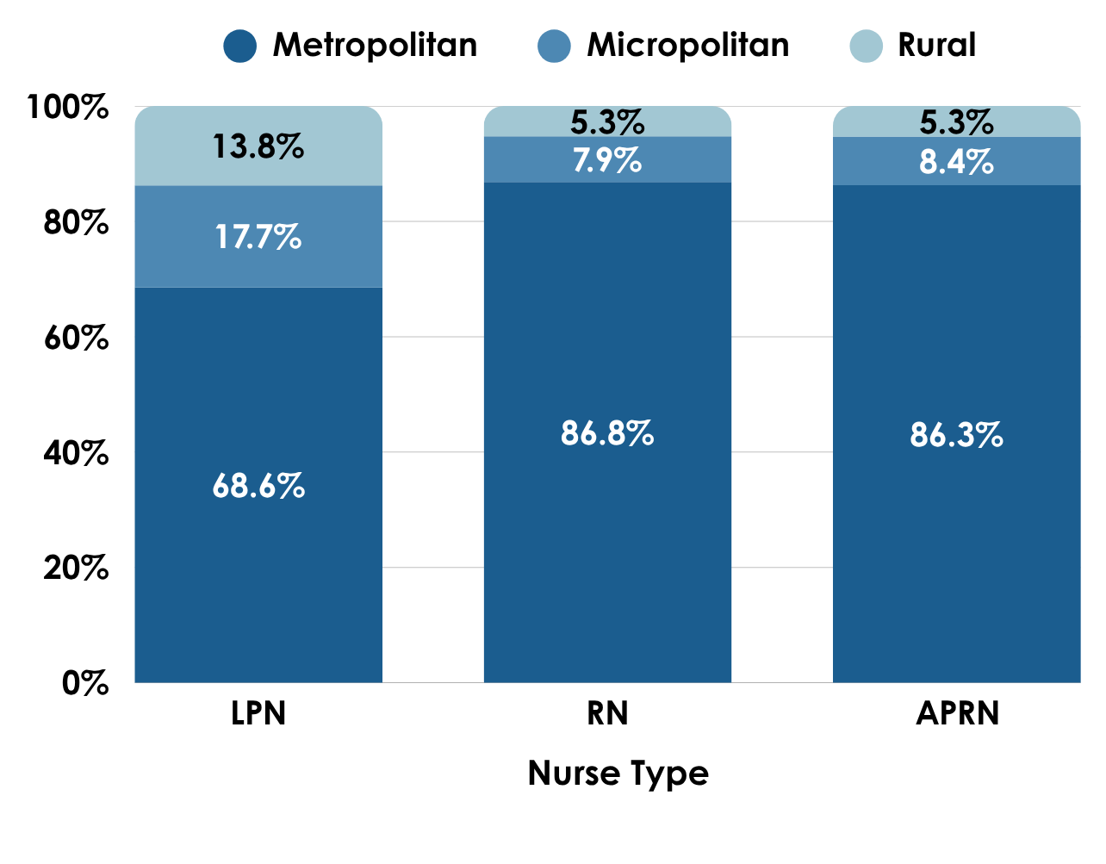
Missouri CBSAs
Geographic Maldistribution: Nurses are disproportionately located in metropolitan areas.
Geographic Distribution of Missouri Nurses
Counties with Lowest Nurse Representation
Worth County
Schuyler County
Knox County
Hickory County
Carter County

Slide 57
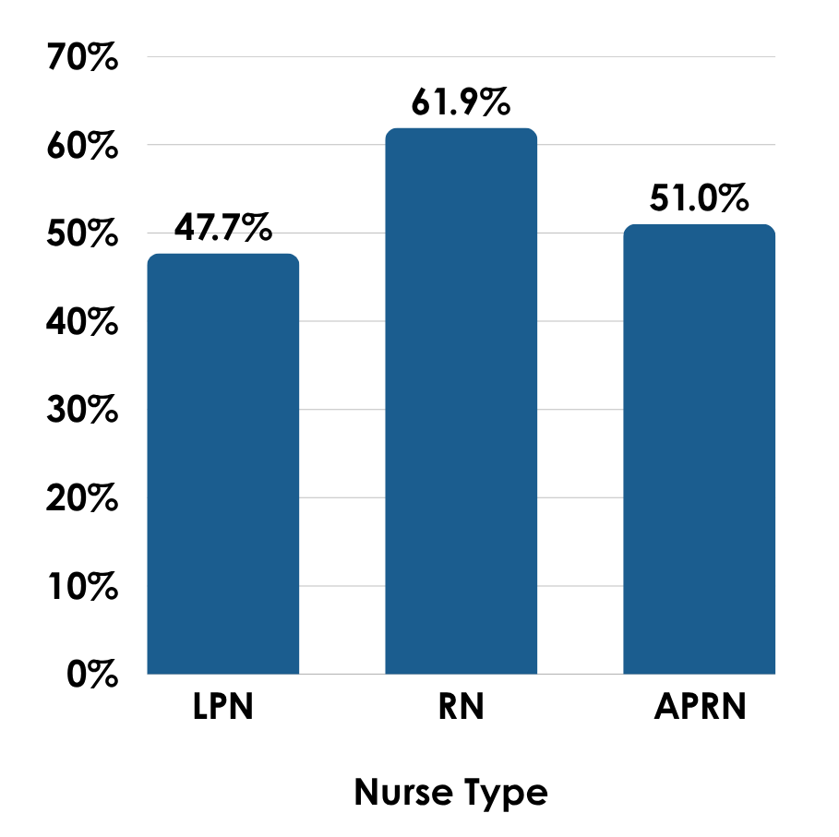
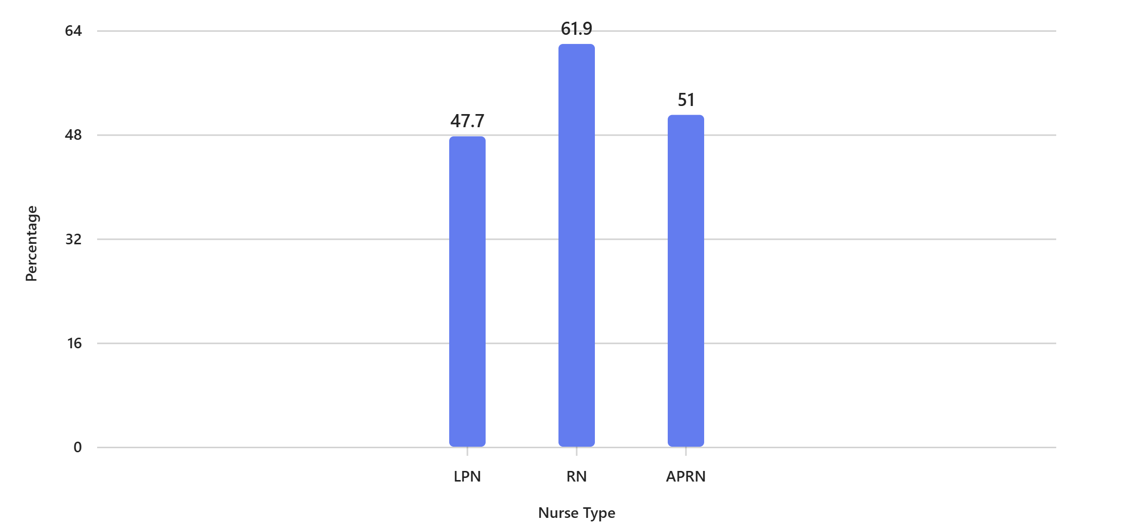
Where are nurses working? – Hospital – Inpatient Employment Settings
Least Common Employment Settings:
LPNs: 9.3% outpatient clinics
RNs: 6.2% Outpatient ambulatory care
APRNs: 0.9% Administration, education

Slide 58
Nursing Workforce - What you need to know
Policy Implications
Expand funding for nursing education programs
Incentivize rural and underserved area placements
Support aging workforce transitions
Strengthen cross-sector partnerships
Enhance workforce data analytics
Promote diversity and inclusion
Invest in recruitment and retention strategies

Slide 59
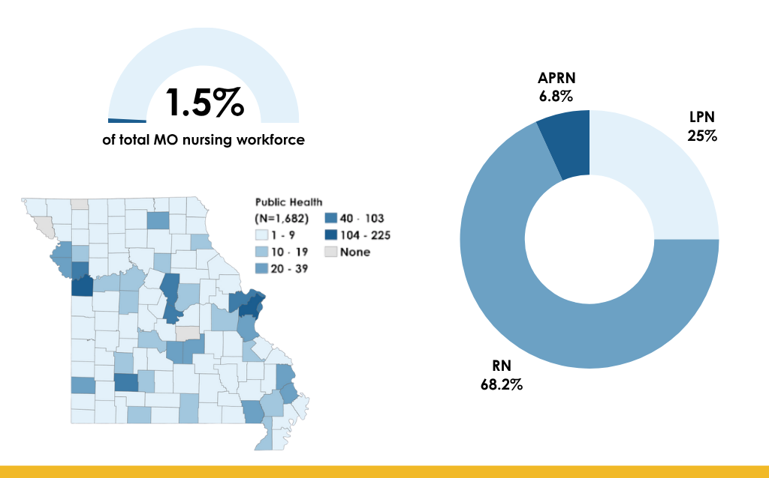
18.7%
2+ positions
Public Health Nursing Services (N =1,981)

Slide 60
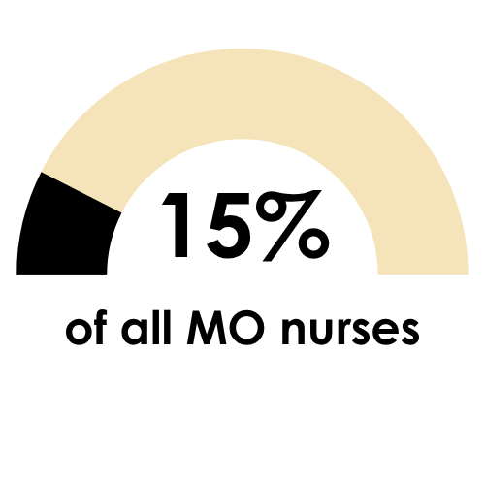
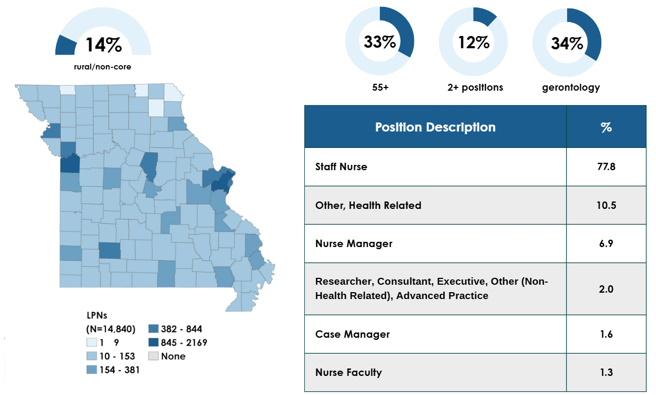
Understanding the LPN Workforce (N = 20,796)
Who are they & What are they doing?

Slide 61
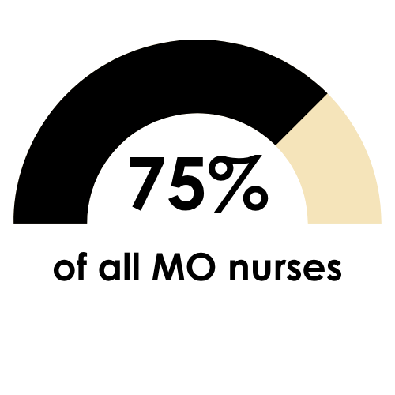
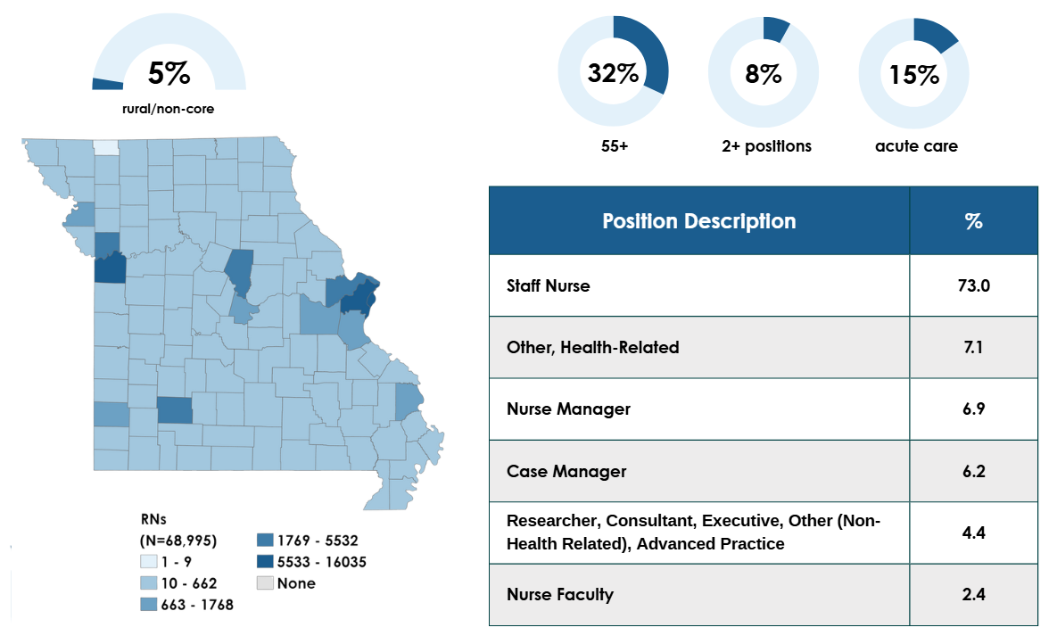
Understanding RN Workforce (N = 100,372)
Who are they & What are they doing?

Slide 62
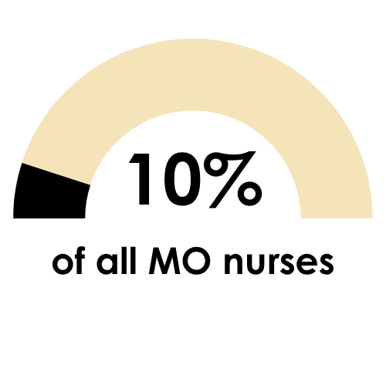
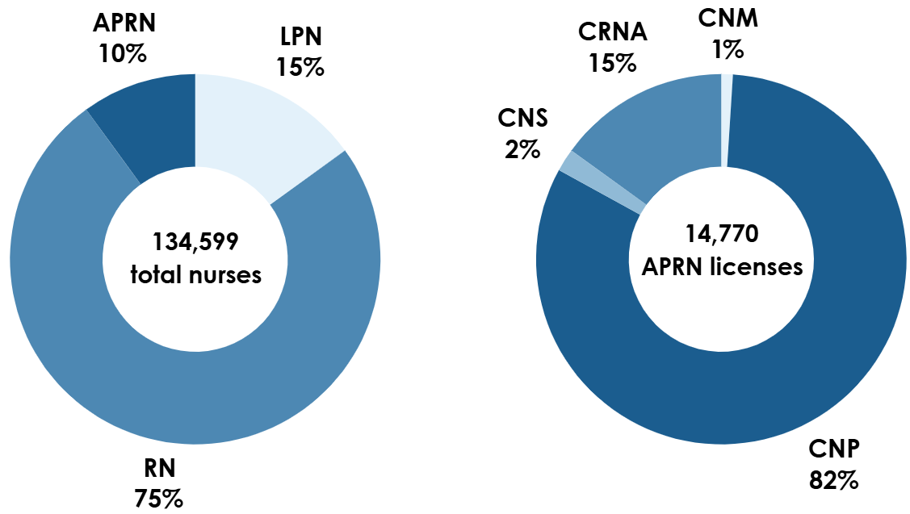
APRN License Distribution
Total Individual APRNs (N = 13,431)

Slide 63
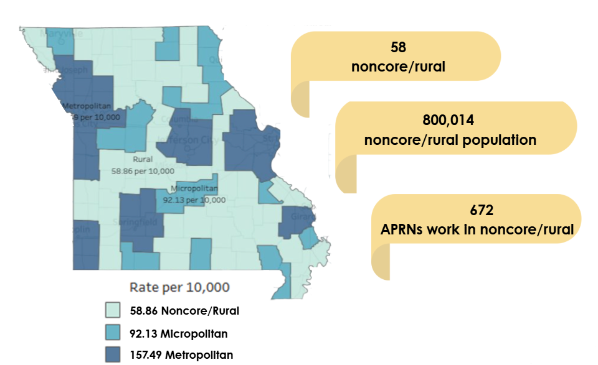
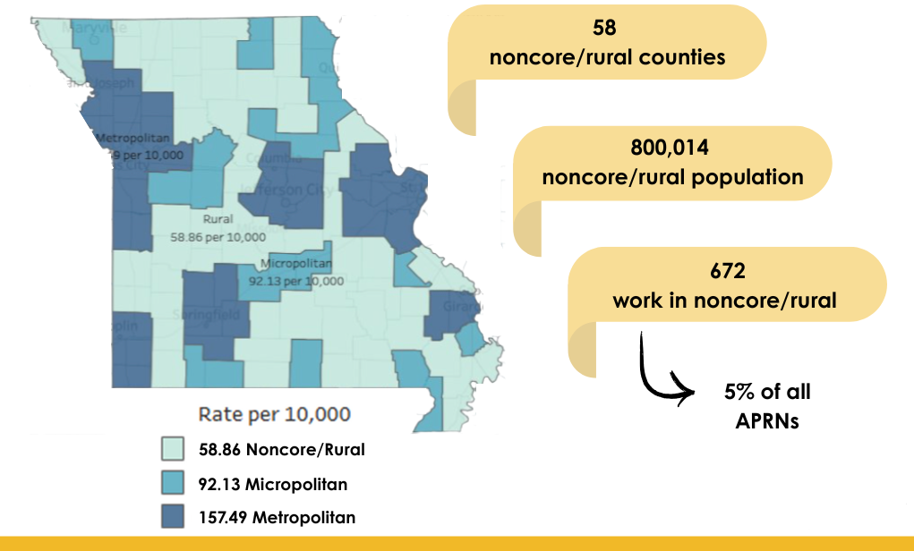
Addressing APRN Shortages (N = 13,431)
What is the distribution by area?
Data demonstrating maldistribution of APRNs among most employment settings.

Slide 64
Rural Health Care Access
Missouri has
48 Small Rural Hospitals
35 Critical Access Hospitals
21 Hospital Closures Since 2014
More than 55 rural counties without a hospital.
23% of MO physicians practice in rural Missouri.
37% population lives in rural Missouri.

Slide 65
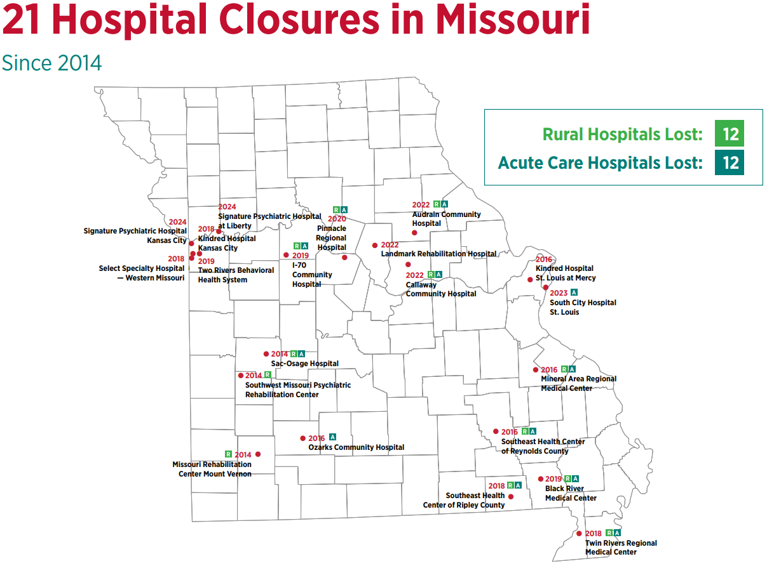
2014-2022: 15 Hospitals Closed
2022-2023: 4 Additional Hospitals Closed. Total: 19
Missouri Hospital Association
21 Hospital Closures in Missouri https://www.mhanet.com/mhaimages/advocacy/Missouri_Hospital_Closures.pdf

Slide 66


Slide 67
Next Steps - MHCWP
Expand our support, relationships, and access to adequately and efficiently study Missouri's health care workforce to support state and local policymakers.
Advocate for consistent, affordable access to licensure/credentialing data.
Implement process for policymakers and researchers to utilize project data and resources.
Participate and contribute to the workforce research community and literature.
Notes:
Tracy

Slide 68
Key Takeaways
Advancing Missouri’s Health Workforce Planning
Strategic Use of MHCWP’s Data Repository
Centralized warehouse of accurate, timely, and reliable workforce data
Supports planning and assessment of health professional needs
Enables evidence-based decisions using longitudinal and regional insights
Collaboration & Partnerships for Actionable Insights
Co-develop use-inspired workforce questions with stakeholders
Link workforce characteristics to access, distribution, and population health
Strengthen CHP’s impact through strategic, cross-sector partnerships
Interactive Tools for Workforce & Health Analysis
Access dynamic dashboards and mapping tools
Customize views for local, regional, and statewide planning
Empower users with intuitive, decision-support interfaces
Notes:
Tracy

Slide 69

How Can We Help You?
  Share our expertise/experience in our evidence-based work which can be used to enhance/frame your specific health care workforce data collection needs.
  Adapt our methods/processes to meet data visualization/reporting needs.
    Questions? – What can we do for you?
Notes:
Tracy
Expanding on the LTC Nurses Educational Data analyzed to include further analysis on understanding LTC Nurses education and training.

Slide 70


Contact Us for Assistance
MISSOURI HEALTH CARE WORKFORCE PROJECT WEBAPP

Slide 71

Contact Us
Department of Public Health, College of Health Sciences, MU Center for Health Policy, Office of Health Outreach, Policy & Education (HOPE)
Kate Trout, PhD, MPH
Sara Smith, MS, LSSGB
Associate Professor of Health Sciences
Director, Center for Health Policy
Director, National Food Security Innovation Hub
Director, Center Convergence Science Innovation
Office: 573-882-9435
Email: kate.trout@health.missouri.
MU Center for Health Policy Program Director, Missouri Health Care Workforce Project Director
Office: 573.882.2300
Email: sara.smith@health.missouri.edu

Slide 72
References
Armstrong, D., & Moore, J. (2015). The health workforce minimum data set (MDS): What you need to know. Health Workforce Technical Assistance Center. https://www.healthworkforceeta.org/
research-alerts/the-health-workforce-minimum-data-set-mds-what-you-need-to-know/.
Beck, A. J., Singer, P. M., Buche, J., Manderscheid, R. W., & Buerhaus, P. (2018). Improving data for behavioral health workforce planning: Development of a minimum data set. American Journal of Preventive Medicine, 54(6), S192-S198. DOI: 10.1016/j.amepre.2018.01.035.
CDC. (2024). Public health workforce development. About public health workforce development. Centers for Disease Control and Prevention. https://www.cdc.gov/workforce/php/about/index.html.
CDC Foundation. (2023). What is public health? Centers for Disease Control and Prevention.
https://www.cdcfoundation.org/what-public-health.
Crawford, C. A. G., Summerfelt, W. T., Roy, K., Chen, Z. A., Meltzer, D. O., & Thacker, S. B. (2009). Perspectives on public health workforce research. Journal of Public Health Management and Practice, 15(6), S5-S15. DOI: 10.1097/PHH.0b013e3181bdff7d.
Gaul, K., & Armstrong, D. (2016). Health workforce data collection FAQs. Health Workforce Technical
Assistance Center. https://www.chwsny.org/wp-content/uploads/2016/09/Health-Workforce-
FAQs.pdf.
Gaul, K., Ricketts, T., & Moore, J. (2016). Beyond the minimum data set (MDS): What additional data do
states collect on health workforce supply? Health Workforce Technical Assistance Center.
https://www.healthworkforceeta.org/wp-content/uploads/2023/07/HWTAC_TA-to-States_Brief_
2016.pdf.
Hanson, Melanie. (2025). Student Loan Debt by State. Education Data Initiative. https://educationdata.org/student-loan-debt-by-state.

Slide 73
References
Health in Rural Missouri Biennial Report (2022). Office of Rural Health and Primary Care. Retrieved from https://health.mo.gov/living/families/ruralhealth/pdf/biennial2022.pdf
Health Resources & Services Administration (HRSA). (2023). Explore health workforce data
policy. https://bhw.hrsa.gov/data-research/explore-health-workforce-data-policy#:~:text=
minimum%20Data%20Sets,practice%20characteristics%20of%20health%20
professionals.
Lee, L.M., & Zarowsky, C. (2015). Foundational values for public health. Public Health Reviews, 36(2),
1-9. DOI: 10.1186/s40985-015-0004-1.
National Governors Association. (2022). Next generation of the healthcare workforce project. National Governors Association. https://www.nga.org/projects/next-generation-of-the-healthcare-
Workforce-learning-collaborative/.
Szabo, S., Nove, A., Matthews, Z., Bajracharya, A., Dhillon, I., Singh, D. R., Saares, A., & Campbell, J. (2020). Health workforce demography: A framework to improve understanding of the health workforce and support achievement of the sustainable development goals. Human Resources for Health, 18(1), 7. DOI: 10.1186/s12960-020-0445-6.
National Sources: i-National Council of State Boards of Nursing (2022); ii-U.S. Bureau of Labor Statistics. Occupational employment and wages; iii-National Association of Nurse Clinical Specialists (2020); iv-Association of American Medical Colleges. (2024).
U.S. Bureau of Labor Statistics. (2023). Occupational Outlook Handbook: Licensed Practical and Licensed Vocational Nurses. https://www.bls.gov/ooh/healthcare/licensed-practical-and-licensed-vocational-nurses.htm

Slide 74
Model and Development
Investing in Health Care Workforce Development -
  Health Resources and Services Administration (HRSA), other federal and state agencies, participated in workforce development establishing best-practices in collecting, gathering, and analyzing workforce data.
  HRSA supports the Health Care Workforce Technical Assistance Center (HWTAC) in building Health Care Workforce Minimum Data Set (MDS) Model, including TA on data collection methods (data sources & integral partnerships) and legislative requirements (impacts-benefits & risks).
HWTAC/HRSA provide guidance to states on best practices –
  Sources of data and how states can collaborate to build workforce data analysis and reporting.
MHCWP Created Missouri MDS Model -
  MHCWP developed and modeled the Missouri MDS Model after HRSA’s model (MDSs to collect, how to collect, who to partner).
Support from Other Agencies –
  MHCWP collaborated w/partners gaining support from other agencies, such as the National Governor’s Association.

Slide 75


Health Workforce Technical Assistance Center
(HWTAC)
HWTAC provides technical assistance to federal, local and regional entities, states, boards, associations, and organizations engaging in workforce planning and on the collection, analysis, and reporting of health workforce data.
  https://www.healthworkforceta.org/

Slide 76


National Governor’s Association (NGA)
  The National Governors Association Center for Best Practices is working with States in a new learning collaborative on strategies to grow and retain the next generation of the healthcare workforce.
Next Generation of the Healthcare Workforce Project - National Governors Association (nga.org)

