Slide 1
Overview of The
BureaU of HIV, STI and Hepatitis
Bureau of HIV, STI and Hepatitis
2025

Slide 2
Bureau update
Where we are?
Where we’re going?
Notes:
@Dustin – I replaced the image on this slide because it used Inclusion as the center word of the word cloud.

Slide 3

What are the program priorities?
  Prevention and awareness surrounding STIs, HIV and PrEP
  Clients with symptoms of primary or secondary syphilis
  Women who are pregnant or whose pregnancy status is unknown
  Congenital syphilis
  Newly diagnosed HIV clients
  Re-engagement in HIV care and viral suppression
  Reducing health disparities
  Getting people with HCV into treatment

Slide 4
Disease Intervention Specialists Overview

Slide 5

What are disease Intervention specialists?
Disease Intervention Specialists (DIS) are critical public health professionals that work to stop the spread of infections that threaten communities throughout Missouri.

Slide 6

Disease Intervention Specialists
DIS provide:
  counseling about behaviors that put a person at risk for STIs, including HIV infection.
  STI education outreach to health care providers, community-based organizations, and the public.
  Partner Notification and testing.
  Risk reduction and prevention education.

Slide 7
Pre-exposure prophylaxis (PrEP) and Post-exposure prophylaxis (PEP)

Slide 8

WHAT IS PrEP?
PrEP (pre-exposure prophylaxis) is a medication that prevents HIV.
PrEP is now available in both oral and injectable forms.
Almost everyone can use PrEP.
PrEP is highly effective at preventing HIV through sex when taken as prescribed.
PrEP only prevents against HIV. Condoms are still important to prevent other STIs.
Notes:
Notes:
Two oral forms (Truvada, Descovy) and one injectable form (Apretude). PrEP medications are anti-retroviral medications (the medication formulations are also used for ART).
~99.7% effective (for sexual contact)
Any prescriber can prescribe PrEP in Missouri
There is at least one form of PrEP that everyone HIV- can use.
TDF – everyone; ≥60mL/min
TAF – MSM, TW; ≥30mL/min
Cab – everyone; no renal impact
Other PrEP options are currently being reviewed by the FDA
Useful PrEP Information: https://stacks.cdc.gov/view/cdc/112360

Slide 9

WHAT IS PEP?
PEP is a medication that prevents HIV after an exposure.
PEP must be started within 72 hours of an HIV exposure.
PEP is a 28-day medication regimen.
PEP is effective at preventing HIV.
Notes:
https://hivinfo.nih.gov/understanding-hiv/fact-sheets/post-exposure-prophylaxis-pep
Notes:
PEP uses antiretroviral therapy (ART) like the medications used to treat PLWH
PEP should be prescribed as a three-drug regimen, for 28 days (according to the CDC)
Is effective at preventing HIV
Efficacy for PEP is not defined in the literature, but it could be up to 80% effective (according to the CDC)
Examples of exposures: workplace, sexual violence, other
Efficacy requires adherence to prescription (e.g., taking medications every day)
PEP could be prescribed by any provider
Useful PEP information: https://stacks.cdc.gov/view/cdc/38856

Slide 10

Expanding PrEP IN MISSOURI
Regional PrEP Providers
  Four State-funded PrEP Clinics
Regional PrEP Navigators
PEP Education and Navigation
Provider Technical Assistance / Academic Detailing
PrEPlocator.org
Notes:
Notes:
Clinics:
Butler County Health Department
Cape Girardeau County Public Health Center
Columbia/Boone Department of Public Health and Human Services
Scott County Health Department
RLAs have PrEP navigators; PrEP clinics have staff who do PrEP navigation
Sierra Freeman, the Statewide PrEP Coordinator, can provide provider TA/AD for LPHAs, clinics, hospitals, etc. (Sierra.Freeman@health.mo.gov // 573-751-6084)

Slide 11
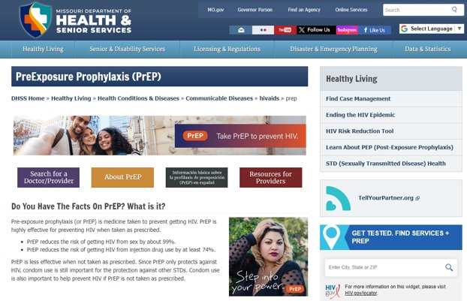

moprep.org
Notes:
moprep.org provides CDC-based, factual information all in one place with the PrEP Locator embedded.

Slide 12
STI Prevention, Testing and Treatment

Slide 13

STI Program
Over 180 program partners
  LPHAs
  Community Organizations
  Colleges and Universities
Testing through the State Public Health Lab
Free STI medications
  Chlamydia
  Gonorrhea
  Syphilis
    Uninsured and Under-insured
Condom Distribution
Biomedical Interventions
DoxyPEP
Expedited Partner Therapy (EPT)
Notes:
Over 180 program partners
LPHAs
Community Organizations
Colleges and Universities
Testing through the State Public Health Lab
Free STI medications = over 45,000 medications provided
Azithromycin- 15,174
Bicillin- 3,740
Ceftriaxone- 2,680
Doxycycline- 17,940
Gentamicin- 950
Lidocaine- 4,775
Uninsured and Under-insured
Condom Distribution: 600,000
Funded by the PCHD grant and GR
2024 Testing Dashboard
Rapid HIV Tests: 51,365
Serum HIV Tests: 30,697
TOTAL HIV: Over 82,000
Serum Syphilis: 23,960
Chlamydia & Gonorrhea EACH: 51,247

Slide 14
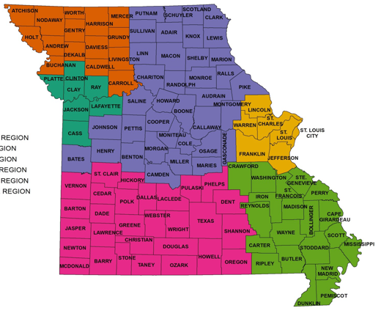
STI Surveillance
2024 Preliminary Numbers
Chlamydia
  28,705 new cases reported
  7.8 % decrease from 2023
Gonorrhea
  10,316 new cases reported
  18.2% decrease from 2023
  Syphilis
    3,034 new cases reported
    18.3% decrease from 2023
    HIV
      576 new cases reported
      4.3% increase from 2023
https://health.mo.gov/data/hivstdaids/data.php

Slide 15
HIV Prevention and Testing Program

Slide 16


HIV Testing and Prevention
5 Regional Lead Agency Partners
  Prioritized HIV Outreach Testing and Counseling
  Risk Reduction Education
  STI Testing
  HCV Testing
Healthcare Opt-Out Testing
Self-Test Kits
Condom Distribution
Ending the HIV Epidemic
Notes:
5 Regional Lead Agency Partners
Prioritized HIV Outreach Testing and Counseling
Risk Reduction Education
HIV tests: almost 15,000 outreach/prioritized HIV tests in 2024
HCV Testing
Healthcare Opt-Out Testing: over 31,000 in 2024
Washington University- Barnes Jewish Only hospital system in nation to offer opt-out at all ERS
Kansas City
Columbia Boon
APO
Self-Test Kits: 378 in 2024
Condom Distribution: 600,000 in 2024
Ending the HIV Epidemic:
Partnered with Livingston CHD to offer testing in their county and 7 surrounding counties in the Northwest area.
This funding also supports 4 PrEP clinicsFunded by the CDC

Slide 17

Ryan White Case Management
Types of Case Management:
Medical/ Non-medical
Linkage to Care
Lost Retention Peer Navigation
State Plan Personal Care (SPPC)
AIDS Waiver
Transitional Case Management
Notes:
The Ryan White Part B Case Management program helps link People with HIV (PWH) to a range of medically appropriate levels of health and client-centered support services based on the client's medical, social, psychological, and economic needs. A main component of HIV Case Management is the coordination and follow-up of client care. The goal is to help the client reach optimal health outcomes by reducing HIV-related disparities and health inequities. An undetectable viral load is an example of this.
With most Ryan White clients being low-income, male, people of color and sexual minorities, HIV Case Management services must be delivered in a culturally competent manner that respects the client’s individuality.
Key Case Management activities include an initial client assessment of their service needs, the development of an individualized service plan, coordinating the services required to implement the care plan, client monitoring to assess whether or not the plan is working, and re-evaluating and adjusting the plan every six months or more frequently as needed.
In addition to Medical and non-medical Case Management, specialty case management programs are set up for clients with higher needs. These include Linkage to Care, Lost Retention Peer Navigation, SPPC/AIDS Waiver, and Transitional Case Management. Direct Enrollment Services (DES) is another specialty program, but the opposite of the ones mentioned. It is for virally suppressed people with fewer needs.

Slide 18
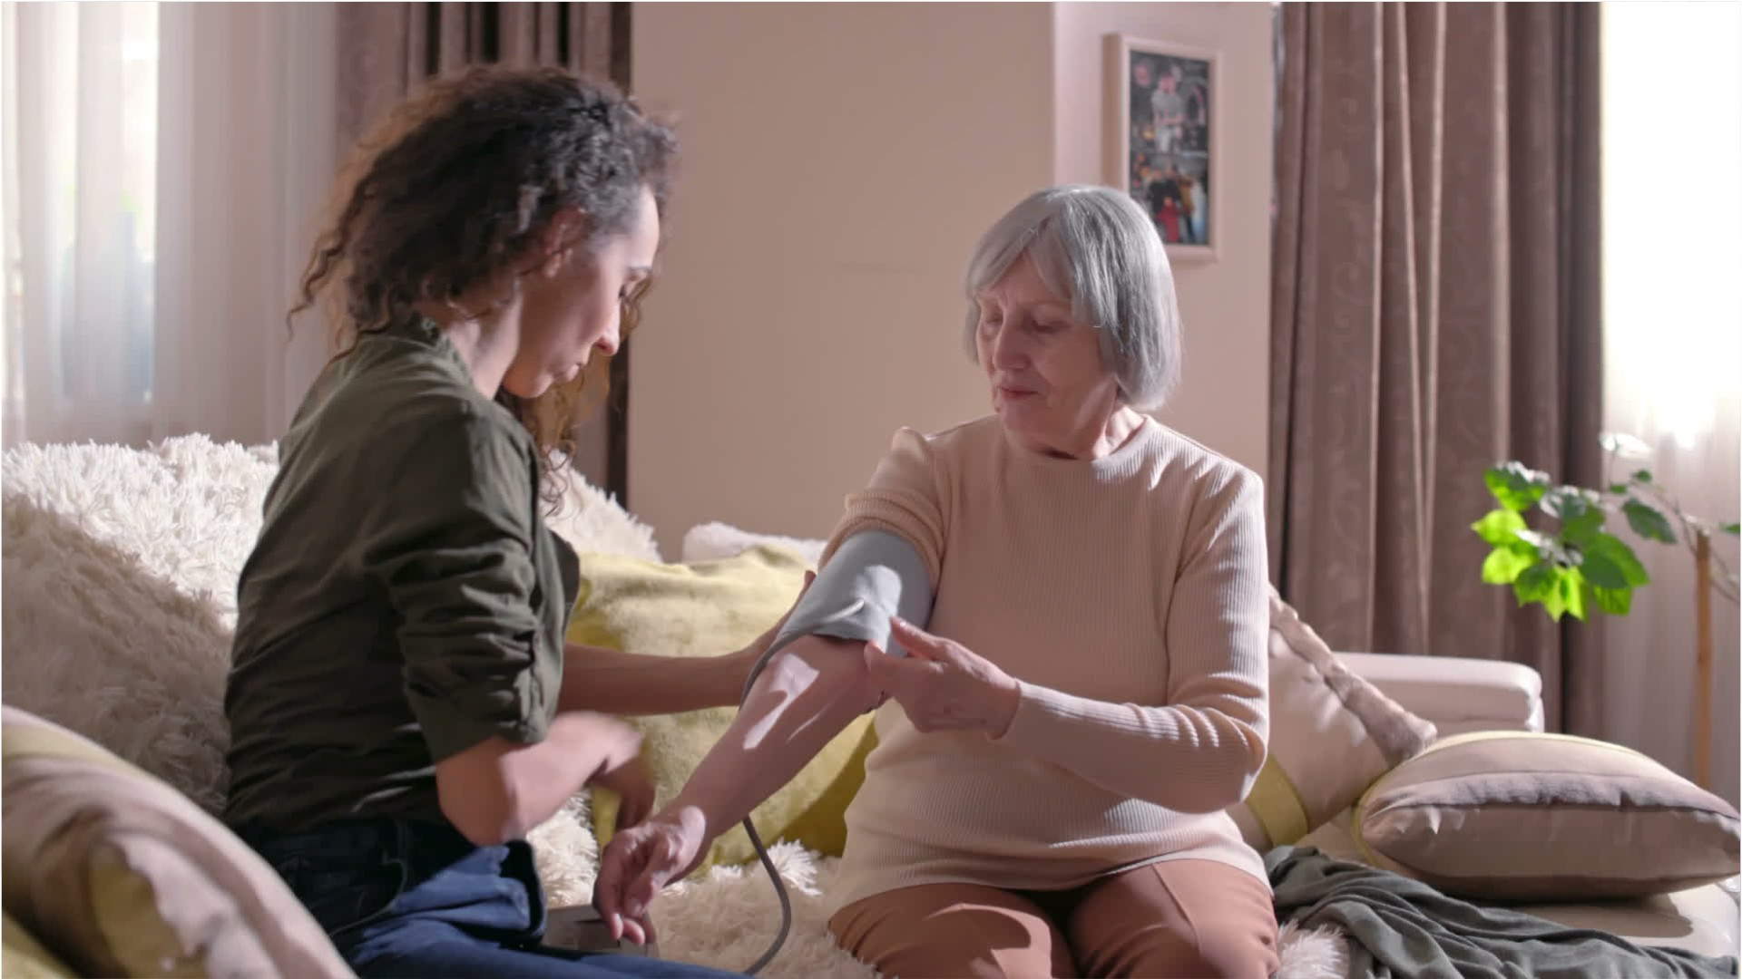
SPPC /AIDS WAiver
DHSS & DSS Collaboration
Purpose
Qualifications:
- Case Manager
- Client
Types of Services:
Notes:
The MO HealthNet AIDS Home and Community-Based Waiver allows clients with HIV or AIDS, MO HealthNet eligible and with intense medical needs, to receive care in their homes. This is a more cost-effective alternative to living in a nursing care facility. In addition, people generally do better in their own homes.
Case Managers must be MSWs, LCSWs or RNs to assess clients for the SPPC/Waiver program.
Eligible clients may receive the following in-home services to meet their medical needs:
• State Plan Personal Care (SPPC)
• Waiver Personal Care (WPC)
• Advanced Personal Care (APC)
• HIV/AIDS-specific supplies (adult incontinence briefs, underpads, gloves)
• Attendant Care
• Authorized Nurse Visit

Slide 19
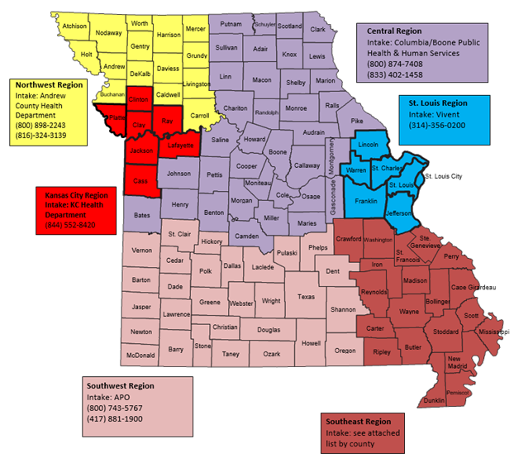
Notes:
This map breaks Missouri down by the regions. St. Louis and Kansas City make up the two Transitional Grant Areas (TGA). This means that these regions have had between 1000 – 1999 AIDS cases in the last five years. The TGAs receive mostly Part A funding, but some Part B funding as well. We also have four Outstate Regions. These are mostly rural areas and receive mainly Part B funding.
Clients can access this map to help them find a case management agency near them by going to our webpage at:
https://health.mo.gov/living/healthcondiseases/communicable/hivaids/casemgmt.php
At this site, a client can also choose to use our interactive map of agencies by clicking on:
Find Case Management Near You:
Link: https://health.mo.gov/hivcasemanagement.

Slide 20

Additional Part B Services:
Statewide Services
  Medications
    Must be on MO ADAP formulary
  Health insurance premium assistance
    Medical care co-pays only
  Mental health services
  Substance use services
  Treatment adherence
Outstate Services
  Outpatient/Ambulatory care
  Dental
  Housing and Utility Assistance
  Medical Transportation
Notes:
Part B provides eligible clients across the entire State with assistance for medications, health insurance premiums, mental health, substance use, and treatment adherence. Clients who are insured across the state also receive assistance with co-pay expenses for eligible medical care visits. Uninsured clients in St. Louis and Kansas City receive assistance from the Part A grantee for medical care visits. Clients are only eligible to receive assistance with medications that are listed on the current MO ADAP formulary.
In the Outstate regions, Part B also assists clients with outpatient/ambulatory care, dental, housing and utility assistance, and medical transportation assistance.

Slide 21

Statewide Services:
ADAP Uninsured
Health Insurance Continuation Program (HICP)
Notes:
The Statewide Services program offered through BHSH has two primary components: ADAP Uninsured and Health Insurance Continuation Program (HICP).
The ADAP Uninsured program ensures that clients who do not have primary health insurance still have access to medications and, in the Outstate regions, HIV-related outpatient/ambulatory care.
HICP assistance provides eligible clients across the state with assistance for their health insurance premiums, co-pays, deductibles, co-insurance, and out-of-pocket maximum expenses. Clients with insurance must use providers that are in-network with their insurance and their medications must be covered under their insurance’s formulary. All clients in the Part B program may only access assistance with medications, if the medication is listed on the current MO ADAP formulary.

Slide 22

Housing opportunities for persons with Aids (hopwa)
Federal program dedicated to the housing needs of people living with HIV/AIDS
Outstate HOPWA Program
  Access through Part B Case Management agency
  Services clients living in the 100 counties of the Outstate regions
  Tenant Based Rental Assistance (TBRA)
  Short-Term Rent, Mortgage, and Utility (STRMU) assistance
St. Louis and Kansas City receive their own competitive HOPWA funding to serve clients in the TGAs.
Notes:
BHSH is also the grantee for the Housing Opportunities for Persons with AIDS (HOPWA) program. HOPWA is the only federal program dedicated to helping people living with HIV/AIDS with their housing needs. HOPWA assistance through BHSH/Part B is only available to the clients living in the 100 counties that make up the Outstate regions. Clients in the Outstate regions can receive Tenant-Based Rental Assistance (TBRA) or Short-Term Rent, Mortgage, and Utility (STRMU) assistance. TBRA provides clients with long-term, ongoing housing assistance with rent and utility expenses. Clients must apply their TBRA funds to rent first and any additional funds can be applied to utility expenses. STRMU assistance provides up to three (3) months of assistance with rent, mortgage, and/or utilities and are only available to clients who are already housed but need assistance to maintain stable housing.

Slide 23
Housing assistance:
Deposit Assistance
  Rent
  Utilities
Emergency Financial Assistance (EFA)
  Eviction notices
  Shut-off/disconnect notices
  Temporary emergency housing
Notes:
Outstate clients can also receive assistance with deposit costs for rent and/or utilities. Deposit assistance is provided on a one-time basis over the client’s lifetime, and deposit funds must be returned to the program if the landlord returns deposit funds upon vacating a property.
The last housing assistance type available to Outstate clients is Emergency Financial Assistance (EFA). EFA is to assist clients who have received an eviction notice for their home, a utility disconnect/shut-off notice or need temporary emergency housing. EFA assistance is also available up to three (3) times/months per program year.

Slide 24

Viral Hepatitis
Prevention and Testing
Missouri Hepatitis C Elimination Planning Committee (MOHEPC) – effective May 19, 2022.
  Vision: Increase access to hepatitis C prevention, testing, and treatment for all Missouri citizens
  Mission: Create a plan to eliminate hepatitis C in Missouri by ensuring universal testing, improving health care outcomes for people living with hepatitis C, and preventing new infections.
Notes:
The Viral Hepatitis Prevention Program (VHPP) receives state and federal funding.
The Program receives funding from the CDC via the PS 21-2103 grant, which has both a surveillance and prevention component. The grant supports rapid and confirmatory testing, prevention, patient education and the state elimination plan – MO HEP C.
The State Elimination Plan – MO HEP C began on 5/19/2022. The vision is to increase access to hepatitis C prevention, testing and treatment for all Missourians by creating a plan for universal testing, improving health outcomes for people living with hepatitis C and preventing new infections.

Slide 25
Viral hepatitis
State Public Health Lab offers Hep B and C Testing
  Adult Hepatitis B
  Hepatitis C Antibody and confirmatory
  Available through any of our HIV/STI Testing Sites
Telehealth Services and Patient Navigation
  Partnering with 5 health organizations to offer telehealth services throughout the State, thus lowering the barrier to treatment.
Notes:
The federal grant also supports testing for hepatitis B and C at the State Public Health Lab. That testing is available through any of our HIV/STD testing sites throughout the state. There are no stipulations for testing.
In 2024, the Program was fortunate and received state funding. Our state funding supports our rapid testing program, which can detect HCV antibodies in 20 minutes from a simple fingerstick. This is the first step in diagnosing someone with an active case of HCV. The Program partners with several agencies to distribute these POC tests, allowing the agencies to find potentially positive clients, meet them where they are, educate them, and refer them to treatment in the field.
Additionally, the VHPP offers patient navigation to get clients who have tested positive into care. We partner with 5 health organizations across the State to provide telehealth services to lower the barrier to treatment. Even though the providers may be in KC or STL, labs are drawn locally to the client, and the medications are sent directly to the patient’s door.

Slide 26

VIRAL HEPATITIS
Project Hep Cure - An initiative through the Department of Social Services to cure hepatitis C with prescription Mavyret. Anyone with MO HealthNet coverage and has tested positive for hepatitis C is eligible for the treatment. The treatment is available at no cost to MO HealthNet participants.
Notes:
To follow up on the idea of lowering the client’s barriers to care, DSS partnered with Abbvie, a drug manufacturer, to create Project Hep Cure. Project Hep Cure is an initiative for MoHealthNet subscribers who are hepatitis C positive to receive treatment at no cost to the client. The treatment with Mavyret is over 95% effective, taken daily and better tolerated by clients compared to interferon.

Slide 27


Ending the HIV Epidemic in Missouri:
The Four Pillars of the EHE Initiative:
  Diagnose
  Treat
  Prevent
  Respond
Other activities:
  Community Engagement
  Social and digital media and information dissemination
Notes:
Rebecca

Slide 28
Questions or Comments?
BHSH@health.mo.gov
(888) 252-8045

