Slide 1
Enhancing Workplace Wellbeing with Mental Health First Aid
LPHA Spring Regional Meeting

Slide 2
Agenda
Why MHFA?
Understanding the curricula
Bringing MHFA to your organization
Notes:
Why MHFA?
MH Challenges are Common
They impact us at work
Understanding the curricula
How MHFA is proven to address the concerns LPHAs have (see above)
Bringing MHFA to your community

Slide 3
Why Mental Health First Aid?
1
5
in
People in the United States will experience a mental illness each year.¹
Notes:
Top Line: Mental Health Challenges are common- especially in MO

Slide 4
Mental Health in the Workplace
76% of US workers reported at least one symptom of a mental health condition.
81% of workers reported that they will be looking for workplaces that support mental health in the future.²
A survey of U.S. workers showed that 1 in 5 rate their mental health as fair or poor, resulting in four times more unplanned absences.
When employees feel that their employers care about their overall wellbeing, they are three times more likely to be engaged at work.³
Notes:
Topline: mental health challenges impact us at work
Mental Health Challenges are Common in the Workplace
76% of US workers reported at least one symptom of a mental health condition.
81% of workers reported that they will be looking for workplaces that support mental health in the future (US Surgeon General).
A survey of U.S. workers showed that 1 in 5 rate their mental health as fair or poor, resulting in four times more unplanned absences. When employees feel that their employers care about their overall wellbeing, they are three times more likely to be engaged at work (Gallup)
https://dmh.mo.gov/media/pdf/phig-overview

Slide 5
Mental Health First Aid
Mental Health First Aid is a skills-based training course that teaches participants how to identify, understand and respond to signs and symptoms of a mental health or substance use challenge or crisis.
Notes:
Help offered to a person developing a mental health challenge or experiencing a mental health crisis.
Like CPR, given until appropriate treatment and support are received or until the crisis resolves.
Not a substitute for counseling, medical care, peer support or other professional treatment.
Who should take this class? Everyone. spend a lot of time with our colleagues- we all have the ability to help.

Slide 6
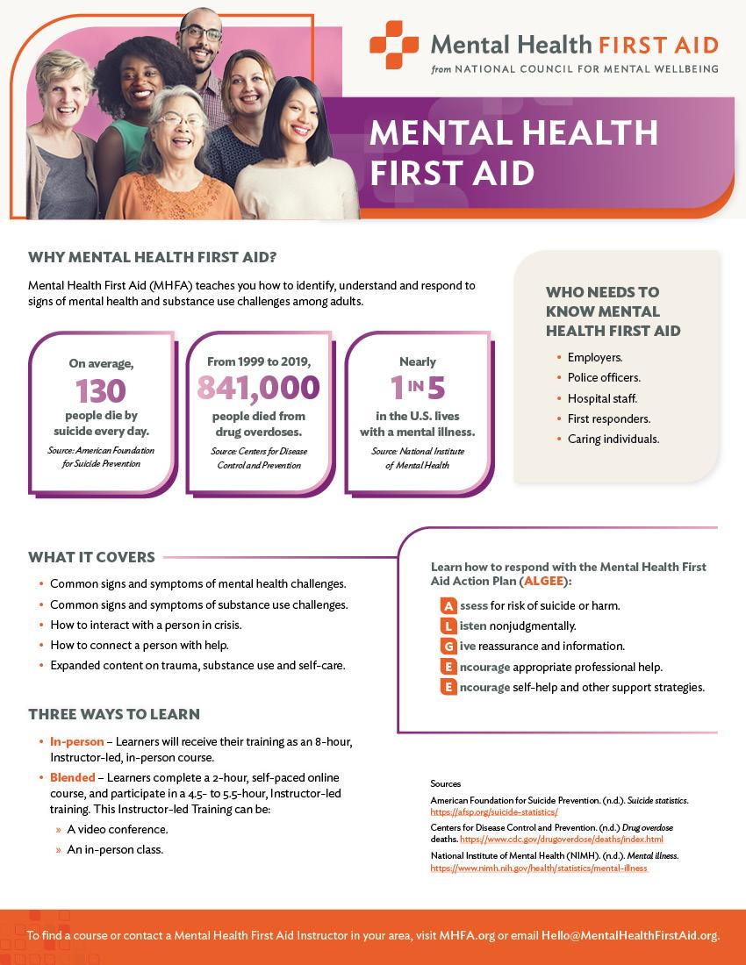
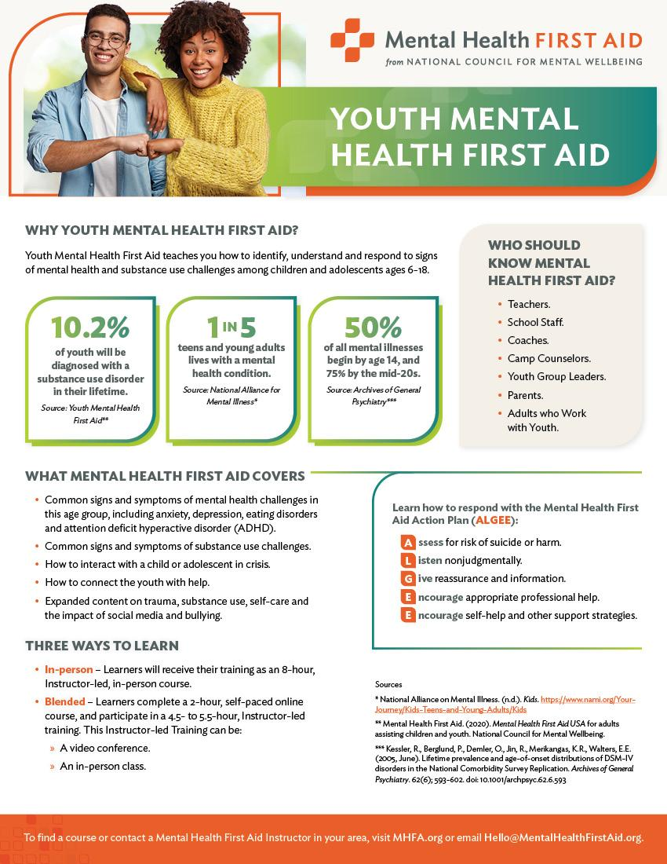
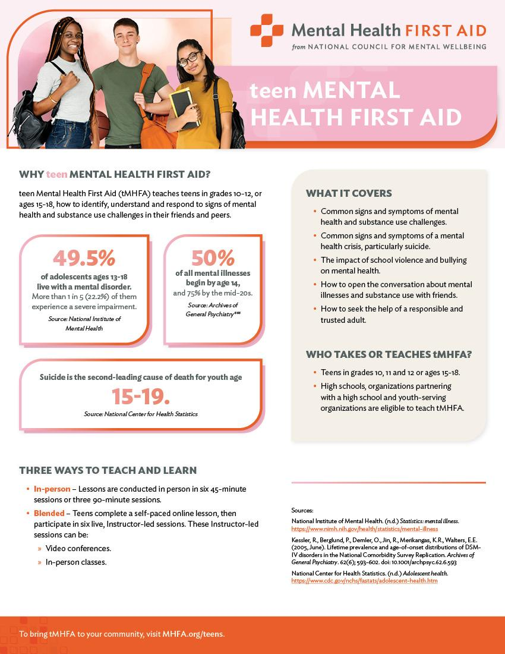
Mental Health First Aid (MHFA) Overview
Youth Mental Health First Aid for adults assisting youth
teen MHFA​ for high school students helping their peers
Adult MHFA
Notes:
Quick on this slide- primarily focus on Adult MHFA.
Ask if they are familiar with adult and/or youth MHFA. If not.....
First, let me tell you a little bit about Mental Health First Aid. We currently have three different programs: Adult, Youth, and teen.
Each program teaches participants how to identify, understand, & respond to mental health challenges faced by certain populations.
For example, Adult MHFA is a programs that teaches adults about adult mental health challenges;
youth MHFA (or MHFA for Adults Assisting Youth), teaches adults about mental health challenges faced by youth ages 12-18;
& teen MHFA teaches teens about mental health challenges faced by their friends or peers.
Once participants complete any of these courses, we refer to them as Mental Health First-Aiders.

Slide 7
What Participants Learn
Risk factors and warning signs of mental health and substance use challenges.
Information on depression, anxiety, trauma, psychosis and substance use.
A 5-step Action Plan to help someone who is developing a mental health challenge or is experiencing a crisis.
Available evidence-based professional, peer and self-help resources.
Notes:
The course teaches:
Risk factors and warning signs of mental health concerns.
Information on disorders such as depression, anxiety, trauma, psychosis and substance use.
A 5-step Action Plan to help someone developing a mental health challenge or crisis.
Available evidence-based professional, peer and self-help resources.
Information presented in an interactive environment. Participants practice the Action Plan through scenarios, discussions and other activities.

Slide 8
Mental Health First Aid Action Plan
Assess for risk of suicide or harm.
Listen nonjudgmentally.
Give reassurance and information.
Encourage appropriate professional help.
Encourage self-help and other support strategies.
Notes:
Briefly describe each action step. Talk about what the step entails and give an example.
Note that the plan is not necessarily done in order.
Mention that this mnemonic is also the name of the Mental Health First Aid mascot, ALGEE the koala.

Slide 9
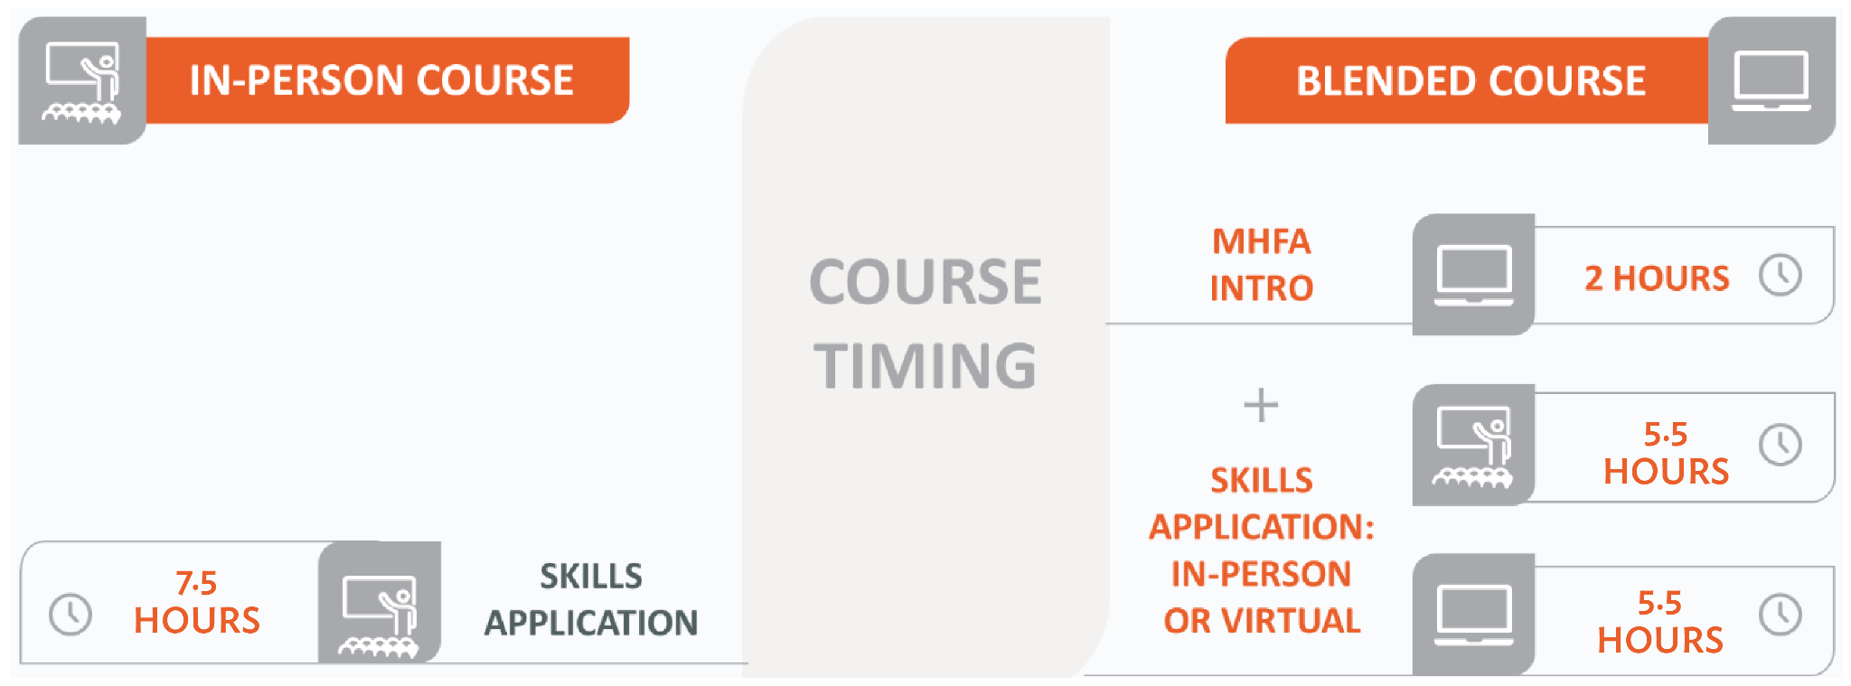
Adult MHFA Class Options

Slide 10
MHFA Outcomes
Improved Knowledge and Skills: Studies indicate that MHFA training leads to significant increases in mental health knowledge and confidence in assisting individuals with mental health challenges.⁴
Behavioral Impact: Research shows that 56% to 97% of individuals trained in MHFA have applied the program's action plan steps within six months post-training.⁵
By equipping staff with these skills, local health authorities can provide a more comprehensive and effective response to mental health issues with colleagues and in the community.

Slide 11
Workplace Wellbeing Funding
Partnership with Missouri’s DHSS and Department of Mental Health.
Goal to train 500 LPHA staff by 2027.

Slide 12
Get Involved
Attend Mental Health First Aid in July
Send additional staff to virtual or regional trainings
Become an Instructor
3 day virtual training
Plan to train at least 3 courses per year for staff or community
Notes:
3 phase
Become a Mental Health First Aider in July at the Conference formerly known as the NAO (New Administrator Orientation)- Tiffany is going to share a little in a moment to sweeten the deal to get you there.
We’ll join one of your Tuesday meetings in Mid May to remind you about the training, then give you access to your 2 hours of prework. We’ll complete the 5.5 hours of ILT as part of the NAO.
After July- if you found it valuable, we’ll share opportunities to get some of your staff trained in virtual trainings or if we can get 20 people together in a region we can do in person courses
We plan to offer scholarships for people to attend the train the trainer course. This might not be you- but we hope if you found value you might identify other members of your staff who could provide this course within your organization or your surrounding community.

Slide 13
Questions
MHFAMissouri.org
info@mhfamissouri.org

Slide 14
References
National Alliance on Mental Illness (NAMI). (2023). Missouri state fact sheet. Retrieved from https://www.nami.org/wp-content/uploads/2023/07/MissouriStateFactSheet.pdf
Office of the U.S. Surgeon General. (n.d.). Mental health in the workplace. U.S. Department of Health and Human Services. Retrieved from https://www.hhs.gov/surgeongeneral/reports-and-publications/workplace-well-being/index.html#framework
Gallup https://www.gallup.com/workplace/404174/economic-cost-poor-employee-mental-health.aspx
Carpini, J. A., Chandra, J., Lin, J., Teo, R., Truong, N., Boyne, E., Wylde, T., Clifford, R., & Ashoorian, D. (2021). Mental health first aid by Australian tertiary staff: Application rates, modes, content, and outcomes. Early Intervention in Psychiatry, 15(5), 1234-1242. https://doi.org/10.1111/eip.13072
Carpini, J. A., Chandra, J., Lin, J., Teo, R., Truong, N., Boyne, E., Wylde, T., Clifford, R., & Ashoorian, D. (2021). Mental health first aid by Australian tertiary staff: Application rates, modes, content, and outcomes. Early Intervention in Psychiatry, 15(5), 1234-1242. https://doi.org/10.1111/eip.13072

Slide 15
Additional Resources
PubMed Central. (n.d.). Mental Health First Aid outcomes: Knowledge, skills, and behavioral impact. Retrieved from https://pmc.ncbi.nlm.nih.gov/articles/PMC8814050/
Mental Health First Aid. (n.d.). Mental Health First Aid: A skills-based training course. National Council for Mental Wellbeing. Retrieved from https://www.mentalhealthfirstaid.org/take-a-course/what-you-learn/
Substance Abuse and Mental Health Services Administration. (2023). 2021 National Survey on Drug Use and Health: Final report. Retrieved from https://www.samhsa.gov/data/sites/default/files/reports/rpt39443/2021NSDUHFFRRev010323.pdf
Missouri Department of Mental Health. (2021). Status report on Missouri’s mental health system 2020: Section A. Retrieved from https://dmh.mo.gov/sites/dmh/files/media/pdf/2021/05/sr2020-section-a.pdf
KFF. (n.d.). Mental health and substance use: Missouri state fact sheet. Retrieved from https://www.kff.org/statedata/mental-health-and-substance-use-state-fact-sheets/missouri
Missouri Department of Mental Health. (n.d.). Public Health Infrastructure Grant (PHIG) Overview. Retrieved from https://dmh.mo.gov/media/pdf/phig-overview
PubMed Central. (2023). Research on mental health interventions and outcomes. Retrieved from https://pmc.ncbi.nlm.nih.gov/articles/PMC9859566
Mental Health First Aid. (2025, February). The research-backed value of Mental Health First Aid training. Retrieved from https://www.mentalhealthfirstaid.org/2025/02/the-research-backed-value-of-mental-health-first-aid-training

