Slide 1

Title Slide
Health.Mo.Gov

Slide 2
CLPHS Contract Invoicing
With the end of the fiscal year quickly approaching, we want to remind everyone about upcoming invoice deadlines for CORE, PHIG, and ACCR.
Please ensure that ALL INVOICES for the current fiscal year are submitted ON OR BEFORE JUNE 3, 2026.
We will NOT be able to process or pay any invoices received after this date, which may lead to a risk of non-payment.
Timely submission is crucial so please adhere to the JUNE 3rd deadline.
Notes:
Specify that CORE & Incentive WILL NOT be paid if not submitted in time.
ACCR & PHIG – CAN be paid after fiscal close.
CORE – CANNOT be paid after fiscal close.
LPHA’s should assume anything submitted after COB will NOT be paid.

Slide 3

CORE Contract Invoicing
6+++++
Utilizing Smartsheet for Invoice Submission
        Cody McReynolds & Mary Blevins
        Center for Local Public Health Services

Slide 4

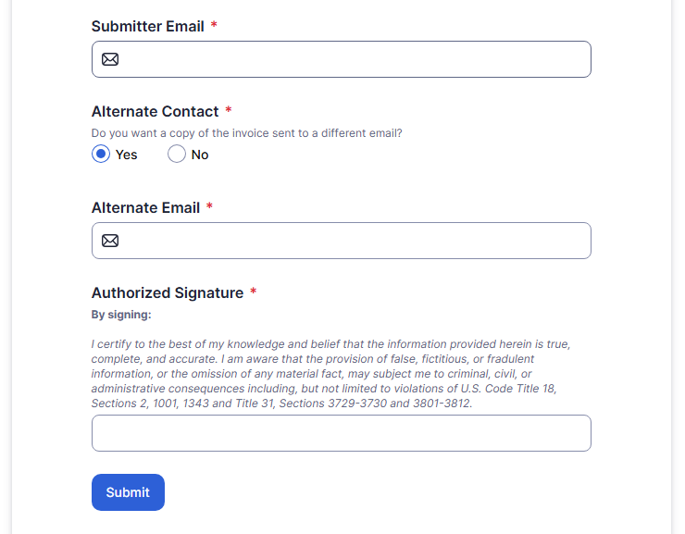
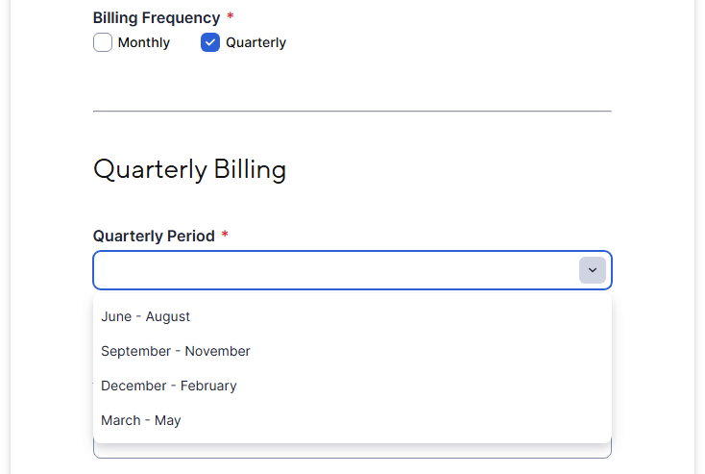
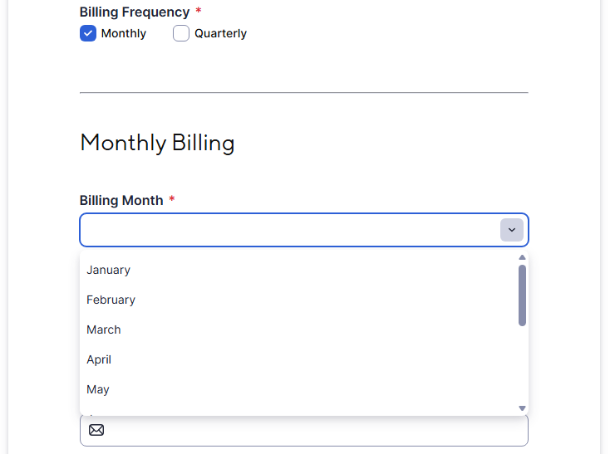
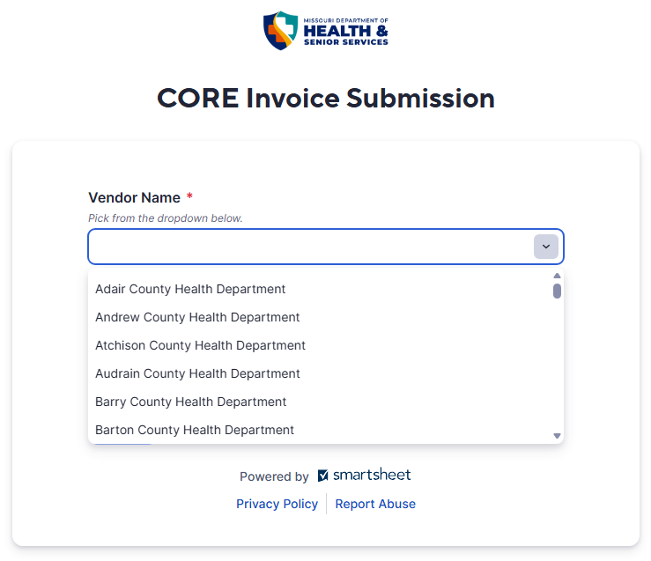
CORE Invoice Submission
Vendor Name is selected via a dropdown menu.
For Monthly billing, the invoice month is selected via a dropdown menu.
For Quarterly billing, the quarterly period is selected via a dropdown menu.
To receive a copy of the generated invoice, an email address must be entered.
Submitter Email: Sent here by default.
Alternate Contact: If the invoice needs to go to a separate billing staff member.
Submission Form
Notes:
Basic overview of information collected; live demo should be more in-depth.

Slide 5
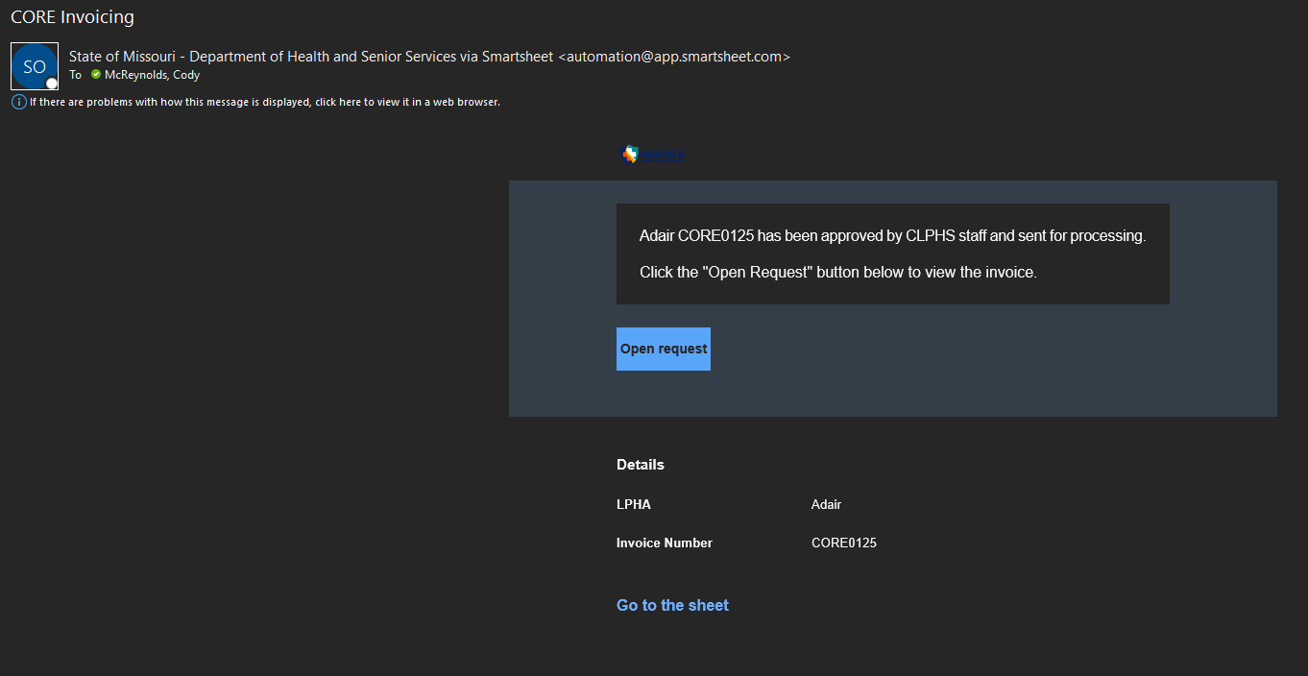
Submission Email
To access the submitted CORE invoice, select the “Open request” button in the submission email.

Slide 6
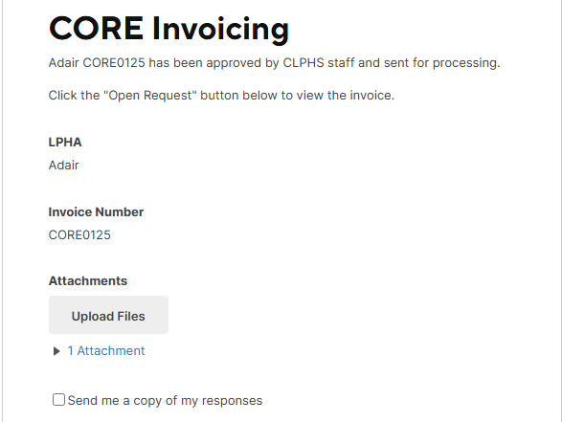
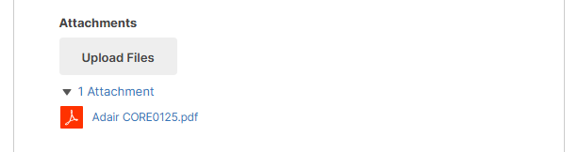
CORE Invoice Submission
Click the “1 Attachment” option to view the dropdown.
Select the invoice to download the PDF of the invoice for your records.
Retrieving the Invoice
Notes:
Reiterate that LPHA does NOT need to do anything outside of clicking the PDF link; the PDF will automatically open for review/saving.

Slide 7




QUESTIONS?
Cody.Mcreynolds@health.mo.gov
Mary.Blevins@health.mo.gov
Training Material will be made available
at a later time on the LPHA Hub.
A second demo will be shown during the
May 5th LPHA Tuesday Call.
573-526-6782
573-751-2889
Health.Mo.Gov
Notes:
Smartsheet Questions: Use CM contact info.
CORE Contract Questions: Use MB contact info.

