Slide 1

6+++++
Childhood Lead Poisoning
Prevention Program

Slide 2
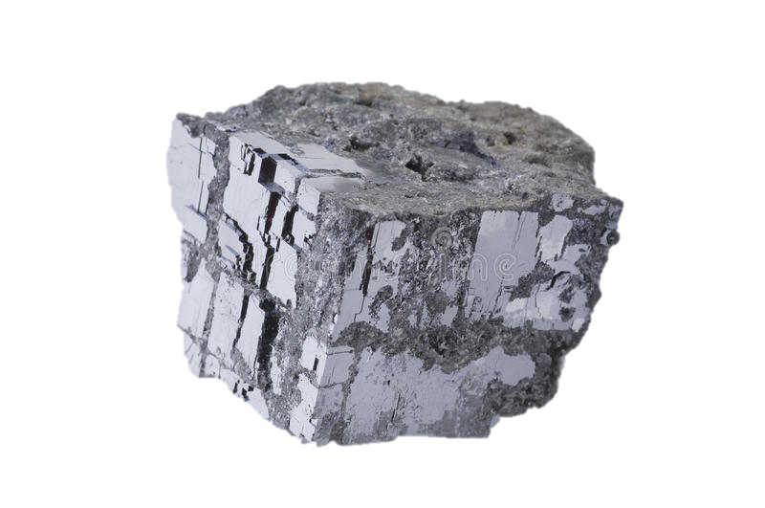
Lead in Missouri
Missouri is the nation’s top producer of primary lead ore
Highest rate of adults poisoned in the nation
Children’s average elevations are higher than the national average
About 65% of Missouri houses were built before 1978
https://www.dreamstime.com/photos-images/galenite.html
Notes:
For most of the late 19th and early 20th centuries, Missouri was the global leader in lead production, and even today some of the largest and most important remaining lead deposits in the world are located in southeast Missouri.
Lead production has played an important role in the economic growth and development of Missouri.
Estimates of the aggregate lead production in Missouri since mining began in the early 18th century, top 17 million tons, at a value of nearly $5 billion.

Slide 3

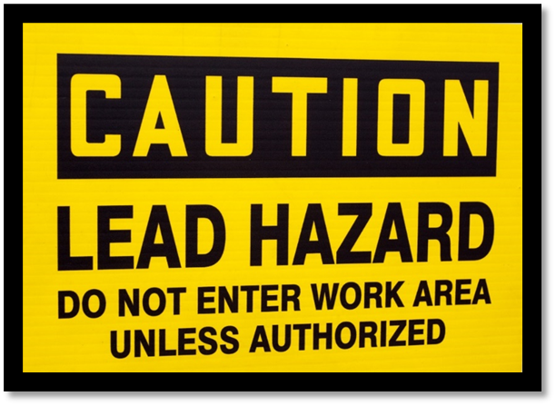
High Risk Populations
Children under the age of 6 who:
  Live in pre-1978 housing
  Live low-income households
  Are immigrants or refugees
Pregnant and breastfeeding women
Adults working in industries or have hobbies that expose them to lead
  Battery manufacturing
  Lead mining, smelting and refining
  Renovation of older homes
Notes:
Although CLPPP manages lead testing results for children 72 months and under, many adults are tested each year primarily related to their occupation.

Slide 4

Testing rates in Missouri
Percentage of children (under 72 months) tested
Notes:
As you can see, testing rates have consistently increased in the last five (5) years; however, both Nebraska and Iowa are still ahead of Missouri. Our goal is to continually work to increase testing rates with your help, of course.

Slide 5

Basic Lead Care Management Principles
Eliminate the source of lead exposure
Pediatric care
Family education
Correct nutritional deficiencies
Chelation (if appropriate)
Notes:
Complete/Update the Lead Risk Questionnaire and provide lead education with parents/guardians at least ANNUALLY for children under 72 months.
Recommend testing to all children under 48 months annually.
Test ALL children receiving Medicaid benefits, at a minimum, at ages 12 and 24 months, regardless of the response to the Lead Risk Questionnaire.

Slide 6

Expectations
As of 3/31/2025, ALL lead case management shall begin at a level of 3.5 mcg/dL and above (19 CSR 20.8.030).
Identification of lead cases in your jurisdiction
Follow up with lead cases in your jurisdiction
Testing reminders or follow-up reminders
Education on risks for lead poisoning, lead hazards, nutrition, cleaning measures, importance of follow-up with pediatrician, etc.
Connect to needed resources (risk assessments, WIC, EBT, testing)
Documentation of case management efforts within ShowMe WorldCare (SMWC)
Notes:
The County Health Department nurse manages lead cases that are fee-for-service and non-Medicaid (non-Managed Care Plan gaps).
Feel free to reach out to me with any questions.

Slide 7

Family Education
Slide title
Provide education on the following:
Sources of lead
Medical follow up
Nutritional needs for children exposed to lead
Developmental milestones
Prevention strategies (wet cleaning, HEPA vacuum, removal of hazards)
Lead Risk Assessment Process
Notes:
I’ve provided you some handouts today that I hope you’ll find helpful.
Cleaning recommendations are typically given by the risk assessor. We ask that you reiterate those teachings. Basic cleaning guidelines can be provided by the nurse as well.

Slide 8
Lead Risk Assessment
Finding lead from the child’s environment by a licensed lead risk assessor
  Done with homeowner/landlord’s permission OR adult occupant’s permission
A lead risk assessment is required at a venous of 10 mcg/dL and above, by regulation.
  3.5-9.9 mcg/dL: DHSS will offer a risk assessment by a letter. The family will need to call the risk assessor to set one up.
  10 mcg/dL and above: DHSS will call the family to set up a risk assessment.
A risk assessment record is called an “outbreak” in SMWC.
  Outbreaks (OBs) are opened MANUALLY by DHSS risk assessors when a child has an elevated venous lead level.
  Once that outbreak is opened, that means the risk assessor has sent a letter to the address on file for that case, offering a home assessment.
Notes:
Risk assessment letters/phone calls do not replace case management.
If you have a child with a level below 10 and the family is requesting a risk assessment, more than likely the RA has already reached out and waiting on family to contact. Provide with RA contact information and if family reaches out, can schedule.
If you have a family requesting to setup a risk assessment, I’d have them call either the risk assessor’s number on the RA map (next slide / website) or have them call 573-751-6102 and tell them you’d like to set a risk assessment up. We have a lot of case managers contacting us letting us know a family would be interested, and then the family either declines or doesn’t answer.

Slide 9
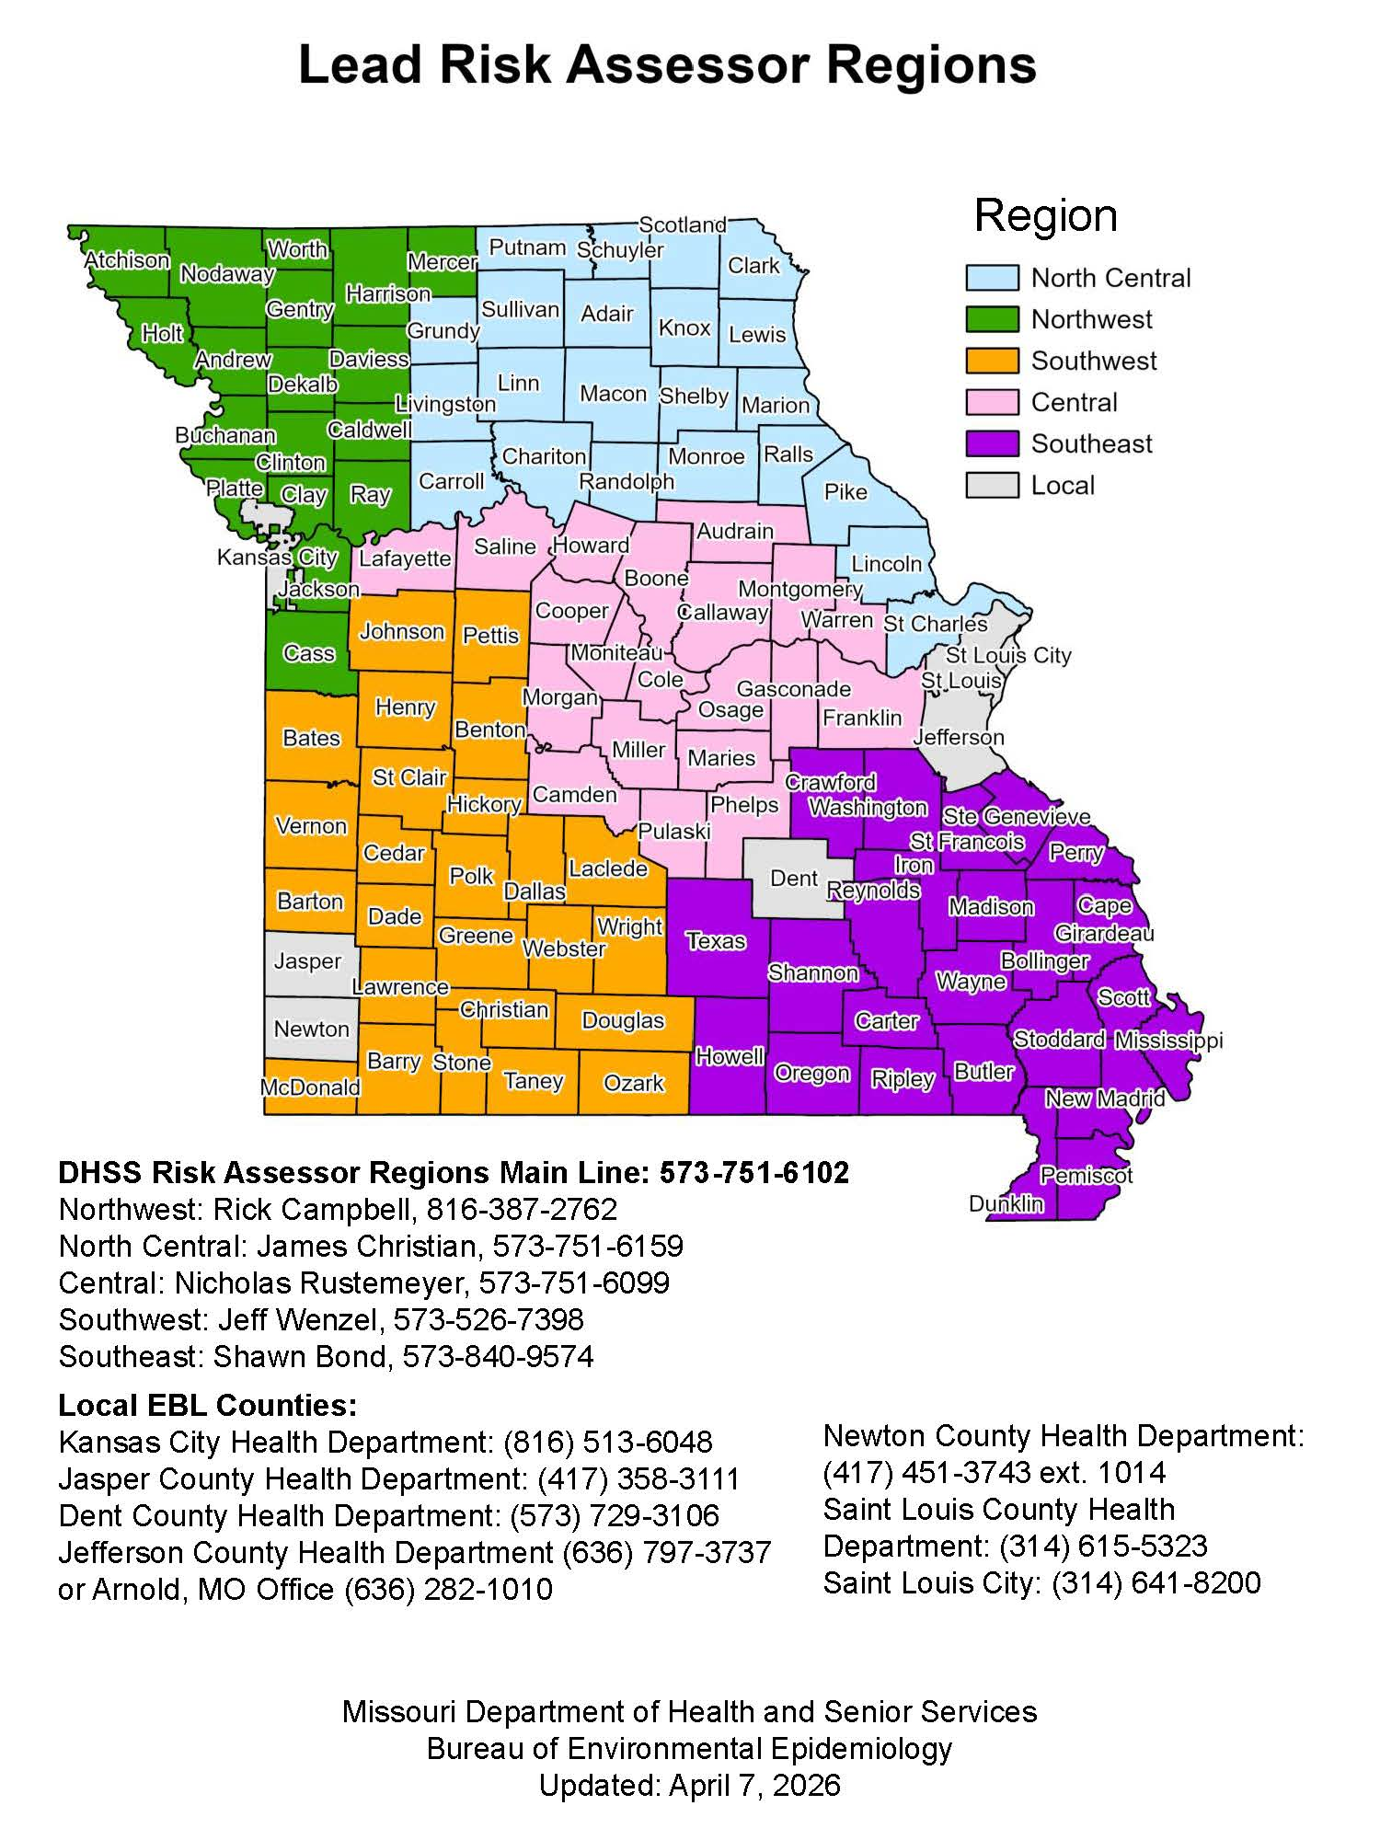
Lead Risk Assessor Map
Northwest: Rick Campbell rick.campbell@health.mo.gov
North Central: James Christian
James.Christian@health.mo.gov
Central: Nicholas Rustemeyer
Nicholas.Rustemeyer@health.mo.gov
Southwest: Jeff Wenzel
Jeff.Wenzel@health.mo.gov
Southeast: Shawn Bond
Shawn.bond@health.mo.gov
Notes:
Our Lead Risk Assessors are always happy to have the County Health Department nurses managing lead join them for a “ride along” experience. We value your partnership as we work with families. The risk assessors are very good about reaching out.

Slide 10


OPTIMAL HEALTH AND SAFETY FOR ALL MISSOURIANS
Case Management Contacts:
Shelly Wehmeyer, BSN, RN
573-526-9079
Shelly.Wehmeyer@health.mo.gov
Teresa Wortmann, MSN, RN
CLPPP Supervisor
573-751-4718
Teresa.Wortmann@health.mo.gov
Health.Mo.Gov
Notes:
What questions do you have?
I also have a packet of posters for you.
FUNDING: Child Health Insurance Program (CHIP) & Health Services Initiative (HSI) – A percentage of funding from MC for lead testing, education, and outreach.

