Slide 1

6+++++
Wastewater Surveillance Program
Funded by CDC/HHS.
This project is supported by the Centers for Disease Control and Prevention (CDC) of the U.S. Department of Health and Human Services (HHS) as part of two financial assistance awards totaling $3,662,000.00 with
100 percent funded by CDC/HHS. The contents are those of the author(s) and do not necessarily represent the official views of, not an endorsement, by CDC/HHS or the U.S. Government.

Slide 2
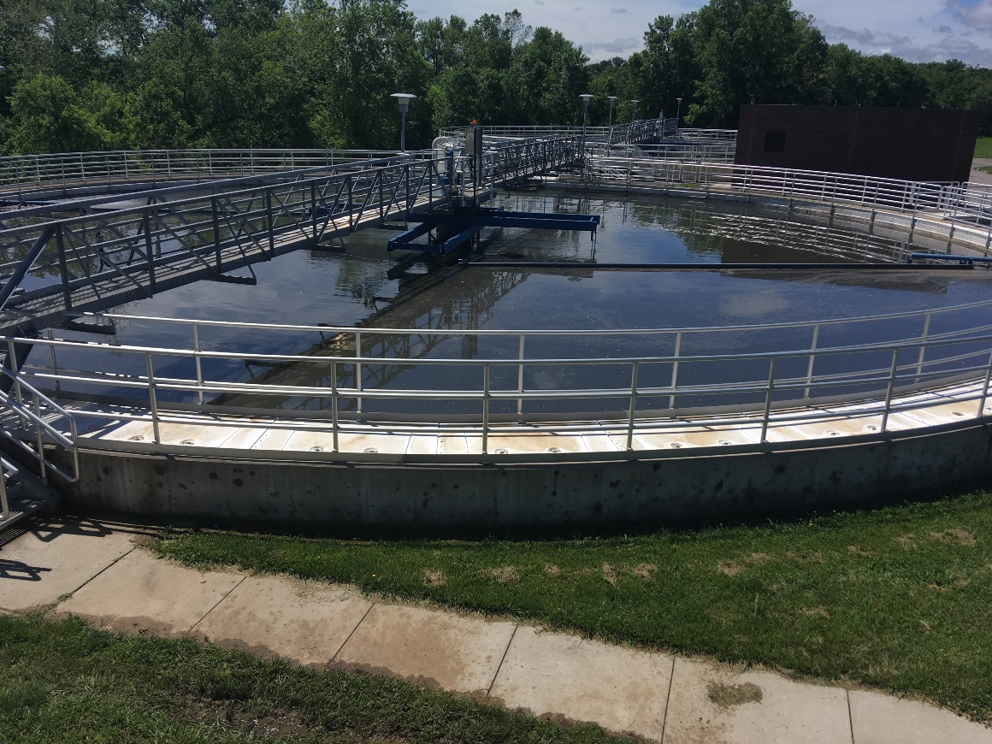


The Partnership
  Wastewater Operators and Local Public Health Departments collect samples. It is a voluntary program with a sample reimbursement of $100 per sample submitted.
  University of Missouri–Columbia conducts sample analysis.
  DHSS administers project funding and conducts data analysis to inform public health strategy.

Slide 5
Future of Wastewater Surveillance
Missouri Wastewater Surveillance Program
Current targets for Missouri wastewater
  SARS-CoV-2 (COVID-19)
  Influenza
  RSV
  (as needed) mpox, C. auris, and measles
Possible additional targets for Missouri
  Emerging infectious diseases of concern
2026 FIFA WORLD CUP-Kansas City,

