Slide 1

Title Slide
Health.Mo.Gov

Slide 2

CLPHS – Fiscal Processes
6+++++
Invoicing, Budget Adjustments, New Items & Activities, and Contract Amendments
        Nicole Cooper
        Principal Investigator

Slide 3

Fiscal Processes
1
Invoicing
How to submit PHIG/ACCR invoices and the forms to use.
2
Budget Adjustments
How to submit a request for a budget adjustment.
3
Requesting New Items/Activities
How to submit a request to add new items/activities to the contract budget.
4
Contract Amendments
What requires an amendment and the standard length of the amendment process.

Slide 4

Section 01
Invoicing

Slide 5
PHIG & ACCR Invoicing
There are 3 different invoice templates that can be utilized for contract invoicing.
  DA-38
  Invoicing Template – % of Hours Worked
  Invoicing Template – Hours Worked
Any of the 3 templates are acceptable for PHIG and ACCR invoicing, paired with an invoicing tool.
Full invoice itemization of the billed expenditures is required regardless of the template used.
All Local Public Health Agency Infrastructure Grant (PHIG) and Accreditation Assistance (ACCR) invoices should be sent to: CLPHSCONTRACTS@health.mo.gov

Slide 6
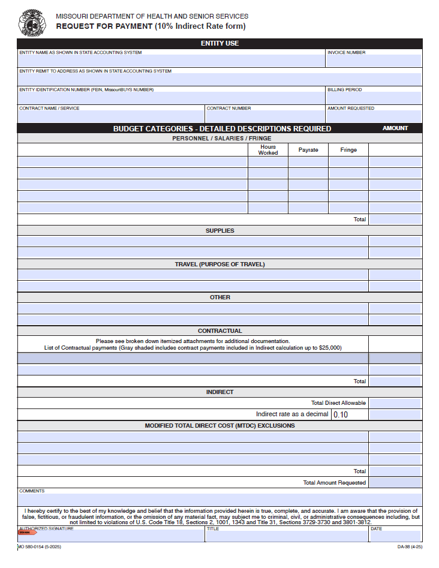
DA-38
DHSS Invoicing Template
Utilizes direct hours worked on the contract.
Rows cannot be added as needed.
All “Additional Expense” categories are combined into a single section.
  Capital Expenditures
  Equipment
  Rental/Lease
  Participant Support Costs
  Incentive/Tuition Reimbursement
Each category (except Indirect) auto-calculates the total amount.
The invoice auto-calculates the total invoice amount.

Slide 7
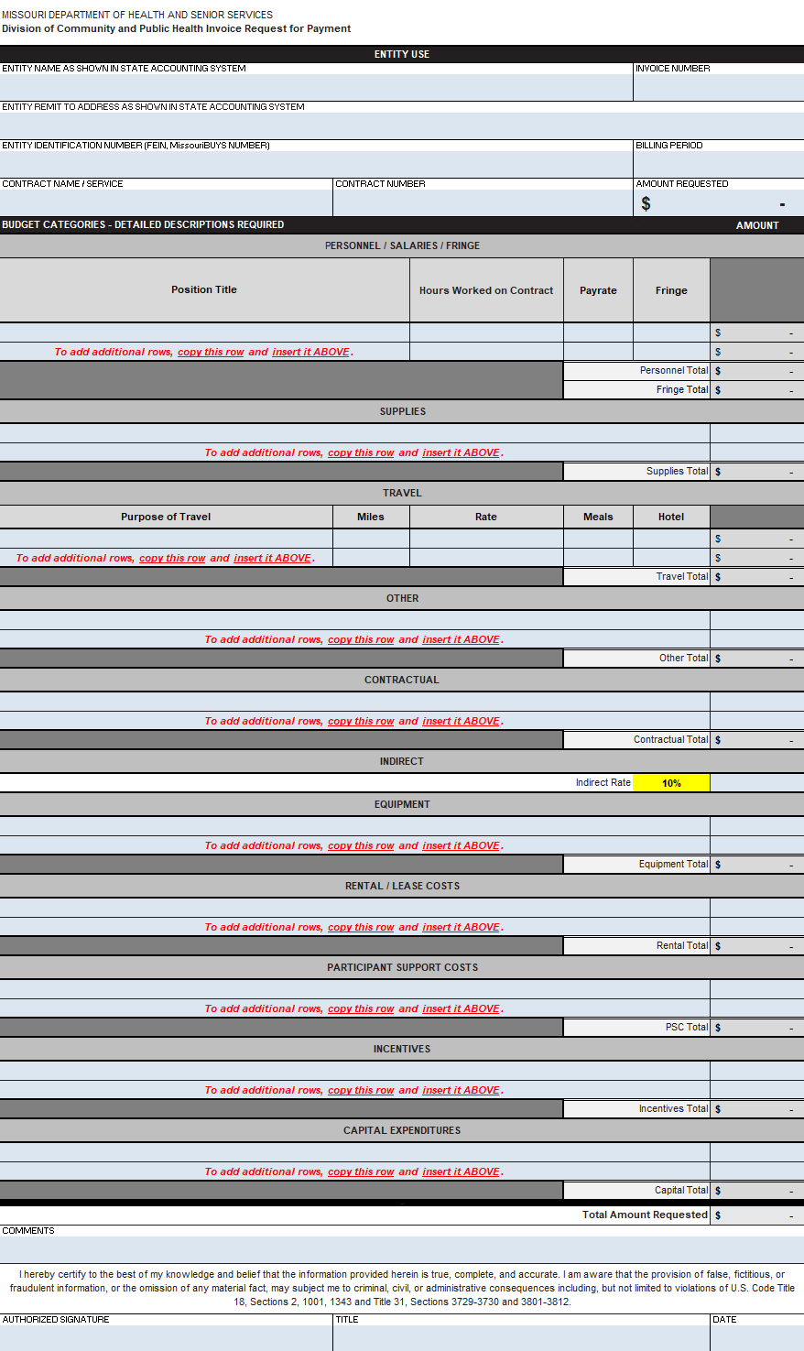
Invoicing Template
CLPHS Invoicing Template for Hours Worked
Utilizes direct hours worked on the contract.
Rows can be added as needed.
Each category (except Indirect) auto-calculates the total amount.
The invoice auto-calculates the total invoice amount.

Slide 8
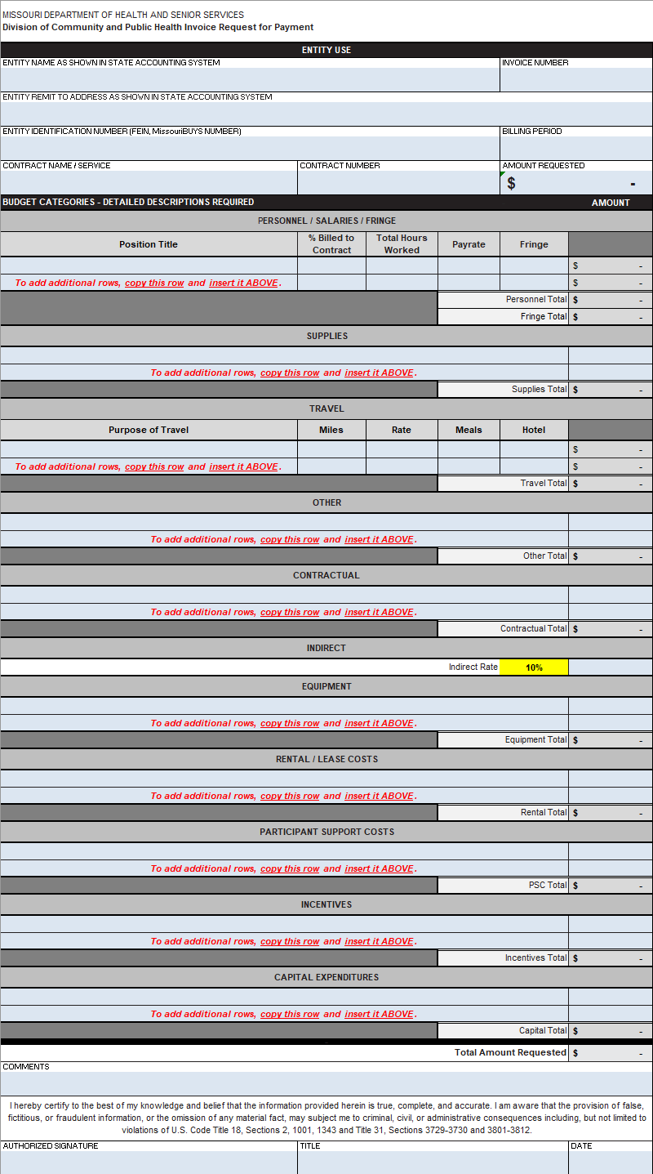
Invoicing Template
CLPHS Invoicing Template for % Hours Worked
Utilizes a percentage of total hours
worked across all contracts.
Rows can be added as needed.
Each category (except Indirect) auto-calculates the total amount.
The invoice auto-calculates the total invoice amount.

Slide 9
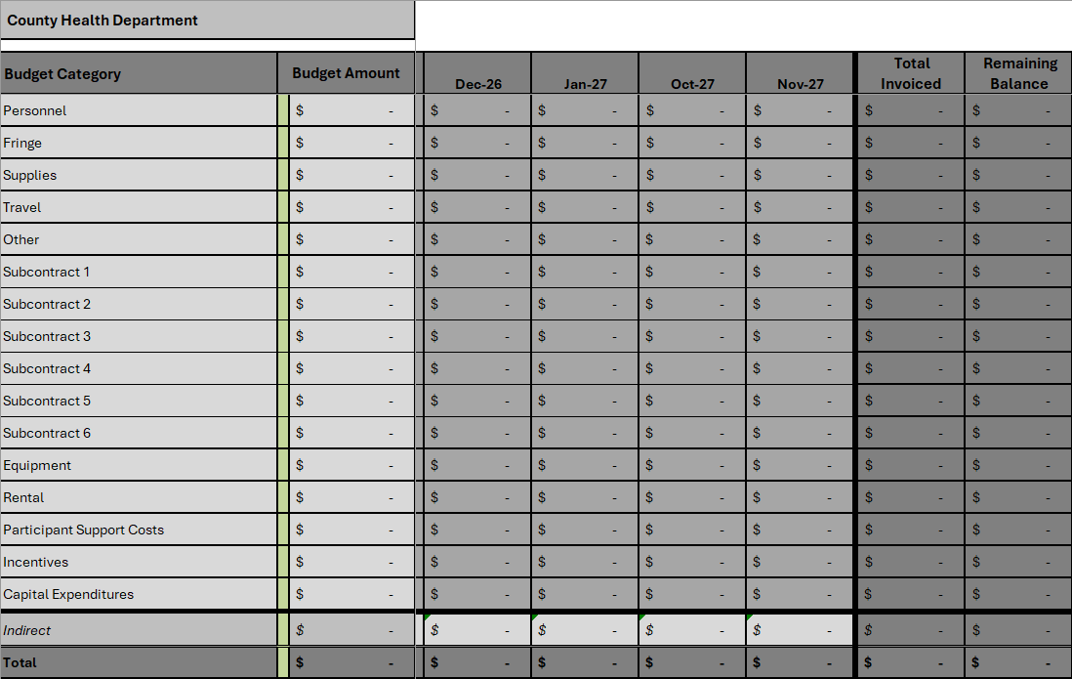
Invoicing Tool
This must be filled out and submitted with each invoice.
The tool utilizes the current budget totals and current expenditures to calculate a running balance of remaining contract funds.
Budget Total – Monthly Expenditures = Remaining Balance
Budget Total
Monthly Expenditures
Remaining Balance

Slide 10
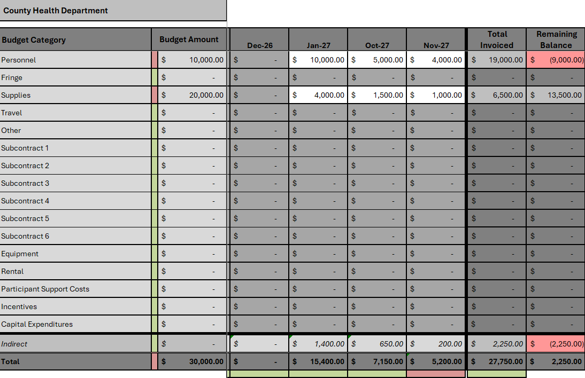
Invoicing Tool
A red cell in the “Remaining Balance” column indicates a redlined (negative) balance.
  This must be corrected before an invoice can be processed.
A red cell at the bottom of a monthly column indicates that the Indirect formula has been removed.
  This happens when an amount is manually entered.
  Verify the amount is correct before submitting.

Slide 11
PHIG & ACCR Invoicing
Invoices are due by the last day of the following month.
  A November invoice is due by December 31st.
Expenditures should be billed in the month they were incurred.
  An item purchased in May cannot be billed for in October.
Items billed on an invoice must correlate to the current contract budget narratives.
  If an item is not listed on the budget, the invoice will be denied and sent back.

Slide 12
Section 02
Budget Adjustments

Slide 13
Budget Adjustments
Process from Request to Execution
Step 01: Request
Step 02: Review
Step 03: Approval
Step 04: Execution
Budget Adjustments must be requested by submitting an email to the CLPHS Contracts inbox detailing:
  Funding Move(s)
  Adjusted Category
  Updated Narrative
Adjustments must be routed through CLPHS so we can keep track of the cumulative % moved.
CLPHS reviews the requested adjustment(s) and adjusts the budget to match the request.
If there are any follow-up questions, we will reach out.
After the adjustment is finished, it is sent for county approval.
Once the county has approved the changes made to the budget, the adjustment is finalized.
A new invoicing tool is created to reflect the changes made and is sent along with the finished budget.
Notes:
Discuss contractual language regarding budget adjustments.

Slide 14
Section 03
New Items & Activities

Slide 15
New Items & Activities
Process for Adding New Items/Activities to the Budget
Step 01: Request
Step 02: Approval
Step 03: Budget
New item/activity Request Forms can be filled out and submitted by email to the CLPHS Contracts inbox.
  Each question on the form should be filled out with detailed information.
CLPHS reviews any submitted Request Forms and will determine if the requested item(s) fall within the scope of the grant.
  Regardless of approval status, an email with the final decision will be sent to the county.
If approved, CLPHS reviews the requested adjustment(s) and adjusts the budget to match the request.
After the adjustment is finished, it is sent for county approval.
Once the county has approved the changes, the adjustment is finalized.

Slide 16
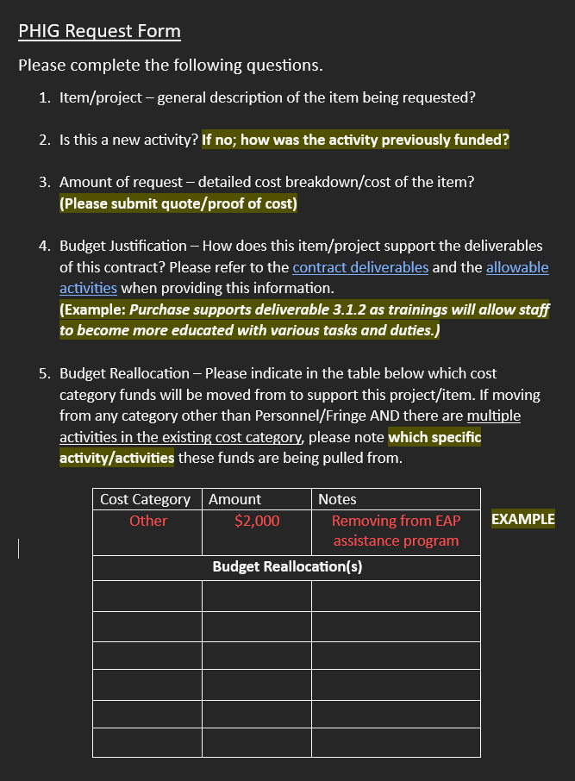
Request Form
Each question on the Request Form should be sufficiently answered.
Question 2
  If “no,” provide how the item was funded for the past 3 years.
Question 3
  Submit a quote document, receipt, invoice, etc. correlating to the requested amount.
Question 4
  Provide the specific contract deliverable(s) the item supports AND how it supports them.

Slide 17
Section 04
Contract Amendments

Slide 18
Contract Amendments
What Requires an Amendment?
Cumulative 10% Budget Move
Increase in Indirect
When a county cumulatively moves 10% of their Total Contract Amount or higher, a contract amendment is required.
This total is reset after each amendment, beginning at 0% with the next move.
The cumulative % moved is tracked by CLPHS.
Any increase to the Indirect amount requires an amendment.
Indirect typically increases in two instances:
  Moving funds out of a Subcontractor with a budgeted amount more than the allowable Indirect amount.
    PHIG = $25,000
    ACCR = $50,000
  Moving funds from the “Additional Expenses” categories to the “Programmatic Expenses” categories.
    Capital, Equipment, Rental, Incentives, Support Costs.

Slide 19
Amendment Timeline
From Procurement to Execution
Amendment Step | Average Lead Times
From CLPHS → Procurement
From Procurement → County
From Procurement → CLPHS
From CLPHS → County
2-5 Days
60-90 Days
5-10 Days
2-5 Days
The amendment document is emailed to the county by DHSS Procurement staff.
  Please ensure emails on file are accurate and up-to-date so there aren’t any delays.
Procurement cannot execute the amendment until a signed copy of the amendment is returned by the county.

Slide 20



QUESTIONS?
Principal Investigator:
Nicole.Cooper@health.mo.gov
573-526-6960
PHIG:
Cody.McReynolds@health.mo.gov
573-526-6782
ACCR:
Samantha.Williams@health.mo.gov
573-751-6770

