Slide 1
Institute Updates &
Grant Management Training
Liz House, MPH – Program Director
LPHA All-In Meeting 07.31.25

Slide 2
Who We Are
Non-profit 501(c)(3) and member of the National Network of Public Health Institutes.
Dedicated to transforming Missouri’s public health system.
Collaborator with stakeholders and communities to create the conditions for improved health outcomes statewide.

Slide 3
MOCPHE vs. Institute
MOCPHE – membership association within Institute
Each have their own board
  MOCPHE board considered an advisory board to Institute
Non-Member Access
  Resources we create and share on website
  Accreditation tools and resources
  Contracted services
  Cohorts and Collaboratives
  Chatting about Public Health
  Come and check us out!

Slide 4
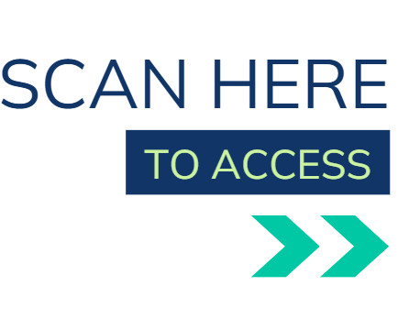
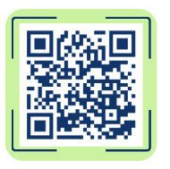
MOCPHE Membership
Offer multiple tiers of membership, with two levels based on population
More than 45 members
Benefits
  Learning and development opportunities
    Monthly Meetings
    Learning Collaboratives
    Trainings
  Advocacy and Partnership Support
  Capital Day
  Resources and Tools
  Discounted Contracted Services
  More
Meet Monthly – First Wednesday
kmcgowan@mophi.org

Slide 5
Collaboratives and Cohorts
Data Collaborative
Public Health Nursing Collaborative
Accreditation Related
  PHAB Collaborative
  MICH Collaborative
  Reaccreditation Cohort
  CHA/CHIP Cohort
  Strategic Planning Cohort

Slide 6
Governmental Public Health Summit
Date: December 9th and 10th
Location: Old Kinderhook in Camdenton, Missouri
Curated content designed by LPHAs and other leaders
Participants will learn, collaborate, and engage in strategic conversations that will shape the future of public health in Missouri
Registration details and agenda highlights will be shared in the coming weeks
kmcgowan@mophi.org

Slide 7
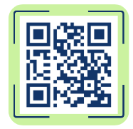
Institute Resource Library
Public Health Trust Poll
Accreditation
Measles
Advocacy
Statewide Syphilis Initiative
More

Slide 8
Grant Management Training
Informed by both DHSS and LPHAs
Two educational sessions – each with two opportunities to attend
Opportunity to apply content between sessions
First opportunity at Governmental Public Health Summit
Second training to occur virtually in March, with repeat in April
Institute to provide documentation
Registration and other information will be shared with Tiffany

Slide 9
Thank You!
Questions? Contact Liz House at lhouse@mophi.org

