Slide 1

Health.Mo.Gov

Slide 2

6+++++
Local Public Health Civics 201
Another primer on the political nuts and bolts of Missouri’s public health system
Daniel Bogle
Health Policy Director

Slide 3
101 Recap:
In Local Public Health Civics 101 we covered:
  The basic structure of Missouri’s public health system and its history.
  The legal basis for different forms of local public health governance and administration.
  Missouri laws on local public health power (and related court cases).
  The ethics of public administration, including practical applications for implementing ethics in organizations.
If you missed the 101 presentation the recording is available in the LPHA Hub.

Slide 4
Welcome to LPH Civics 201
1
2
(Practical) Political Theory
More on Local Government
Concepts of Political Theory and Public Administration.
How our local governments are legally organized.
3
Individual Moral Formation
Theories to inform a more ethical organization.

Slide 5
(Practical)
Political Theory
Political Theory and Public Administration

Slide 6
Public Health as a Converging Discipline
Medicine
Politics, Policy & Administration
Public Health
Social and Behavioral Sciences
Epidemiology
Environmental and
Biological Sciences
Communications

Slide 7
Separation of Powers
Montesquieu’s The Spirit of Law directly influences how you practice governmental public health!
Proposed the concept of separation of powers between executive, legislative, and judicial to promote liberty.
Inspired many later legal and political documents including the U.S. Constitution.
  Federalist #47 (Madison): The accumulation of all powers in the same hands is tyranny regardless of political system.
However, separation of powers can also result in inaction.
  “…the separation of powers was adopted…not to promote efficiency but to preclude the exercise of arbitrary power. The purpose was, not to avoid friction, but, by means of the inevitable friction…. to save the people from autocracy.” – Justice Brandeis, Myers v. United States (1926)
The separation of powers leads to many of the tensions present in public administration.
Approaches to Public Administration¹
Managerial Approach
Political Approach
Legal Approach
Executive
Effectiveness and efficiency
Hierarchy and specialization
Treats individuals as cases
Legislative
Representativeness and responsiveness
Accountability
Pluralistic processes and decisions
Treats individuals as populations
Judicial
Safeguards individual rights
Equal Protections
Procedural (ensures due process)
Focused on the individual
Notes:
These tensions create a dilemma for the policymaker and the public administrator. Ex:
Burdensome reporting and accountability structures require significant time.
Drawn out processes to protect individual rights can slow down work.
Incorporating input from communities, interests, and stakeholders isn’t efficient.
Hierarchies and specialization can create silos and mitigate pluralistic decision making.

Slide 8
Tension Between Approaches
These tensions create a dilemma for the policymaker and the public administrator. Ex:
Burdensome reporting and accountability structures require significant time.
Drawn out processes to protect individual rights can slow down work.
Incorporating input from communities, interests, and stakeholders isn’t always efficient.
Hierarchies and specialization can create silos and mitigate pluralistic decision making.
Yet, concepts of efficiency and effectiveness, accountability and responsiveness, and procedural due process are all important. These concepts are in tension and there are tradeoffs, and it is a public administrator’s job to balance each of them.
Some recommended approaches:
Building mutual systems of accountability.²
  On the micro level, demonstrate to employees how their work is consequential.
  Meso level, organizations are accountable to customers, while customers should be accountable for clarifying their own needs and giving feedback.
Instead of only measuring efficiency, measure value and quality so that you are reporting on a net benefit rather than scrutinizing costs.
Implement risk-based oversight strategies where greater risk programs/processes involve more bureaucratic oversight while lower risk functions are given greater discretion.

Slide 9
Pluralism and Political Responsiveness
Political pluralism is a political theory that in democracies political power is (or should be) dispersed among many different groups, interests and perspectives.
Conflict between groups is inevitable, so government systems should mitigate the effects of factionalism (Federalist #10).
The dispersal of power results in laws and policies in the national interest that are an amalgam of views and interests.
Governmental public health must be responsive to elected leaders:
In our federalist republic, elected leaders represent the will of the citizens we serve.
Elected leaders (executive and legislative) contend with many competing (pluralist) interests that they must consider, which is representative but not always effective or efficient.
  “Evidence-based policy is my jam.” – Daniel Bogle
    The public health lens is that health considerations should determine policy. The political science lens views political decisions as resulting from competing interests.
    There should be a connection between evidence and policy, but that relationship is not always direct or linear.³
  “People who quote themselves in presentations are morons.” – also Daniel Bogle
Back to separation of powers: As executive agencies, governmental public health is a part of the “inevitable friction” described by Brandeis.
Notes:
Reasons evidence -> policy isn’t always a linear relationship:
Research does not always answer the questions that political interests or political decisionmakers are concerned about.
(Public health sometimes thinks that if we could just explain the science better then policymakers would come around on our policy goals (knowledge translation), without acknowledging that the science may not be speaking to the needs or goals of decisionmakers.)
2. Research does not always examine the questions and social problems that policymakers are interested in addressing.
3. The research literature does not always agree and researchers within the same field of study often dissent, making a linear relationship between research and policy difficult (basing public health practice on one study that affirms your preconceived notions does not make it “evidence based policy”)

Slide 10
The Role of Bureaucracy
Compliance Model of Bureaucracy:
Bureaucrats as Hobbesian “public ministers” that derive authority from the sovereign.⁴
Instrument of legislative mandates with only technical capacity.
Traditional Public Administration:²
Neutral arbiters of the public interest.
Civil service reforms and the professionalization of public administration.
  Rooting out patronage and corruption.
  High levels of bureaucratic control.
Highly skilled experts who apply expertise and authority to policy and administration.
New Public Administration:
Individual and organizational values and ethics.
Community engagement and social equity.
Bureaucracy’s active role in political advocacy.
Rise of the Administrative State:¹
Delegation of legislative powers (through rules and regulations).
Executive function of a highly professional, skilled bureaucracy.
Adjudicates compliance.

Slide 11




Contemporary Challenges
There are many challenges that face the field of public health and public administration today.
Administrative State
Data Consolidation
Responsiveness
Misinformation
Does political responsiveness mean total capitulation?
Bureaucracy sometimes fills a legislative, executive, and judicial role – is that bad?
As we seek more efficiencies in government data, do we risk oversurveillance?
How to respond when misinformation is presented as science?

Slide 12
More on Local Government
How our local governments are legally organized.

Slide 13
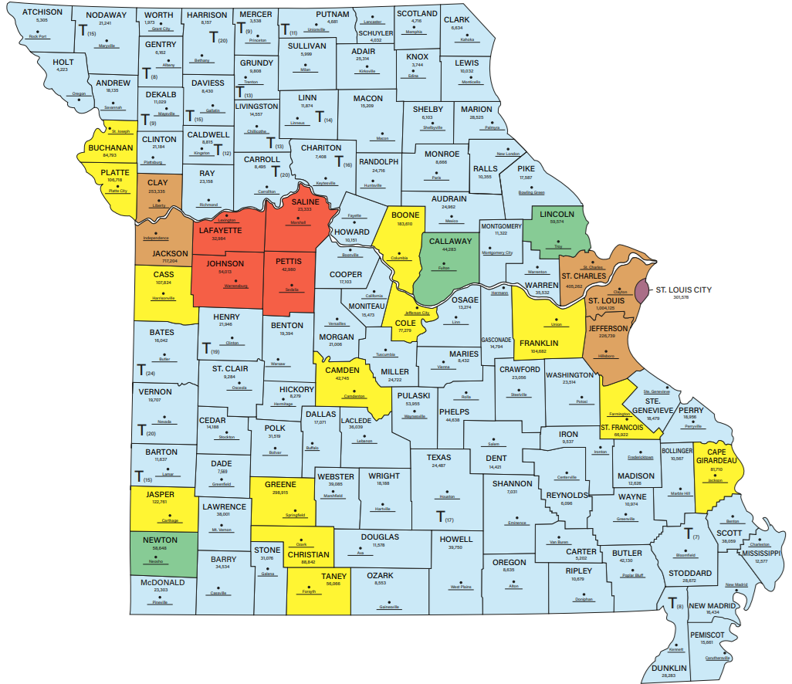
County
Classification
Charter Counties
Classification 1
Classification 2
Classification 3
Classification 4
Source: Missouri Association of Counties, mocounties.com

Slide 14
County Classifications
County Classifications:
Charter: Any county having 85,000 inhabitants or that is a first class county for at least two years can vote to adopt a charter - Art VI, Section 18(a)
Classification 1: Assessed valuation of $900 million.
Classification 2: Assessed valuation of $600 million (and less than $900 million)
Classification 3: Assessed valuation less than $600 million.
Classification 4: Counties that were Classification 2 prior to August 13, 1988, but would become Classification 3 otherwise shall continue under the laws of Classification 2 counties.
A county shall not change classification unless it maintains its new valuation level for five years (Section 48.030, RSMo).
Classification three and four counties may adopt a township form of government. The county still maintains a commission, but certain powers are granted to sub-county governments (ex. roads).
There are 20 counties with townships.
Each township must elect one trustee, one clerk, and two board members.
Some other counties designate “townships”, but they are not statutory township governments.

Slide 15
Differences in County Classes
Primarily, the differences are in the county officers:
Every county must elect a Clerk, Assessor, Prosecuting Attorney, and Sheriff.
Collector: All counties except for class 3 counties with a township system.
  Collectors in different classifications have different responsibilities.
Treasurer: All counties except class 3 counties with township system elect a collector-assessor.
Recorder: All counties, except some counties still combine recorder with circuit court clerk.
Auditor: Classifications 1 and 2 (and therefore also Classification 4)
  Class 1 charter counties must elect an auditor (budget officer and accounting officer).
  Classification 1 counties without a charter and Classification 2 counties must elect an auditor, though there are differing requirements depending on classification.
  Because Class 4 counties operate under Class 2 laws, they must elect an auditor.
Coroner: All counties must elect a coroner except those that have a medical examiner.
Medical examiner: Appointed in counties that meet the requirements of Section 58.700, RSMo.
Surveyor: Classification 2, 3, and 4
Highway Engineers: Classification 1 counties without a charter must employ a County Highway Engineer. Classification 2, 3, and 4 counties are permitted but not required.
Generally, county government vests both legislative and executive powers in the county commission. Charter counties may create different systems of government, though they must still comply with statutory requirements for officers.

Slide 16
Municipal Classifications
Municipal Classification in Missouri has five different levels of classification, each statutorily permitted to have different forms of government:⁶
Towns and Village (less than 500)
4th Class (500-2,999 population)
3rd Class (3,000-29,999 population, there are 57)
“Home Rule” Constitutional Charter (5,000+ may adopt a charter, there 36)
Special Charter (specially authorized, there are seven)
Cities are classified by population when incorporated and reclassification occurs by vote.
All city and city/county LPHAs are in Constitutional Charter cities.
Art VI, Section 19(a): Charter cities shall have all powers which the general assembly of the state of Missouri has authority to confer upon any city, provided such powers are consistent with the constitution of this state and are not limited or denied either by the charter so adopted or by statute. Such a city shall, in addition to its home rule powers, have all powers conferred by law.
Section 71.010, RSMo: If there is a general law of the state on a subject then all municipalities must restrict its ordinances to be in conformity with the state law (unless prescribed otherwise by the charter itself).
Notes:
Special charter cities: Carrollton, Chillicothe, LaGrange, Liberty, Miami, Missouri City, and Pleasant Hill.

Slide 17
Differences in City Classes
Different classifications permit different forms of government:
Towns and Villages must have a board of trustees.
4th Class must have a mayor and board of aldermen (but also may have a city administrator)
3rd Class has options between:
  Mayor/council
  Mayor/council/city administrator
  Council/manager
  Commission
Charter cities decide their governance via charter.

Slide 18
Classification and Public Health
There are many statutes enumerating what varying classifications of counties and cities are required or authorized to do within their jurisdiction. One of those is the establishment of health centers/units/departments:
As a review of LPH Civics 101, County Classification makes a difference in what kind of health department a political subdivision may establish.
All counties may establish a county health center by a vote of the people (board of health).
Non-charter first class counties are statutorily authorized to create a health department as a function of county government (commission governed departments).
Charter counties may create health departments in their charter.
Charter cities may create health departments in their charter.
Counties and cities/counties may contract for services via Chapter 70, RSMo.
Classification 3 and 4 cities may enact ordinances for securing “the general health” of the city and have the power to appoint health officers.

Slide 19
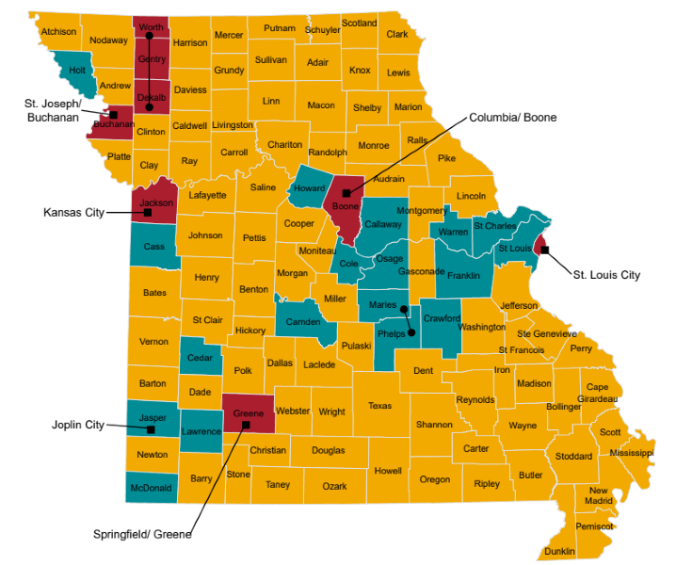
LPHAs by Governance
County Health Centers – County Board of Trustees
Independence
Health Depts / Units – Commissions or Charter
Other Forms of Governance
City or City-County Departments
Multi-County Departments

Slide 20
Dillon’s Rule
Judge John F. Dillon was an Iowa Supreme Court Justice who ruled in an 1868 case that local governments have three types of powers:
Those granted in express words,
Those necessarily or implied in or incident to the powers expressly granted, and
Those essential to the declared objects and purposes of the corporation, not simply convenient, but indispensable.
Also, if there is reasonable doubt whether a power has been conferred on a local government, then the power has not been conferred.⁸
Some iteration of Dillon’s Rule is applied in 40 states including Missouri, meaning that local governments only have powers expressly granted to them by statute.
Except that Home Rule cities and Charter counties have more powers under their charters.

Slide 21
Laws on Local Public Health Power
A bit of review!
Both county commissions and county health center boards are authorized to make and promulgate orders, ordinances, rules, or regulations to enhance public health and prevent the entrance of diseases into the county (192.300, RSMo).
  State rules and regulations supersede local rules and regulations (192.290, RSMo).
  They therefore cannot conflict with DHSS rules and regulations (192.300, RSMo).
  Cannot impose standards on agricultural operations that are inconsistent with, in addition to, different from, or more stringent than Missouri law (192.300.1(2), RSMo).
Restrictions in Section 67.265, RSMo on orders that close businesses, churches, schools, or places of gathering:
  If a declared emergency, it can only be in effect for 30 days within a 180-day period unless extended by the political subdivision’s governing body (simple majority).
  If not an emergency and the order is of “general applicability” the order can only be in effect for 21 days within a 180-day period unless extended by a 2/3 majority of the political subdivision’s governing body.
  The governing body always has the power to terminate an order with a simple majority vote.

Slide 22
Process for Local Legislation
How exactly does a county, city, or board of health make and promulgate orders, ordinances, rules, or regulations?
State law is not prescriptive!
State law does prescribe the local legislative process for villages, towns, and cities of the 3rd and 4th class – but this does not apply to any health departments.
Charter cities and counties establish their own local legislative process via charter.
Counties are given responsibilities and powers by statute but are not governed by a statutory process for enacting orders, ordinances, rules, or regulations.
Boards of Health “shall make and adopt such bylaws, rules and regulations for its own guidance and for the government of the county health center as may be deemed expedient for the economic and equitable conduct thereof.” (Section 205.042.3)
The general process for local legislative processes is for an elected member of the governing body to introduce a measure and for it to be enacted on a majority vote. However, the procedural specifics can vary widely between jurisdictions.

Slide 23
Hancock Amendment in Brief
The Hancock Amendment (Article X, Sections 16-24) includes provisions affecting both state and local taxation. For local governments:
New and increased local taxes must be approved by the voters (except if a local tax is levied below an authorized rate, it may be increased up to the authorized rate).
If the definition of the base of an existing tax is broadened, the maximum authorized levy shall be reduced to yield the same estimated revenue as on the prior base.
The state cannot reduce support for local government functions or require local governments to take on new duties without providing funds necessary for the task.
If rapid increases in property values result in rapidly increasing property tax revenues, then the property tax rate must be adjusted.
  There is a ceiling placed on a political subdivision’s property tax revenues, which is the previous year’s total property tax revenue plus inflation and holding aside new construction and improvements.
  Voters must authorize increases in the tax rate ceiling.
Notes:
*Passed in 1980

Slide 24
Processes for County Property Taxes
County Health Centers: Trustees (Board of Health) set the annual rate of the tax levy, though it cannot exceed the maximum tax rate authorized by the vote of the people (205.042.8, RSMo).
The maximum tax may not exceed 40 cents per $100 assessed valuation of property.
County Commission Run Health Departments: County commissions set property tax rates each year after a public hearing on proposed rates (137.055, RSMo). Maximum rates are limited by state statute (137.065, RSMo):
Classification 1 counties cannot exceed 35 cents on $100 assessed valuation
Other counties cannot exceed 50 centers on $100 assessed valuation
These limits do not include taxes for the payment or renewal of bonds
A county may increase the maximum rate for up to four years by a petition of the people (10% of voters voting for governor) and 2/3 voter approval.
County commissions are empowered to determine distribution of revenues by setting a county budget.
Note: Article X, Section 11(c) specifies political subdivisions may levy a rate of taxation in excess of these rates for public health “when authorized by law.”

Slide 25
Processes for City Property Taxes
Article X, Section 11(b) limits municipalities to a property tax limit of $1 on every $100 of assessed valuation. State statute makes it more complicated.
Fourth Class Cities:
May not exceed 30 cents but may levy an additional 20 cents for hospital, public health, and museum purposes.
Third Class and Special Charter Cities:
May not exceed $1 but may levy an additional 20 cents for hospital, public health, and museum purposes.
Constitutional Charter Cities:
May by ordinance levy a tax not exceeding $1 except that they may by ordinance levy an additional tax up to 40 cents on library, hospital, public health, and museum purposes.
All: May exceed property tax levy for general purposes if 5% of more of voters (voting for mayor) petition and 2/3 of voters approve. Legislative bodies may proposed extensions up to four years.
Notes:
For third class: Except that Excelsior Springs (“any city of the third classification with more than 10,800 and less than 10,900 inhabitants and located in more than one county”) may levy a tax of 30 cents for hospital, public health, and museum purposes.
For *All: Special Charter cities are limited to 30 cents in how much they may vote to increase beyond their limit.
City of St. Louis is limited to $1 as a city but is also permitted by statute (92.010, RSMo) to levy property tax as a county.
Kansas City is limited to $1 but has special provisions allowing for levies up to another $1.50 for capital improvements, public works, hospitals, public health, recreation grounds, and museums.
What about sales taxes? All new sales taxes or sales tax increases require a vote of the people. A majority vote of a political subdivision’s governing body places the question on the ballot.

Slide 26
Individual Moral Formation
Theories to inform a more ethical organization.

Slide 27
Framework for Ethics Recap
Values & ethics exist on the personal and organizational level.
  Macro (profession/sector-wide), meso (organizational), micro (individual).
  Organizational ethics are the values that guide the behavior and decision-making within an organization.
  Ethical behavior is a bidirectional interaction:
      Individual ethics inform organizational behavior, and organizational values and culture guide individual behavior.
  External cultural norms and societal values, laws and regulations, and pressure from stakeholders.
Organizational structure and leadership creates the environment for ethical behavior.
  Individual moral formation (micro) and ethical organizational structures (meso) are both needed to build an ethical organization.
  Forces shaping ethical behavior: Leader’s example, organizational policies, organizational culture, and individual characteristics.⁹

Slide 28
Individual Moral Formation Theories
Kohlberg’s Moral Development Theory asserts people develop through moral stages and rationally use moral reasoning to make ethical decisions, depending on their stage of development. ⁹
Level 1: Preconventional | Level 2: Conventional | Level 3: Postconventional
“Outside Group” | “Inside Group” | “Above Group”
Stage 1. Responds to punishment and authority/power. Stage 2. Morals are instrumental. Seeks satisfaction of own needs. | Stage 3. Helping and pleasing others is good/nice. Stage 4. Maintain social order, duty to others. | Stage 5. Observes the social contract. Democratic agreement. Stage 6. Universal imperatives of justice and human rights. Choice of conscience.

Slide 29
Application/Critiques of Kohlberg
Application:
Most people are “conventional”, see themselves as a part of the group, and want to maintain the social order.
If humans apply rational moral reasoning, the public administrator can appeal to a person’s current stage of moral development or help the individual develop.
Critiques:
People do not apply the same level of moral reasoning in all situations.
  Ex: High stress and new situations can modify a person’s moral judgements.
Feminist critique: Kohlberg’s approach is male-centered and does not consider women’s moral formation, which may place the needs of the group/community above abstract moral principles.
Social Intuitionalism: Jonathan Haidt’s research on social taboos indicates that people “see” or “feel” moral conclusions first and then apply rational moral judgements afterwards for justification.

Slide 30






Moral Foundations Theory
Five pillars that form the foundation for human morality and therefore can be the focus of individual moral formation.¹⁰ These pillars are not exhaustive – rather they serve as general building blocks that can be used to understand the components of individual moral and ethics norms, beliefs, and intuitions.
Care/
Harm
Fairness/
Cheating
Loyalty/
Betrayal
Authority/
Subversion
Sanctity/
Degradation
Liberty/
Oppression
The instinct to protect and care for our own children, now extrapolated to other individuals and groups we care about and want to keep safe from harm.
Moral concepts that develop from self-interest, mutually beneficial partnerships, and reciprocal altruism. Humans want to enforce consequences for violating trust.
Forming groups and coalitions was important to basic human survival, creating a moral impetus for loyalty.
Creation of hierarchies that produce order, respect, and obedience. Extolls virtuous leadership and obedient followers.
Natural avoidance of dangerous diseases, parasites, and other threats results in the pursuit of purity and cleanliness as well as disgust for taboo behaviors, ideas, and objects.
Added later: Opposition to bullies and dominators from a group behavior perspective – a motivator for people to assemble to defend liberties or depose oppressors.

Slide 31
Application/Critiques of MFT
Application:
By understanding the building blocks that constitute moral norms and beliefs, organizations can intentionally appeal to these concepts.
MFT identifies that different cultures, worldviews, and political ideologies express different moral “pillars” to varying degrees.
Use of MFT as a framework for understanding the strengths and weaknesses of the organization’s ethical/moral strengths and weaknesses.
Critiques:
The pillars are not comprehensive and could feasibly be consolidated into a more concise model.
MFT attempts to be culturally universal but limited studies in other cultural contexts have shown limited applicability.
May explain the foundations of moral actions but may not consider more complex moral reasoning and does not address moral development.

Slide 32
Social Learning Theory
Albert Bandura blends behavioralist and cognitive theories of learning:¹¹
Pushed back against behavioralist theories that people only learn through reinforcement of behaviors.
  Instead, people learn through both their own behaviors and observing the actions of others.
  Reinforcement does play a role in learning but is not necessary – people sometimes imitate behaviors that were never reinforced.
Components of observational learning:
  Attention, Retention, Motor Reproduction, and Motivation/Reinforcement
Moral reasoning is learned through observation, not a linear development or in stages.
Application:
For individuals to learn ethical behavior (or anything) the organization can produce a model of desired behaviors and ensure the components of observational learning.
Ethical leadership is critical towards individual moral development.
Individual moral development is not fixed at a particular point. An organization can improve ethical behavior by demonstrating ethical behavior.

Slide 33




QUESTIONS?
Daniel.Bogle@health.mo.gov
(573) 522-2843
Health.Mo.Gov

Slide 34
References
1. Rosenbloom, David H. Public Administrative Theory and the Separation of Powers. Public Administration Review 43, no. 3 (1983): 219–27. https://doi.org/10.2307/976330.
2. Barzelay, Michael, and Babak J. Armajani. Breaking Through Bureaucracy: A New Vision for Managing in Government. Berkeley And Los Angeles, CA: University of California Press, 1992.
3. Fafard P. Beyond the usual suspects: using political science to enhance public health policy making. J Epidemiol Community Health. 2015;69(11):1129–1132. doi: 10.1136/jech-2014-204608.
4. Zacka, Bernardo. "Political Theory Rediscovers Public Administration." Annual Reviews 25:21-42 (May 2022). https://doi.org/https://doi.org/10.1146/annurev-polisci-051120-125131.
5. "Counties by Classification." Missouri Association of Counties. Last modified , 2021. https://www.mocounties.com/missouri-county-classifications.
6. “Classification of Municipalities.” Missouri Secretary of State. https://www.sos.mo.gov/cmsimages/bluebook/2003-2004/832-856.pdf
7. "Local Public Health Agencies by Governance.“, Missouri Department of Health and Senior Services, www.health.mo.gov/living/lpha/pdf/ColorMapLPHA.pdf
8. "Dillon's Rule." Cornell Law School Legal Information Institute. https://www.law.cornell.edu/wex/dillon%27s_rule

Slide 35
References, Cont.
9. Bowman, James S., and Jonathan P. West. Public Service Ethics. CQ Press, 2015.
10. Haidt, Jonathan. The Righteous Mind: Why Good People are Divided by Politics and Religion. New York City: Pantheon Books, 2012.
11. Kretchmar, Jennifer. "Social Learning Theory." EBSCO. Last modified , 2024. https://www.ebsco.com/research-starters/education/social-learning-theory.

Slide 36

PROMOTING HEALTH AND SAFETY

